Slide 1
Workplace exposure standards and biological exposure indices

Slide 2
What are the Workplace Exposure Standards? (WES)
A WES is the ‘expected amount’ of substance exposure that an average person can tolerate without adverse reaction (short or long term).
WES values are calculated on work schedules of five shifts of eight hours duration over a 40-hour work week.
Longer shifts or exposure over a day or a week require the WES-Time Weighted Average (TWA) to be adjusted to account for longer periods of exposure and shorter recovery times.
PCBUs have a legal duty to minimise worker exposure to workplace hazardous substances.
The WES provide a guide to maximum recommendations around levels of exposure in a workplace. PCBUs must monitor the workplace exposure levels if the exposure to a substance cannot be eliminated.
Notes:
Exposure monitoring can be used to find out if workers are potentially being exposed to a hazard at harmful levels or if the measures in place to control exposure to that hazard are working. Exposure monitoring is done by having workers wear personal monitoring equipment as they do their job. It can also be done periodically or without having workers wear monitoring equipment under some circumstances (eg to test the effectiveness of controls).

Slide 3
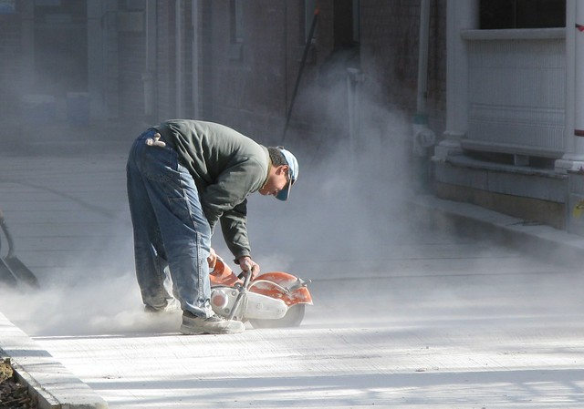
Why have workplace exposure standards changed?
WorkSafe have reviewed ongoing research that indicates that levels of exposure previously considered safe need to be reviewed downwards.
All proposed changes are designed to produce a better health outcome workers.
These changes are part of the WorkSafe strategic plan to reduce workplace related illness.
This Photo by Unknown Author is licensed under CC BY
Notes:
https://worksafe.govt.nz/topic-and-industry/work-related-health/work-related-health-strategic-plan/

Slide 4
Why we need to Monitor
Section 36 of Health and Safety At Work Act 2015 requires PCBUs to ensure worker health and safety ‘so far as is reasonably practicable’.
Regulation 30 of Health and Safety at Work (General Risk and Workplace Management) Regulations 2016 requires a person in charge of a businesses or undertaking (PCBU) to conduct exposure monitoring to determine the concentration of a hazardous substance.
Regulation 32 of the GRWM Regulations also requires the PCBU to make the results of exposure monitoring available to any person in the workplace.
https://besafe.nz/wes-work-place-exposure-standards/

Slide 5
Recent Changes
Substance | Previous TWA 8HR | Current TWA 8HR | % change
Zinc Oxide (respirable dust) | 10mg/m3 | 0.1mg/m3 | -99%
Copper (respirable dust) | NEW | 0.01mg/m3 | NEW
Chromium VI compounds | 0.01mg/m3 | 0.00002mg/m3 | -99.8%
Synthetic Mineral Fibres (non carcinogenic) (inhalable dust) | 5mg/m3 | 2mg/m3 | -60%
Synthetic Mineral Fibres (carcinogenic) (inhalable dust) | NEW | 0.3f/l | NEW
Respirable Crystalline Silica | 0.05 mg/m3 | 0.001mg/m3 | -98%
Benzene | 1ppm +skin notation | 0.05ppm | -95%
Cadmium and Compounds (Cr) | 0.01mg/m3 | 0.004 mg/m3 | -60%
Formaldehyde | 0.5ppm | Ceiling limit 1ppm
Notes:
Crystalline Silica and Crystobalite is to be reviewed 2022, 0.025mg/m3 is a estimate of where it will potentially go to.
Formaldehyde is in the laboratory but not presently used. There is 0.5 litres in storage.

Slide 6
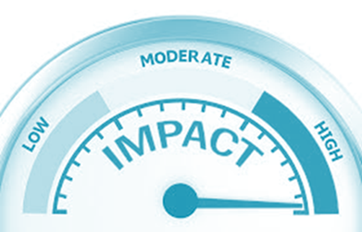
Processes where workplace exposure levels have dropped- requiring increased controls
Benzene | Naturally found in crude oil, and in some types of lubricants, rubbers, dyes, detergents, drugs, explosives and pesticides
Chromium VI compounds | Stainless steel welding, buffing/grinding/welding
Synthetic Mineral Fibres (non carcinogenic) | Pipe insulation (rock wool)- common across construction and manufacturing industries.
Synthetic Mineral Fibres (carcinogenic) | Pipe insulation (rock wool), refractory ceramic fibre (RCF) products
Respirable Crystalline Silica | Manufactured stone benchtops, some concrete products
Notes:
Crystalline Silica and Crystobalite is to be reviewed 2022, 0.025mg/m3 is a estimate of where it will potentially go to.
Formaldehyde is in the laboratory but not presently used. There is 0.5 litres in storage.

Slide 7
Chromium VI Compounds
0.01mg/m3
to 0.00002 mg/m3 is a
-99.8% change
Previous WES |  | Current WES
WES-TWA 8hr TWA 0.01mg/m3 (inhalable) BEI -30 μg total chromium/L of urine (end of shift at end of work week) |  | WES-TWA for all chromium(VI) compounds of 0.00002mg/m3, as Cr(VI) (inhalable)
Impact to businesses
Common stainless steel contains 18% Chromium | Review controls around stainless steel welding and grinding. On tool extraction, work methods eg working out of fume plume, PPE and personal mounted fume extraction. Occupational hygiene measurement of environment pre and post controls. Health monitoring for all personnel who work with Chromium as part of their jobs.
Stainless steels all contain Chromium Stainless steel welding rods and wires contain Chromium
Welding, grinding stainless produces Chromium fumes
Chromium (VI)
compounds are carcinogenic to humans (Group 1) (International Agency for Research on Cancer).
Notes:
Austenitic steels are non-magnetic stainless steels, which contain 16 to 26 percent chromium and up to 35 percent nickel.
The International Agency for Research on Cancer [IARC] evaluation of chromium (VI) compounds concluded that: There is sufficient evidence in humans for the carcinogenicity of chromium (VI) compounds.
Welding samples review with new exposure standard.
Continue to monitor welders respiratory samples.

Slide 8
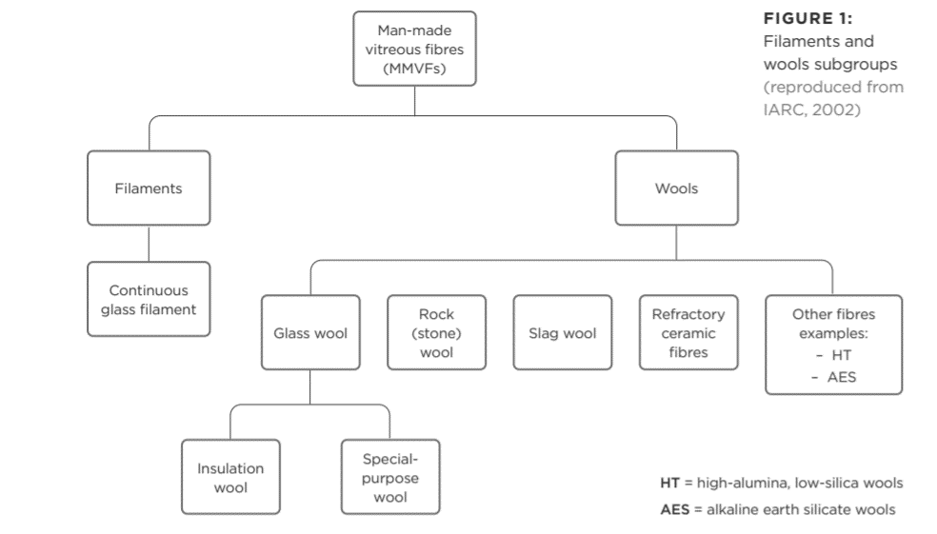
Synthetic Mineral Fibres (SMF’s)
Notes:
It is likely that Methanex will have to treat all insulation insitu as category 2 (carcinogenic/biopersistent) unless we have very good records of where the biosoluble insulation has been retrofitted over the years.
Mineral fibres cannot be considered as a single group with a single hazard profile as they have been in the past and many have not been comprehensively tested. The latest reviews concluded that SMFs could be divided into the following categories a. those fibres classified as carcinogens b. those fibres not classifiable, and c. those fibres classified as not carcinogenic.
Refractory ceramic fibres – particularly in the reformer. RCFs and high temperature performance blankets, boards and blocks are used primarily in industry as insulation for high-temperature applications such as furnaces, boilers and other heating equipment subjected to temperatures up to 1350°C. The form of cristobalite found in the high temperature conversion of the High Temperature fibres has a highly disordered micro-crystalline structure. Cristobalite is classified by IARC as carcinogenic to humans (Group 1) (IARC, 1997). Cristobolite is a form of crystalline silica not fibre at this point.
Exposure to SMF can occur during the installation and removal of SMF containing products. Demolition activities, particularly involving “aged” SMFs subjected to high temperatures over prolonged periods, can lead to exposures with different hazard profiles from the same products during manufacture and installation.
The 2016 AIOH review noted that bio-persistence of the fibres is considered an important factor in indicating the potential toxicity of fibres: “Bio-persistence is a complex interaction between fibre solubility and the natural clearance mechanisms in the lung.”
m the same products during manufacture and installation.
There is no direct conversion between f/mL and mg/m3. So what that will mean is that the Carcinogenic SMF, e.g. Respirable Ceramic Fibre, will need to be measured using a method similar to asbestos fibres with a cowl under the proposed WES change. This may cause some difficulty in comparing historical data if you have been measuring the inhalable fraction in the past.

Slide 9
Synthetic Mineral Fibres (SMF’s)
Previous WES |  | Current WES
WES-TWA 8hr 5mg/m3 inhalable dust |  | WES-TWA classified as not carcinogenic, 2mg/m3 inhalable dust, bio soluble SMFs WES-TWA classified as carcinogenic, for example RCFs, bio persistent SMFs of 0.3f/ml
Impact to businesses
Common names: Glass wool Rock wool Refractory Ceramic Fibres. | Potential controls Review and investigate move to a bio soluble form of Rockwool or insulations where possible. Conduct respirable/inhalable air sample monitoring during insulation/boiler work to gain a baseline. Health monitoring for all workers who work with insulation and refractory products. Note This type of SMF doesn’t usually include fibreglass used in boatbuilding, surfboard manufacture etc as they are bonded with resins. However the dust from sanding can still be hazardous.
Rock wool is used extensively in pipe insulation. Some older types of domestic and industrial structural and insulation contains SMFs. SMFs are found in Refractory Ceramic Fibre (RCF) products in boilers – blocks, blankets etc. RCF products are classified as carcinogenic
Notes:
It is likely that Methanex will have to treat all insulation insitu as category 2 (carcinogenic/biopersistent) unless we have very good records of where the biosoluble insulation has been retrofitted over the years.
Mineral fibres cannot be considered as a single group with a single hazard profile as they have been in the past and many have not been comprehensively tested. The latest reviews concluded that SMFs could be divided into the following categories a. those fibres classified as carcinogens b. those fibres not classifiable, and c. those fibres classified as not carcinogenic.
Refractory ceramic fibres – particularly in the reformer. RCFs and high temperature performance blankets, boards and blocks are used primarily in industry as insulation for high-temperature applications such as furnaces, boilers and other heating equipment subjected to temperatures up to 1350°C. The form of cristobalite found in the high temperature conversion of the High Temperature fibres has a highly disordered micro-crystalline structure. Cristobalite is classified by IARC as carcinogenic to humans (Group 1) (IARC, 1997). Cristobolite is a form of crystalline silica not fibre at this point.
Exposure to SMF can occur during the installation and removal of SMF containing products. Demolition activities, particularly involving “aged” SMFs subjected to high temperatures over prolonged periods, can lead to exposures with different hazard profiles from the same products during manufacture and installation.
The 2016 AIOH review noted that bio-persistence of the fibres is considered an important factor in indicating the potential toxicity of fibres: “Bio-persistence is a complex interaction between fibre solubility and the natural clearance mechanisms in the lung.”
There is no direct conversion between f/mL and mg/m3. Carcinogenic SMF, e.g. Respirable Ceramic Fibre, will need to be measured using a method similar to asbestos fibres under the proposed WES change. This may cause some difficulty in comparing historical data if you have been measuring the inhalable fraction in the past.

Slide 10
Respirable Crystalline Silica
Previous WES |  | Current WES
WES-TWA 8hr 5mg/m3 inhalable dust |  | Interim TWA 0.05mg/m3
Impact to businesses
Respirable crystalline silica is found in many man made stone products eg kitchen benchtops such as Corian etc. Silica is also found in concrete, linea board, ceramic and other tiles | Potential controls: Use low silica products where possible. Minimise cutting and grinding of these products. Extraction and engineering controls to reduce silica in environment. Benchtop manufacture- Occupational hygienist assessment to ensure airborne silica below WES. Personal extraction and PPE Personal health assessments on regular basis by occupational health professional Register on WorkSafe RCS register
Sanding, grinding, cutting the above products produces a fine silica containing dust that can be inhaled deep into lungs. This can cause scarring and fibrosis which is irreversible.
Notes:
It is likely that Methanex will have to treat all insulation insitu as category 2 (carcinogenic/biopersistent) unless we have very good records of where the biosoluble insulation has been retrofitted over the years.
Mineral fibres cannot be considered as a single group with a single hazard profile as they have been in the past and many have not been comprehensively tested. The latest reviews concluded that SMFs could be divided into the following categories a. those fibres classified as carcinogens b. those fibres not classifiable, and c. those fibres classified as not carcinogenic.
Refractory ceramic fibres – particularly in the reformer. RCFs and high temperature performance blankets, boards and blocks are used primarily in industry as insulation for high-temperature applications such as furnaces, boilers and other heating equipment subjected to temperatures up to 1350°C. The form of cristobalite found in the high temperature conversion of the High Temperature fibres has a highly disordered micro-crystalline structure. Cristobalite is classified by IARC as carcinogenic to humans (Group 1) (IARC, 1997). Cristobolite is a form of crystalline silica not fibre at this point.
Exposure to SMF can occur during the installation and removal of SMF containing products. Demolition activities, particularly involving “aged” SMFs subjected to high temperatures over prolonged periods, can lead to exposures with different hazard profiles from the same products during manufacture and installation.
The 2016 AIOH review noted that bio-persistence of the fibres is considered an important factor in indicating the potential toxicity of fibres: “Bio-persistence is a complex interaction between fibre solubility and the natural clearance mechanisms in the lung.”
There is no direct conversion between f/mL and mg/m3. Carcinogenic SMF, e.g. Respirable Ceramic Fibre, will need to be measured using a method similar to asbestos fibres under the proposed WES change. This may cause some difficulty in comparing historical data if you have been measuring the inhalable fraction in the past.

Slide 11
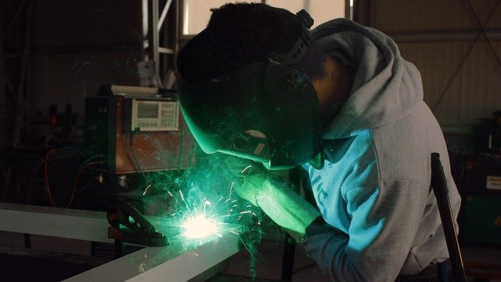
Cadmium and Cadmium Compounds
Current WES: WES TWA 0.01mg/m3
Change(s) proposed: 0.004 mg/m3 proposed WES TWA
Main uses: Cadmium is often used as a coating/plating on steel to prevent rust. Welding on some plated or painted metals can release cadmium fumes. The modern batteries can contain Nickel Cadmium cells
Recommendations:
Include sampling for cadmium when carrying out exposure monitoring for welders.

Slide 12
What is an Occupational Hygienist? Where do I find one?
Occupational Hygienists help employers and employees to understand workplace exposure risks and how to minimize or eliminate them.
Work with the interface of people and their workplaces.
Work to prevent ill health from work environment by measuring and assessing environmental hazards and worker exposures.
Advise on control of risks to health from workplace exposure to hazards.
May measure the substances in the environment or levels in workers ie biological exposure monitoring.
Most occupational hygienists are based in metropolitan areas. Engaging them will require both travel and consultancy costs to be met.
You can find a verified registered occupational hygienist:
https://nzohs.org.nz/
https://www.hasanz.org.nz/

Slide 13
Where to from here?
Review. Review current processes to identify WES substances present in your workplace. Understand what controls you have in place to eliminate or minimise exposure What checks do you have to ensure you are reducing exposures under WES? What checks do you have to ensure worker health is being protected by these controls? May require exposure monitoring and/or personal health monitoring.
Implement. Planned hazard controls using hierarchy of controls, ie substitution, engineering controls, safe work methods, PPE. Check. Exposure monitoring by Occupational Hygenist to check exposure levels before and after controls Personal health monitoring by medical professional to check effectiveness of controls by monitoring worker health.
Notes:
Have contacted HERA (Heavy engineering research association) 4/05/2020 to gain their insights into proposed changes to chromium (a lot of the stainless steel industry potentially affected).
Proposed changes will affect these contractors mainly:
Chromium (Stainless) / Welding:
UGL
Warner Construction
Energyworks
FEGL
Synthetic Mineral Fibres
Crow Refractory
Vickers
Best Insulation
Catalyst: Copper and Zinc Oxide (and Nickel from changes in 2019)
Contract Resources (and any associated labour hire)

