Slide 1


Machine Safety
AS/NZS 4024
Employer / Manager Overview
Please be aware there are some Graphic Photos in this presentation

Slide 2

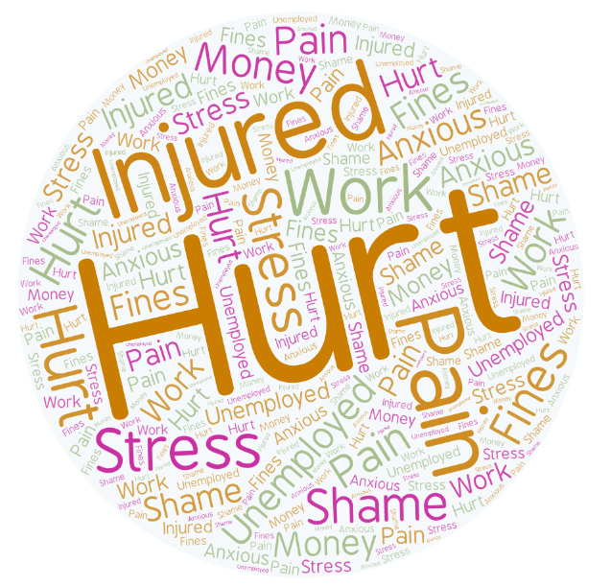
Machine Safety
Machinery accidents can be devastating. They can result in life changing or life ending consequences. Burns, broken bones, amputations, paralysation... even death. No person should suffer this through work. Often, the impacts are suffered long after the accident has taken place.
There is physical and mental harm.
Loss of body function
Deformed physical appearance
Short or long term disability or Inability to work
Chronic pain or ongoing heath issues
Quality of life
Rehabilitation
Stress and anxiety
But the impact goes beyond the victim;
Families are devastated - husband, wife, father, mother, brother, sister, child, grandfather, grandmother...
Co-workers are traumatised
Business reputation is damaged
Business owners are punished
Industries embarrassed
A Nation humiliated
It is in all of our interests to work together and prevent machinery accidents from happening.
It is Achievable.

Slide 3

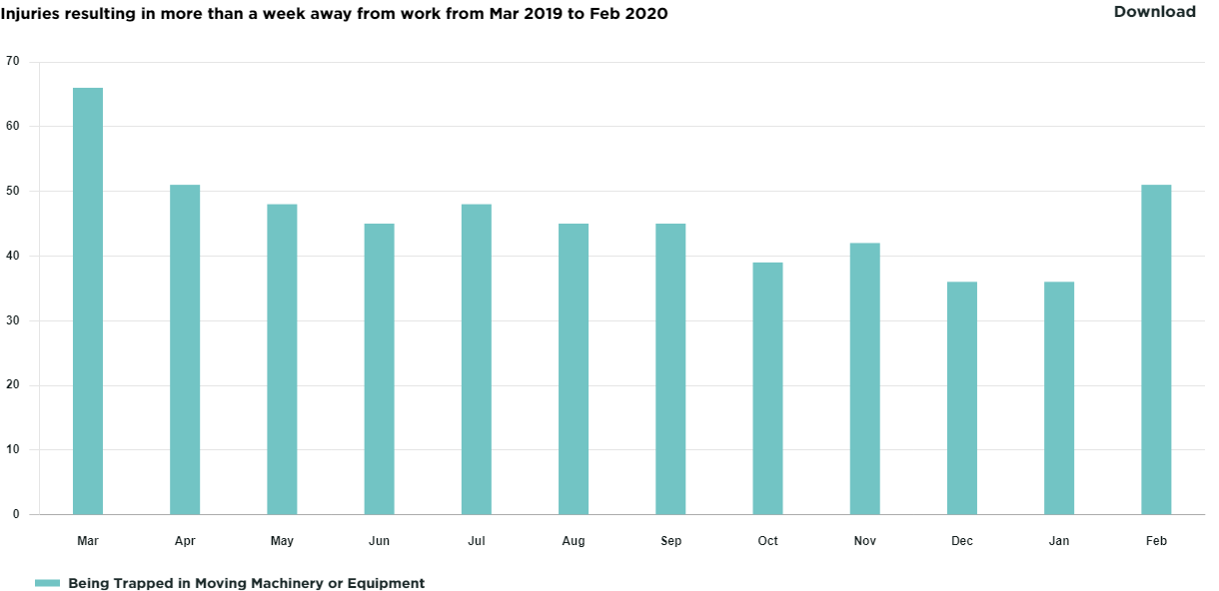
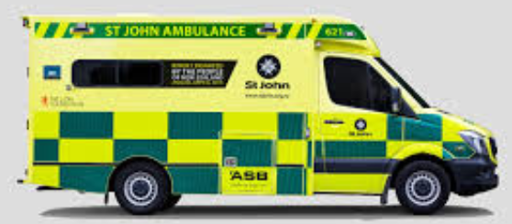
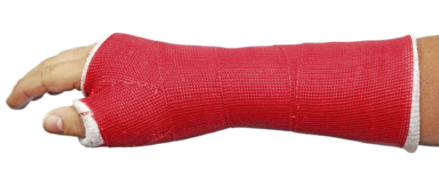
Machine Safety Injury Statistics
Being Trapped in Moving Machinery or Equipment:
7 Deaths between 2018 and 2020 to date
552 Injuries between March 2019 and Feb 2020 requiring more than a week off work
* Worksafe NZ statistics

Slide 4
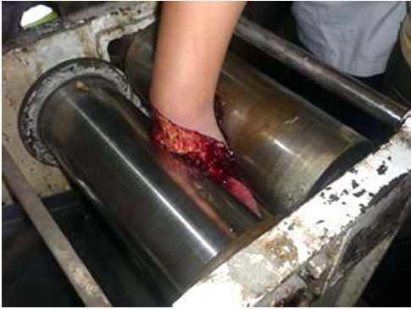
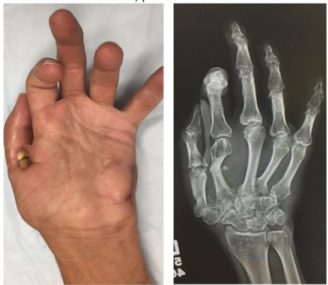
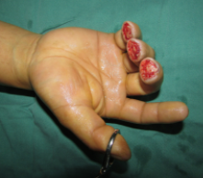
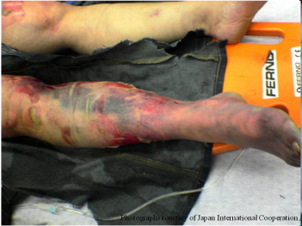
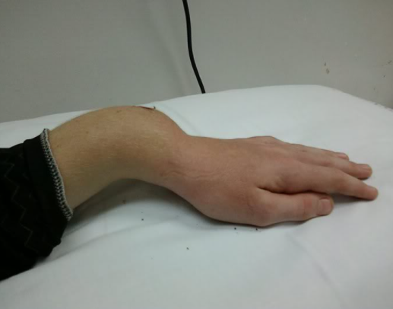
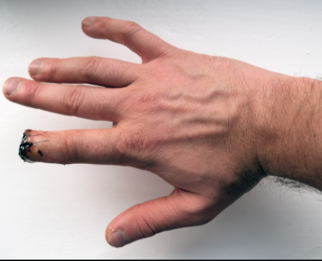

Slide 5
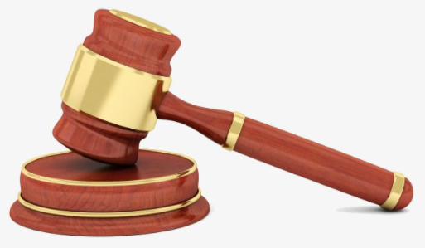

Machine Safety Injury Prosecutions
Worksafe: News and Media
A worker at a sawmill had his hand drawn into the gap between a roller and a metal plate on a wood processing machine. Two fingers were left damaged and required surgical amputation. WorkSafe’s investigation found that failure to adequately guard the machine, a well-known hazard in sawmills, had exposed the worker to risk of serious injury. While there was guarding on the right hand side of the machine, this was not installed on the left, which allowed the worker’s hand to connect with the roller.
A final fine of $323,437 was imposed.
Reparations of $27,160 were ordered (in addition to $5000 already paid).
Costs of $278 were ordered.
The company was charged under sections 36(1)(a), 48(1) and (2)(c) of the Health and Safety at Work Act 2015.
A worker was using a press style machine to create tray clips used in roofing. The worker had made a number of clips when the material got stuck. After attempting to free a jammed clip with some wire, the worker reached up through the outlet chute with his hand. This was not adequately guarded. The worker inadvertently made contact with the controls and the press activated, amputating four digit tips from his right hand.
A fine of $180,000 was imposed.
Reparations of $53,677.70 were ordered ($25,000 had already been paid).
Costs of $2500 were ordered.
The company was charged under sections 36(1)(a), 48(1) and (2)(c) of the Health and Safety at Work Act 2015.
A worker was operating a tyre shredder at the company’s site. When debris obstructed the conveyor belt to the tyre shredder, the worker attempted to remove it while the machine was running and his arm became trapped. The worker was unable to activate the emergency stop, but eventually managed to free his arm. As a result of the incident the worker suffered degloving injuries and a broken forearm. A subsequent WorkSafe investigation found guarding was missing from the conveyor belt which fed tyres into the machine, as it had been removed for modification. Despite having no machine guarding, the machine was still in use.
A fine of $400,000 was imposed.
Reparation of $50,000 was ordered.
The company was sentenced under sections 36(1)(a), 48(1) and 2(c) of the Health and Safety at Work Act 2015.

Slide 6

Machine Safety Injury Prosecutions
A worker was operating a machine used to drill, saw and fabricate steel. When the worker accessed the machine’s operating area it started and a steel beam caught the worker, pulling him onto the machine’s roller table. The worker then became trapped between the steel beam and roller table, and suffered multiple crush injuries to his left leg and pelvis. His leg was amputated. Worksafe investigation found workers were routinely required to access the machine’s operating area to adjust or replace drill bits or repair faults, while the machine was electronically locked out. However, there was inadequate guarding in place to prevent the worker from accessing the operating area if the machines automatic lockout failed
A final fine of $220,000 was imposed.
No reparation was ordered as the Defendant had paid $172,000 to the victim prior to sentencing.
The company was charged under sections 36(1)(a), 48(1) and (2)(c) of the Health and Safety at Work Act 2015.
A worker at a lumber mill suffered fatal chest injuries when she was pulled into machinery the sawmill used for grading and sorting timber. WorkSafe’s investigation found when the worker accessed the machine to clear a fault, it restarted and she was pulled into the machine’s sprockets.
A fine of $350,000 was imposed.
Reparations of $263,762 were ordered (including $145,762 in consequential loss).
The company was charged under sections 36(1)(a), 48(1) and (2)(c) of the Health and Safety at Work Act 2015.
A business which continued to operate unguarded machinery resulting in serious hand injuries to a worker when a worker’s hand was drawn into a machine used to make pastry. The worker suffered fractures and the complete degloving of his middle and index finger on his left hand. He also received lacerations injuries to his thumb and ring fingers. WorkSafe’s investigation found that prior to the incident being reported to WorkSafe, the pastry roller was cleaned with an air gun and continued to be used to make food products including noodles and dumplings.
A fine of $260,000 was imposed.
Reparation of $40,568 was ordered.
The company was sentenced under sections 36(1)(a), 48(1) and 2(c) of the Health and Safety at Work Act 2015.

Slide 7
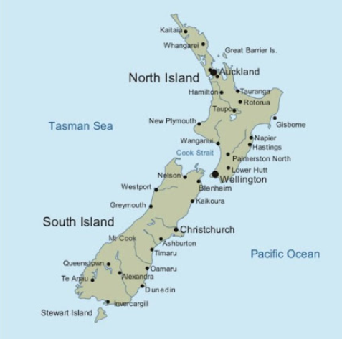
Machine Safety in New Zealand
Workplace safety in New Zealand is covered by the Health and Safety at Work Act 2015 (HSWA) and the Health and Safety at Work Regulations 2016 (HSWR). Workplace safety in monitored by Worksafe.
Machine Safety is governed under AS/NZS 4024
Note that at the time of writing this presentation Australia Standards has released an updated 2019 version of Standard 4024 but it has not been adopted by New Zealand.

Slide 8

Machine Safety Definition
Health and Safety at Work Act 2015
Part 1 Section 16 Interpretation
machinery means an engine, a motor, or any appliance that provides mechanical energy derived from compressed air, electricity, gas, gaseous products, steam, water, wind, the combustion of fuel, or any other source and includes—
(a) any plant by or to which the motion of any machinery is transmitted; and
(b) a tractor, a lifting machine, a lifting vehicle, and a machine whose motive power is wholly or partly generated by the human body
Plant includes -
(a) any machinery, vehicle, vessel, aircraft, equipment (including personal protective equipment), appliance, container, implement, or tool; and
(b) any component of any of those things; and
(c) anything fitted or connected to any of those things

Slide 9

Management (PCBU) - Responsibility
Health and Safety at Work Act 2015
Worksafe: Health and Safety at Work quick reference guide
Part 2 Section 30 Management of risks
(1) A duty imposed on a person by or under this Act requires the person—
(a) to eliminate risks to health and safety, so far as is reasonably practicable; and
(b) if it is not reasonably practicable to eliminate risks to health and safety, to minimize those risks so far as is reasonably practicable….
and
Section 36 Primary duty of care
(3) Without limiting subsection (1) or (2), a PCBU must ensure, so far as is reasonably practicable,—….
(b) the provision and maintenance of safe plant and structures; and …..
(d) the safe use, handling, and storage of plant, substances, and structures; and
Sections 37 thru 43 describe the Duty of PCBU who manages the workplace and/or who manages, designs, manufactures, imports, supplies , install, constructs or commissions plan

Slide 10

Management (PCBU) - Consequence
Section 48 Offence of failing to comply with duty that exposes individual to risk of death or serious injury or serious illness
A person commits an offence against this section if— (a) the person has a duty under subpart 2 or 3; and
(b) the person fails to comply with that duty; and
(c) that failure exposes any individual to a risk of death or serious injury or serious illness.
(2) A person who commits an offence against subsection (1) is liable on conviction,—
(a) for an individual who is not a PCBU or an officer of a PCBU, to a fine not exceeding $150,000:
(b) for an individual who is a PCBU or an officer of a PCBU, to a fine not exceeding $300,000:
(c) for any other person, to a fine not exceeding $1.5 million.
Section 49 Offence of failing to comply with duty
(1) A person commits an offence against this section if the person—
(a) has a duty under subpart 2 or 3; and
(b) fails to comply with that duty.
(2) A person who commits an offence against subsection (1) is liable on conviction,—
(a) for an individual who is not a PCBU or an officer of a PCBU, to a fine not exceeding $50,000:
(b) for an individual who is a PCBU or an officer of a PCBU, to a fine not exceeding $100,000:
(c) for any other person, to a fine not exceeding $500,000.
(3) Despite subsection (2), if the duty or obligation of a PCBU is imposed under a provision other than a provision of subpart 2 or 3, the maximum penalty under subsection (2) for an offence by an officer against subsection (1) in relation to the duty or obligation is the maximum penalty fixed under the provision creating the duty or obligation for an individual who fails to comply with the duty or obligation.

Slide 11
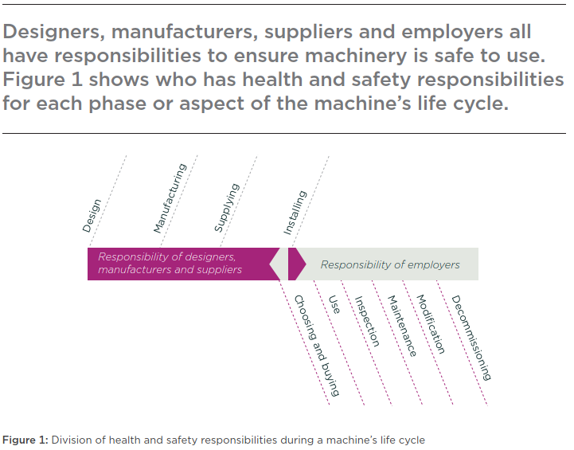

Responsibility
Governing Standard in New Zealand is
AS/NZS 4024 Safety of Machinery
* from Worksafe Best Practice Guidelines

Slide 12




Machine Safety Risks
Machine safety is typically thought of as guarding moving parts. While that is a large part of it there are many other considerations that need to be assessed in every possible operating and maintenance mode.
Mechanical - size, shape, movement, mass
Physical - sharp edges, pinch points, entanglement
Electrical - live energy, static, surges
Heat - contact, radiated
Noise & vibration
Radiation - x-ray, magnetic, microwave, ultraviolet etc
Work Environment - lighting, temperature, weather, visibility
Ergonomic - lifting, reaching, interface locations
Chemicals - lubrication, process, cleaning
Concurrent Processes - foot traffic, vehicle traffic, simops, adjacent equipment etc
Stored Energy - electrical, hydraulic, steam/gas, springs, gravity
Procedures - startup, shutdown, emergency stops
Maintenance - planned, unplanned, access, lockouts
Cleaning – access, chemicals, ergonomics, lockouts
PPE , Worker fatigue & health
https://besafe.nz/risk-assessment/

Slide 13


International Regulations & Standards
AS/NZS 4024 fits under ISO 12100 Safety of Machinery but compliance with ISO 12100 does not guarantee or preempt compliance with AS/NZS 4020.
AS/NZS 4024 is based partially on European CE marking standards as well but CE marking likewise does not mean that the machine meets NZ requirements.
There are many international standards; IEC, ISO, CEN, DIN, OSHA, BS that address machine safety – none of these fully conform to AS/NZS 4024.
Machine and equipment design and fabrication regulations, standards and guidelines do not supersede or comply to AS/NZS 4024.
Any and every machine in New Zealand must comply with AS/NZS 4024, there are no recognized equivalents.

Slide 14
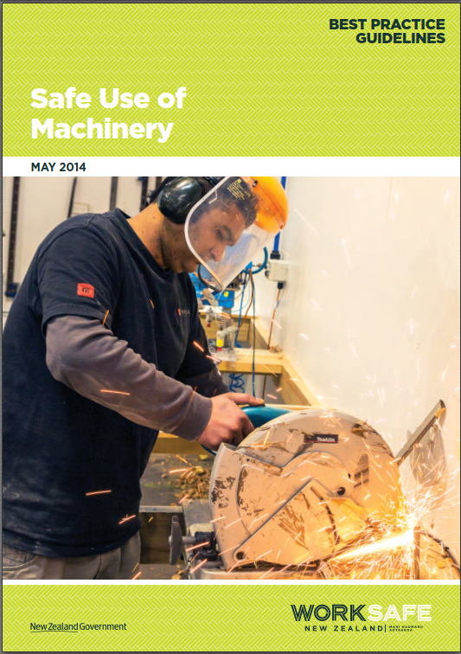
Worksafe
Worksafe - Safe-use-of-machinery Guidelines
Worksafe is New Zealand’s primary workplace health and safety regulator and they have developed Best Practice Guidelines for machinery. The guide contains examples and processes for anyone to use to understand and implement machine safety.

Slide 15
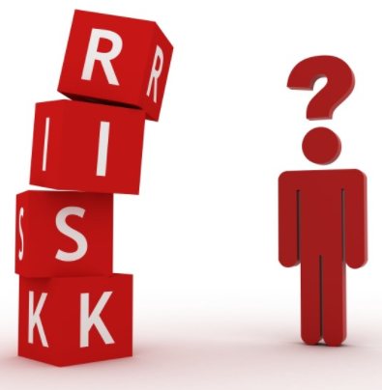
Machine Risk Assessment
The HSWA requires that duty holders (PCBUs) must carry out, or arrange the carrying out of, any calculations, analysis, testing, or examination that may be necessary for the performance of their duties. They must, on request, make reasonable efforts to provide current relevant information per AS/NZS 4024.1303:2014 Section 5.3.3: Recording of information.
As the title says the MRA is primarily a risk assessment, it is all about identifying all the existing and potential hazards and determining the associated risks per the company risk matrix. This provides a basis for any controls that are required to provide a safe work environment.
The HSWA and AS/NZS 4024 stipulate that the risk assessments be carried out by a Competent Person.

Slide 16


Competent Person
A competent person is normally defined as a person has acquired through training, qualification, and experience, or a combination of these knowledge and skills that enable the person to safely and effectively perform the task required.
In terms of machine safeguarding, a competent person has the technical capability to validate and verify the design integrity, reliability and failsafe of the safety related part of the machinery safety control systems and other safety aspects, for example using a certified machinery safety expert or a chartered professional engineer with knowledge and experience in AS/NZS 4024.
The competent person is capable of identifying existing and predicable hazards. The individual also needs to be knowledgeable of applicable standards, regulations and best practices. NZQA US18410 accreditation is a minimum standard for a competent person with respect to machine safety (with sufficient experience).

Slide 17
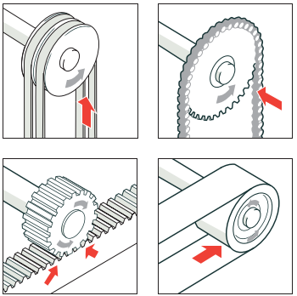
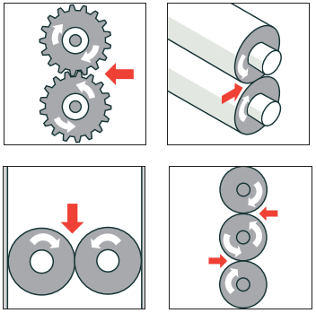
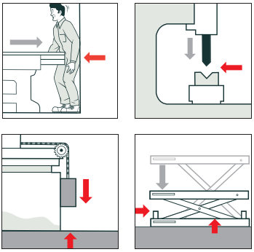
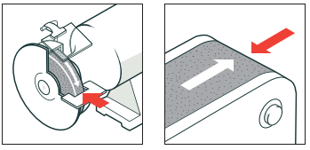
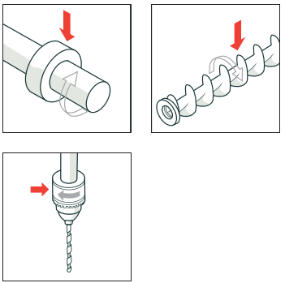
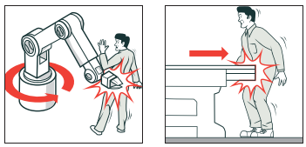
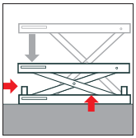
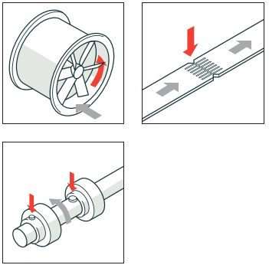
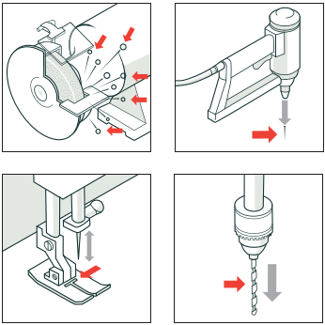
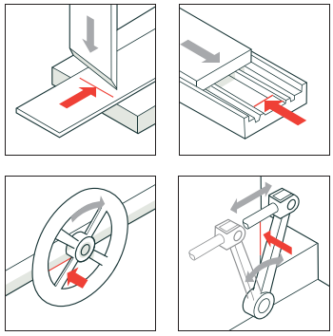
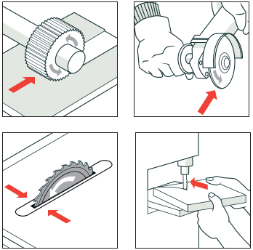
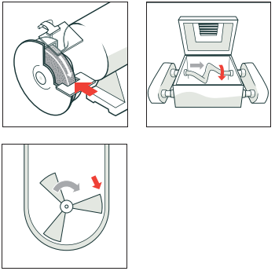
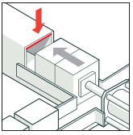
Identify the Hazards
* Examples from Worksafe Best Practice Guidelines

Slide 18
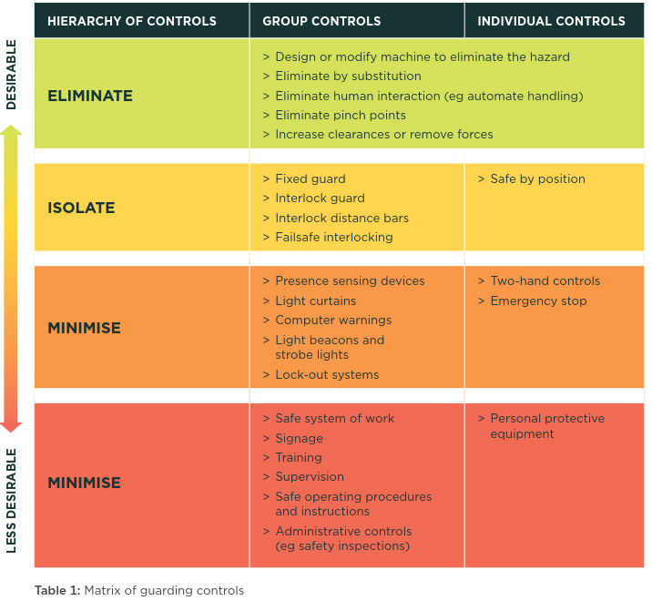
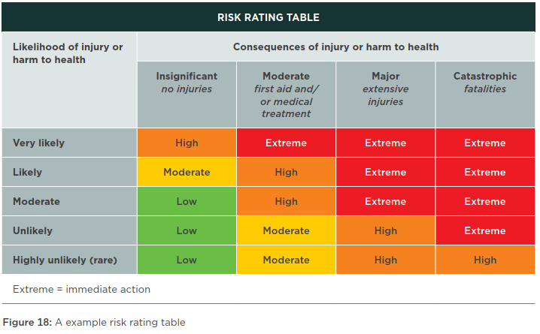
Determine the Risk
Control the Risk
* from Worksafe Best Practice Guidelines

Slide 19

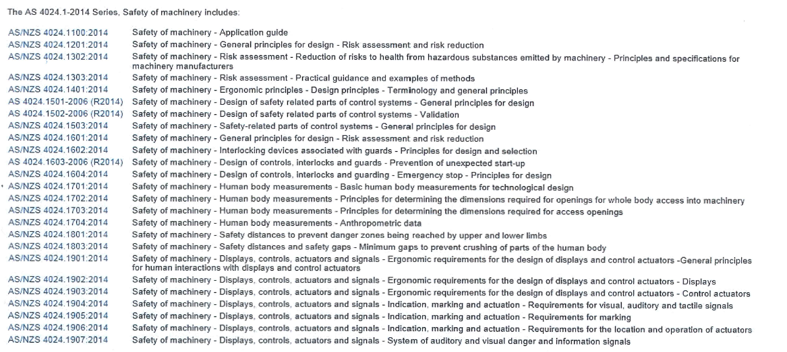
AS/NZS 4024:2014
AS/NZS 4024.1:2014, Safety of Machinery series contains 22 AS/NZS parts that are European (EN) and Internationally (ISO) based safety and design standards with some modifications. These individual parts provide designers, manufacturers, suppliers, employers and users of machinery with guidelines to improve safety for working on, with or near machinery. It is the responsibility of the duty holders or users to confirm the latest version of each relevant standard.

Slide 20


Extents and Considerations
AS/NZS 4024 considers the full life cycle of a machine, including: Design, manufacturing, installation, integration, commissioning, use, maintenance, cleaning, modification and decommissioning.
Safety in Design is important and although it happens before equipment arrives at a site, there are factors that should have site level input and that needs to include Machine Safety.
New machines, existing machines, machines that have been upgraded or repurposed, handheld power tools, stand alone machines and fully automated assembly or packaging lines, all are required to meet AS/NZS 4024 standards.

Slide 21
Awareness and Training
Awareness that machine safety is legislated and compliance is mandatory for new and existing machines. Assessment is necessary and funding may need to be allocated for retrofits.
Corporate Management
Awareness that PCBU responsibility includes machine safety, and knowledge that machine safety is not simply guarding, safety switches and emergency shutdown buttons. Internal training, similar to this slide set, is likely sufficient.
Site Management
Similar knowledge and awareness as site management depending on specific role and responsibility. This level may become involved with MRAs as participants, in this case additional risk and hazardous training specific to machine safety may be necessary. Internal training, such as this slide set, and some study (guided or individual) of Worksafe Best Practice Guidelines is appropriate.
Site Leadership Team
As stated in the HWSA individuals leading machine risk assessments needs to be a “competent person”, the minimum recommended qualification for this is NZQA US18410. Individuals auditing machine safety at site should also be US18410 training. See also the previous slide on Competent Person.
HSE Team/MRA Leads
Supervisors and maintenance personnel will be involved in MRAs and safety audits and need a good understanding of risks and hazards as part of their role. They will also need to understand the infrequencies of the safety functions and interlocks on their machines. Machine safety training needs to be integrated into operation and maintenance procedure training for their role.
Supervisors/Team Leads & Maintenance
Operator training and procedures should include specific information on safety and guarding for the machines and equipment they use – particularly around movable guards and instrumented safety functions for clearing blockages/misfeeds.
Operators

Slide 22
Links
Health and Safety at Work Act 2015
Health and Safety at Work Regulations 2016
Worksafe: Health and Safety at Work quick reference guide
MESNZ Safeguarding Providers
NZQA US18410: Manage Hazard Identification and Control on Plant Machinery
Worksafe - Safe-use-of-machinery Guidelines

Slide 23

Q & A
Thank you

