Slide 1


Burnout

Slide 2
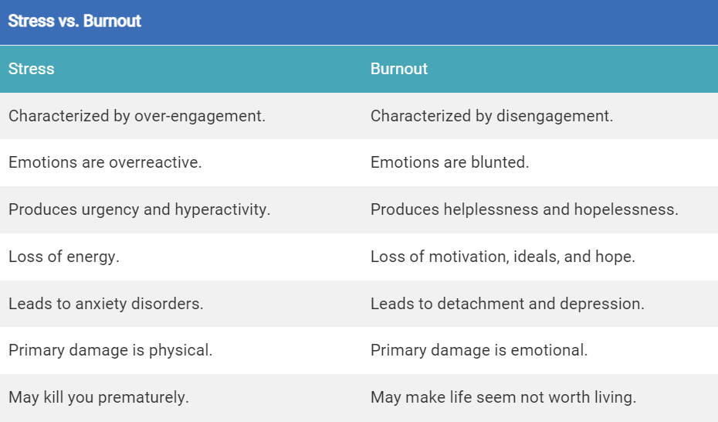
Stress versus Burnout

Slide 3
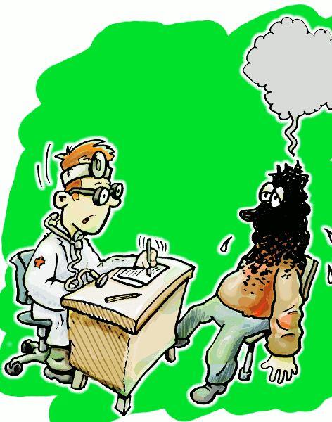
4 Stages of Burnout
emotional exhaustion
a lack of emotional control
indifference to work and
trouble staying focused
If workers score highly across all these areas, the diagnosis is clear: they've got nothing more to give.
Notes:
Professor Jarrod Haar of AUT's business school

Slide 4

Burnout – two sides of the coin
The first one, work-home conflict, arises when stress from work affects aspects of personal life.
The second conflict, home-work conflict, occurs when home issues cause stress that eventually makes work more difficult to deal with.
Together, both of these, deemed work-home interference, can exacerbate a person’s risk of burnout.
Notes:
Medical Daily

Slide 5
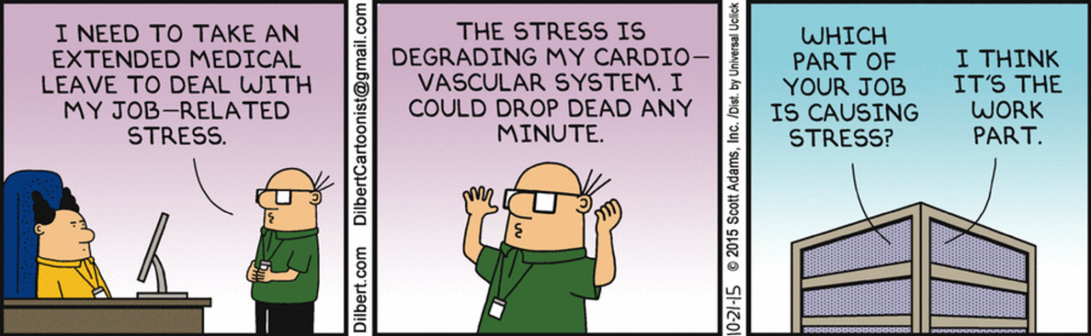
Burnout as it implies, is a state of mental, physical, and emotional exhaustion arising from a spate of stressful situations.
While most people associate it with work, which can be pretty tiring without any breaks, it can also be caused by a busy family or personal life.
It takes time to burnout. Once one has reached that point though, they usually experience feelings of cynicism, depression, and the feeling of being run down.
Notes:
Medical Daily

Slide 6
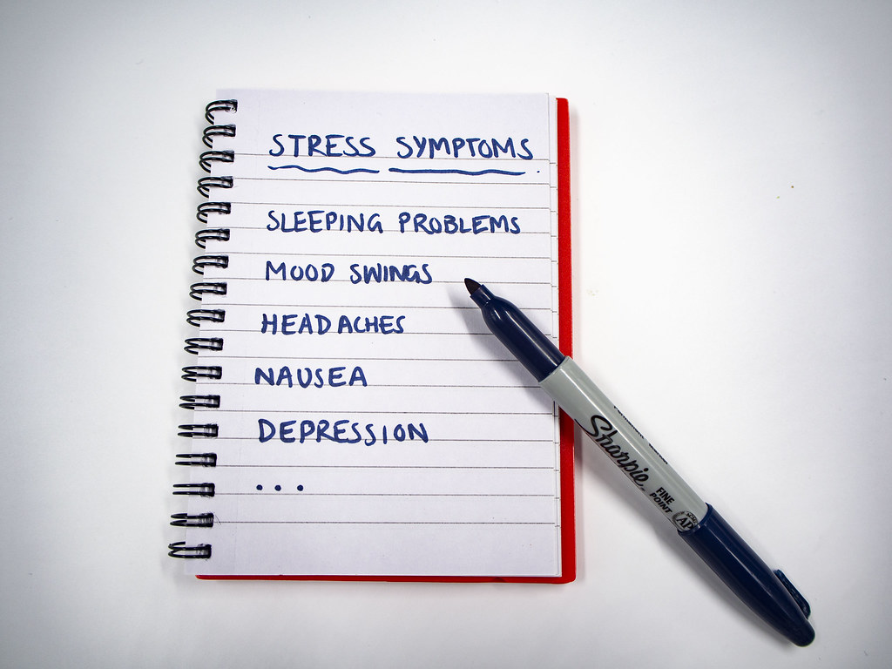
Symptoms of Burnout
Notes:
Have you become cynical or critical at work?
Do you drag yourself to work and have trouble getting started?
Have you become irritable or impatient with co-workers, customers or clients?
Do you lack the energy to be consistently productive?
Do you find it hard to concentrate?
Do you lack satisfaction from your achievements?
Do you feel disillusioned about your job?
Are you using food, drugs or alcohol to feel better or to simply not feel?
Have your sleep habits changed?
Are you troubled by unexplained headaches, stomach or bowel problems, or other physical complaints?

Slide 7
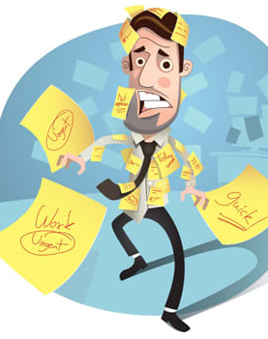
Consequences of job burnout
Excessive stress
Fatigue
Insomnia
Sadness, anger or irritability
Alcohol or substance misuse
Heart disease
High blood pressure
Type 2 diabetes
Vulnerability to illnesses
Notes:
Mayo Clinic

Slide 8
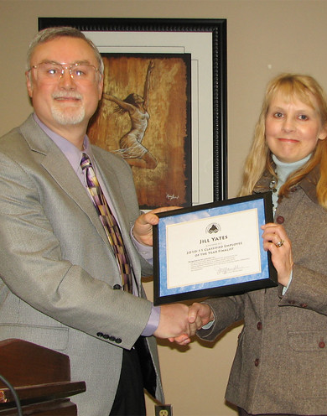
The Person Most Likely……
one of your best employees
conscientious
perfectionist
emotionally invested in the role
meets all deadlines.
This person is likely not to say anything, they will just find another job and leave
This Photo by Unknown Author is licensed under CC BY-NC-ND

Slide 9

Burnout requires the “Three R” approach
:
Recognize. Watch for the warning signs of burnout.
Reverse. Undo the damage by seeking support and managing stress.
Resilience. Build your resilience to stress by taking care of your physical and emotional health.

Slide 10

Stress or Anxiety?
Stress – an event that makes you feal fear or nervous
Anxiety –a feeling of fear, worry or unease, often with no event to trigger
Notes:
Techniques to Reduce Stress or Anxiety
limiting caffeine and alcohol consumption
getting enough sleep
getting regular exercise
meditating
setting aside free time for hobbies and activities that bring you joy
keeping a diary of your feelings and things that trigger stress
practicing breathing exercises
opening up to loved ones about how you’re feeling

Slide 11
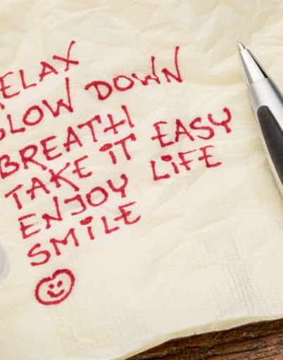
Evaluate your options.
Seek support. .
Try a relaxing activity.
Get some exercise.
Get some sleep.
Mindfulness.
Take time out
This Photo by Unknown Author is licensed under CC BY-NC-ND
Notes:
Evaluate your options. Discuss specific concerns with your supervisor. Maybe you can work together to change expectations or reach compromises or solutions. Try to set goals for what must get done and what can wait.
Seek support. Whether you reach out to co-workers, friends or loved ones, support and collaboration might help you cope. If you have access to an employee assistance program, take advantage of relevant services.
Try a relaxing activity. Explore programs that can help with stress such as yoga, meditation or tai chi.
Get some exercise. Regular physical activity can help you to better deal with stress. It can also take your mind off work.
Get some sleep. Sleep restores well-being and helps protect your health.
Mindfulness. Mindfulness is the act of focusing on your breath flow and being intensely aware of what you're sensing and feeling at every moment, without interpretation or judgment. In a job setting, this practice involves facing situations with openness and patience, and without judgment.

Slide 12

Ways to enhance Resilience
Find a Sense of Purpose
Believe in Your Abilities
Develop a Strong Social Network
Embrace Change
Be Optimistic
Nurture Yourself
Develop Problem-Solving Skills
Establish Goals
Take Action
Keep Working on Your Skills
This Photo by Unknown Author is licensed under CC BY-NC-ND
Notes:
https://www.verywellmind.com/ways-to-become-more-resilient

Slide 13
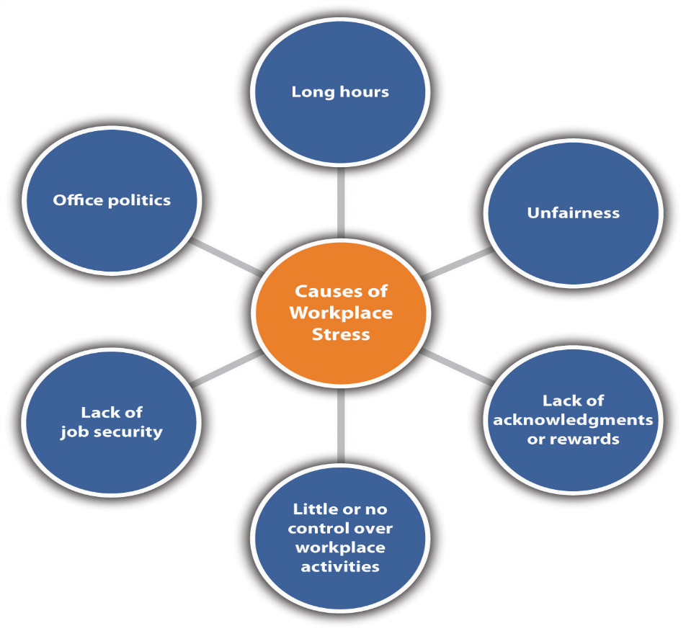
The Organisational Culture most likely…..
No autonomy, very hierarchical, accepts bullying as common practice
The employee will have no clear goals
There is no clear feedback on employees performance (good or bad)
The employee can’t control their workload
No clear work/life boundaries (ie; contacted while on leave or after work hours)
“if not controlled, work will flow to the most competent person until they are submerged”

Slide 14
How your Company can help
Equip your Managers to prevent burnout
Educate your managers on Burnout
Allow Managers time to prioritise their people
Hire the right managers
Design your employee experience to reduce burnout
Notes:
Equip your managers to prevent burnout.
Managers are responsible for generating positive employee experiences and learning how to reduce stress at work for employees.
It's their duty to set clear expectations, remove barriers, facilitate collaboration and ensure that employees feel fully supported to do their best work. When they do, managers can reverse burnout and prevent further burnout before it starts.
Ultimately, managers greatly influence how employees feel about their job.
Educate your managers on burnout
Managers are your best solution for burnout when they take time to learn the causes of burnout and are open to changing how they manage their teams. Taking ownership of their role in preventing burnout shows they are fully committed to helping every employee excel.
Allow managers time to prioritize their people
Leaders should review managers' job descriptions and role expectations, considering whether the expectations allow managers to prioritize people needs first.
Hire the Right Managers
When you carefully choose great managers, they make habits of offering feedback, coaching and support and helping employees achieve the right balance between work and life.
Design your employee experience
Organizations can systematically target burnout by improving their employee experience. The employee experience encompasses the entire journey an employee takes with their organization.
How to Prevent Employee Burnout - Gallup

Slide 15
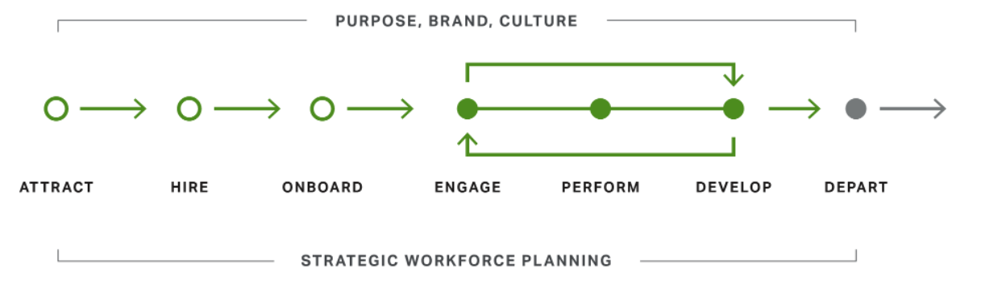
The life cycle of your employee
Notes:
The life cycle is composed of seven critical stages during which organizations have the most influence on the employee experience, from their applicant experience to when they exit the organization.
The employee experience also includes relatively constant aspects that are shaped by employees' relationships with their manager, the clarity of their role, the value they bring to their team, their workspace and their wellbeing
How to Prevent Employee Burnout - Gallup

Slide 16

Employees who strongly agree that they feel supported by their manager are about 70% less likely to experience burnout regularly.
In contrast, a negligent, absent or condescending manager leaves employees feeling uninformed, alone and defensive.
Notes:
How to Prevent Employee Burnout - Gallup

Slide 17

Notes:
Enable content to allow video to play

