Slide 1


Excavation & Confined Space

Slide 2
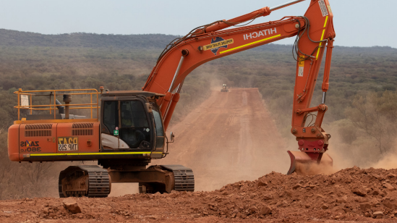
Excavation

Slide 3
What is excavation work?
Excavation work generally means work involving the removal of soil or rock from a site to form an open face, hole or cavity, using tools, machinery or explosives.
Excavation work includes:
open excavations
potholing
pit excavations
trenches and retaining walls
shafts and drives.

Slide 4
Excavation Risks
Make sure controls prevent anyone from being harmed, so far as is reasonably practicable. Common excavation risks include:
Ground collapse
Excavated materials & loads near excavations
Falls
Safe access & egress
Manual work
Overhead & underground services
Atmospheric contaminants
Ground & surface water
Contaminated soils & groundwater
Using explosives

Slide 5
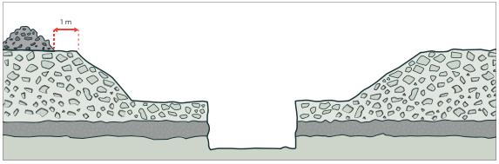
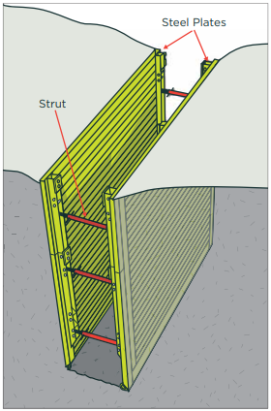
Preventing Ground Collapse
All excavations, no matter what depth, can be risky.
Ground collapse can occur quickly and without warning, giving a worker virtually no time to escape.
Benching and battering is the horizontal stepping or sloping of the face, side, or wall of an excavation.
Shoring prevents collapse by maintaining positive pressure on the sides of the excavation, protecting workers.
Shields do not ensure ground stability but protect workers from ground collapse, by preventing the collapsing material falling onto them.
Notes:
One competent person may not have experience across all the disciplines of temporary works and may require additional technical support on site. Each excavation has its own unique set of considerations to address during the design process, some of which may not be immediately apparent. Therefore, make an assessment of the appropriate level of competence for each individual excavation.
WorkSafe – Excavation 2.5 page 13

Slide 6
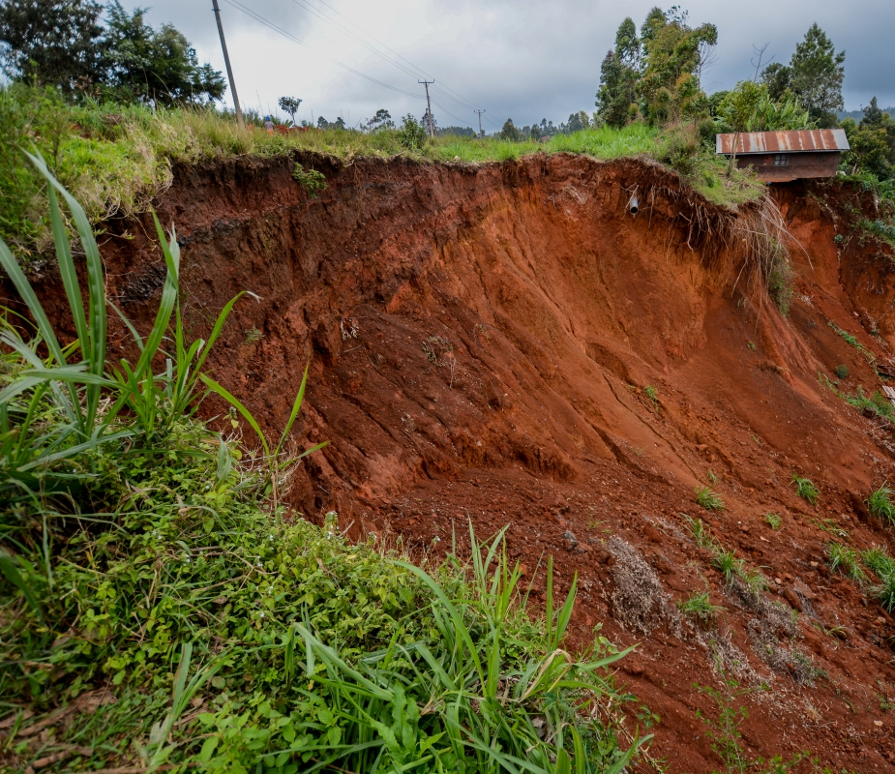
Excavation CRITICAL CONTROLS
Excavation design must be based on the following
Ground conditions
Location
Depth
Work to be performed within or near the excavation
This Photo by Unknown Author is licensed under CC BY

Slide 7
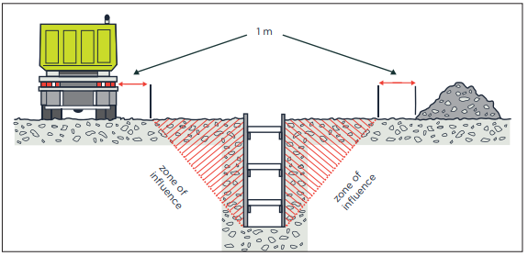
Zone of Influence
Any excavated material and external actions applying a load to the ground nearby can affect the excavation’s stability through the zone of influence. The zone is normally from the base of an excavated face to the surface. The zone’s angle will depend on site-specific factors.

Slide 8
Notifiable Works
You must provide at least 24 hours notice to WorkSafe of particularly hazardous work, including:
Work in any excavation in which any face has a vertical height of more than 5 metres and an average slope steeper than a ratio of 1 horizontal to 2 vertical
Work in any drive, excavation, or heading in which any person is required to work with a ground cover overhead
Submit the online notification form.

Slide 9
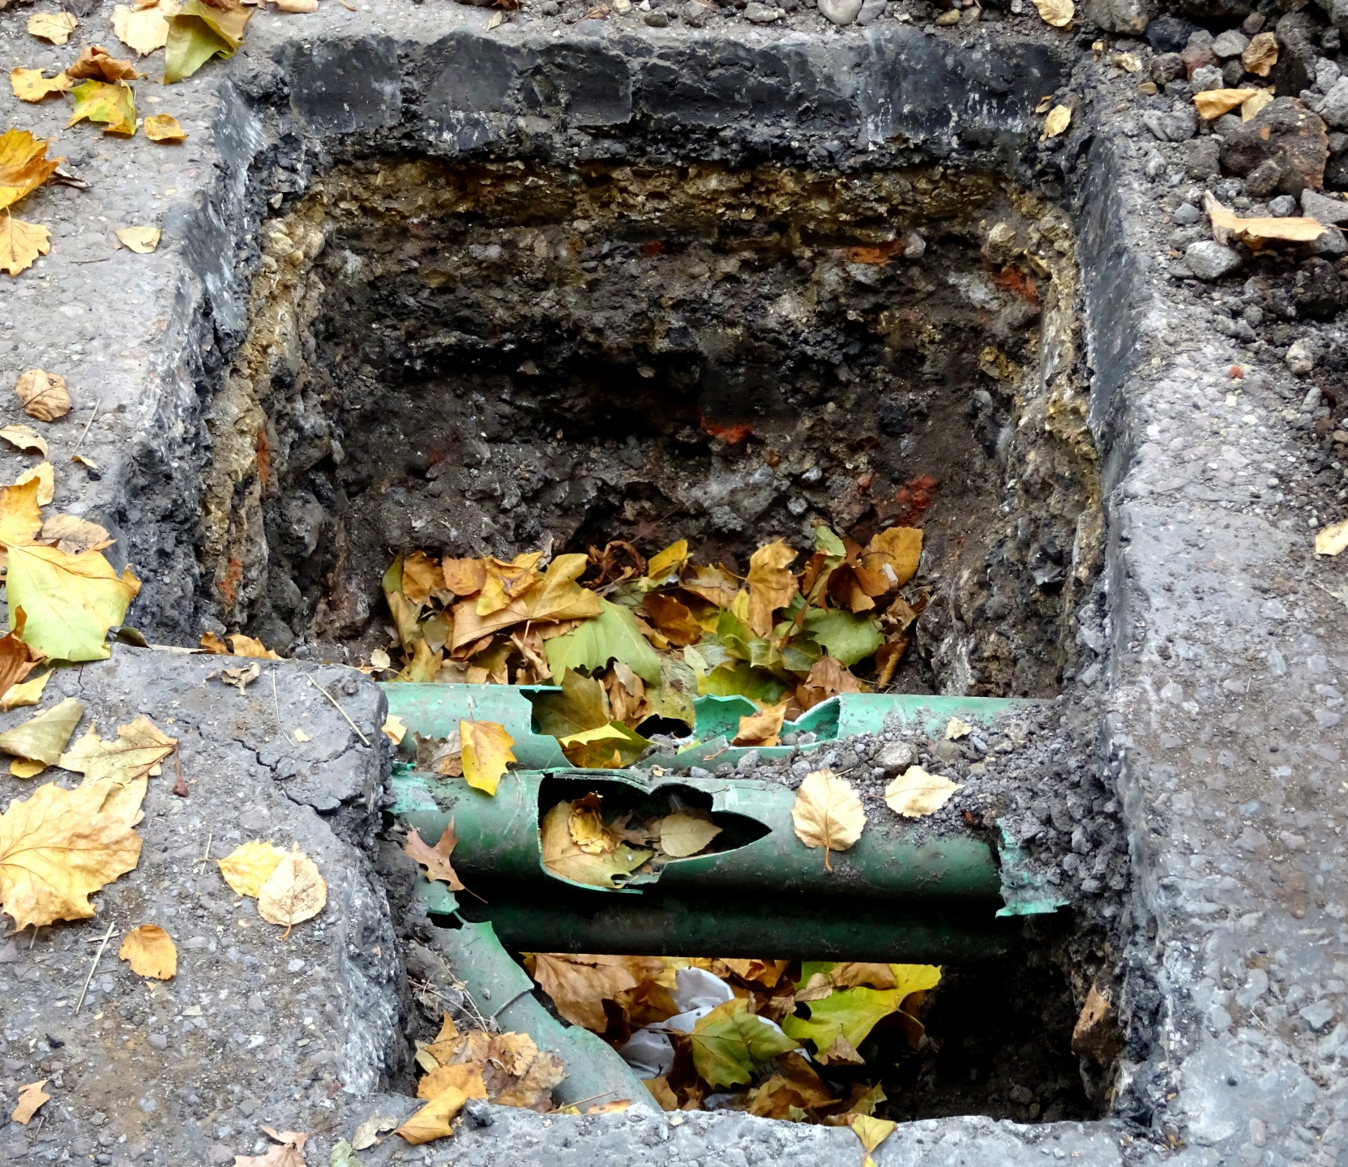
Prevent contact with services and structures
Contact with nearby services and structures must be prevented by:
Communicating exclusion zones to identified at-risk services and structures.
Positively identifying underground services using non-destructive methods.
Having authorized spotters in place.
Work under an authorized permit to work if mechanical excavation is within 15 meters of a known service or structure

Slide 10
People required to enter the excavation
If people are required to enter the excavation:
Mobile plant and bulk materials must remain outside the zone of influence.
Hazardous atmospheres must be identified and controlled using the hierarchy of controls. »
Excavation Checklist completed by an authorized person prior to entry for all excavations over 1.5m.
Minimum training requirements: » Confirm all people are trained and/or certified for their role

Slide 11
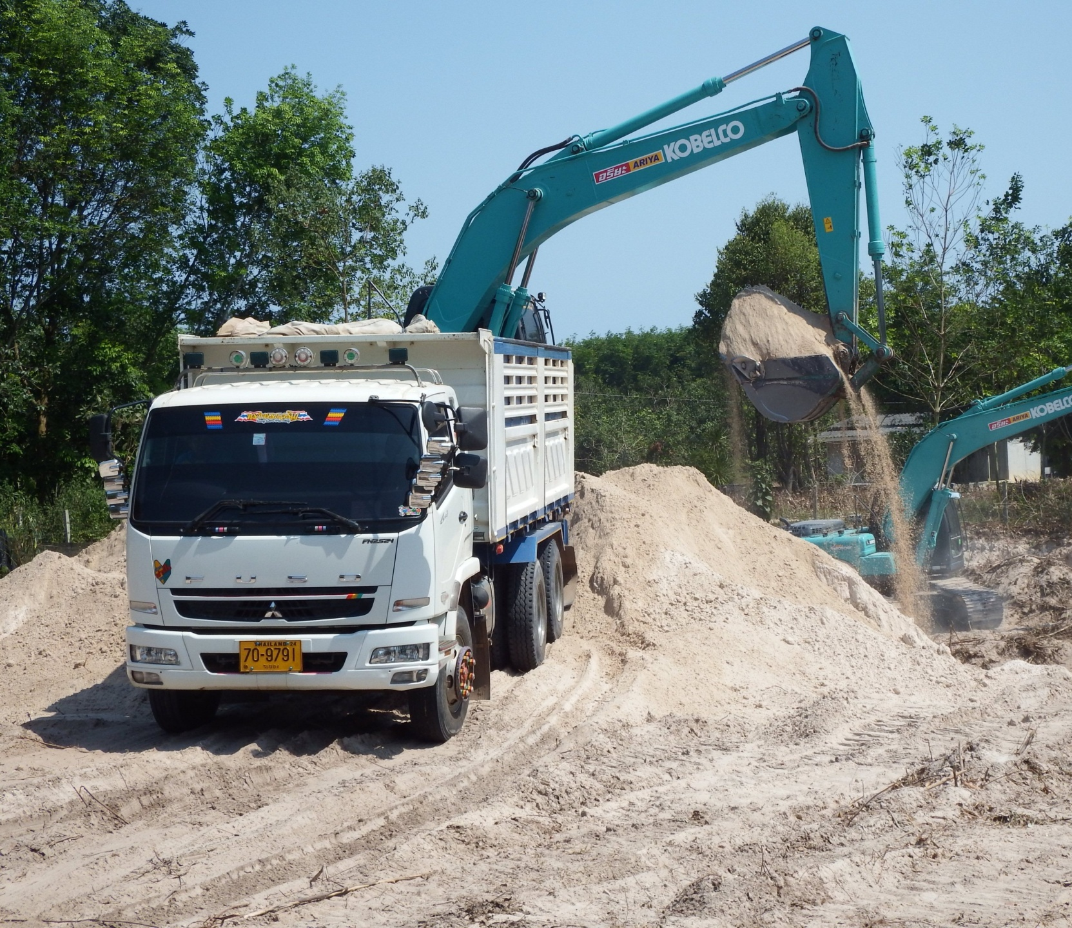
Using mobile plant
When using mobile plant, you must: »
Control interactions between vehicles, mobile plant and pedestrians.
Complete a mobile plant risk assessment.
Confirm the mobile plant is fitted with a seat belt and wear it

Slide 12
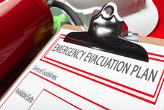
Minimum Emergency Requirements
Emergency response procedures must be: »
Developed based on risk
Implemented on-site
Checked they are working effectively
https://www.worksafe.govt.nz/topic-and-industry/excavation/excavation-safety-gpg/

Slide 13
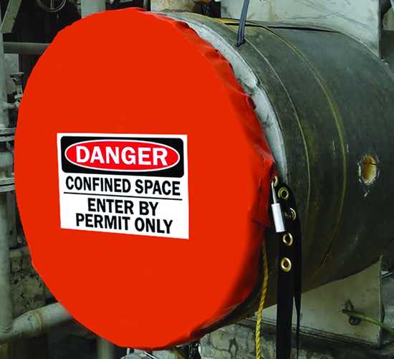
Confined Space

Slide 14
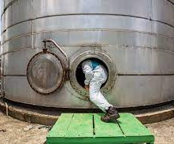
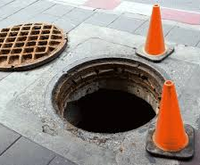
What is a confined space?
A confined space:
Is an enclosed or partially enclosed space; and
Is not intended or designed for primarily for human occupancy; and
May present a risk from one or more of the following at any time:
Unsafe concentration of harmful airborne contaminants
Unsafe concentration of flammable substances
Unsafe levels of oxygen
Substances that can cause engulfment
Notes:
Examples include:
Storage tanks
Process vessels
Boilers
Silos
Pits
Pipes
Sewers
Shafts
Ducts

Slide 15
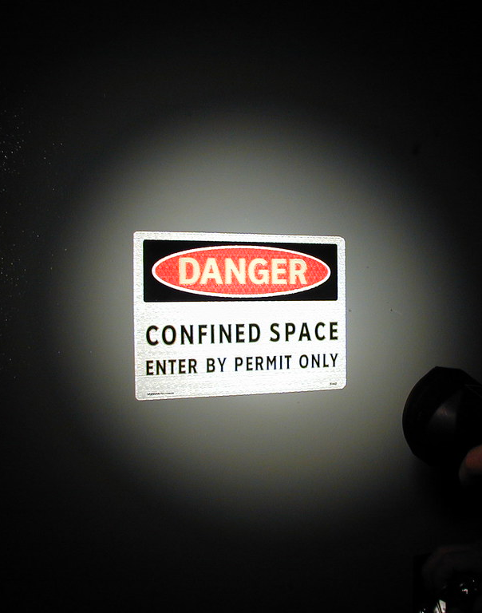
Minimum Site Requirements
Each site must:
Identify confined spaces and document a site register
Display warning signs at confined space access points

Slide 16
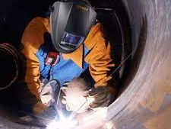
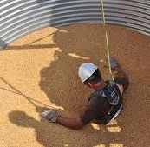
Risks of working in a confined space
Loss of consciousness, injury, or death from contaminants in the air
Injury or death from a fire or explosion
Suffocation from oxygen deficiency
Crushing or suffocation from falling into or becoming engulfed by a substance
Notes:
Toxic atmospheres, containing gases, vapours, dusts or fumes that have poisonous effects on the body. Cleaning, painting or welding may produce dangerous vapours and fumes.
Flammable or explosive atmospheres, containing flammable gases, vapours or dusts which could be ignited by a spark or open flame.
Oxygen-deficient atmospheres, which can cause unconsciousness, brain damage and death. Oxygen deficiency can be caused by rust, fire, absorption by grain or soils, consumption by bacteria, or displacement by another gas.
Engulfment – workers can be trapped or buried by bulk materials such as grain, sand, flour, fertiliser and sawdust.
In some cases, multiple fatalities occur when would-be rescuers enter the space and become victims themselves.

Slide 17
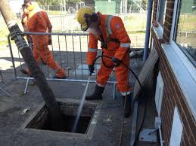
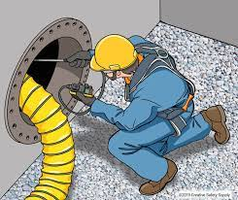
Planning to enter a confined space
Conduct a risk assessment and determine controls.
Can the work be done without entering the space?
Isolate contaminants and moving parts
Clean to remove harmful solids or sludges
Purge to remove harmful gases or vapours
Test the atmosphere
Ventilate the space
Use breathing apparatus if required
Use PPE
Work under an authorised Permit to Work
Use a stand-by person
Use trained and certified personnel
Notes:
Conduct a risk assessment for each confined space specific to the work scope.
When implementing controls, consider the hierarchy of controls. Controls can include:
Elimination – e.g. you might be able to clean a tank with a high-pressure hose through the hatch.
Isolation - prevent accidental introduction of materials (for example, steam, water or bulk materials, through piping, ducts, vents, etc). De-energise, lockout or tagout machinery.
Use a suitable cleaning method to remove harmful solids or sludges.
Purge with fresh air to remove harmful gases or vapours.
Atmospheric testing – Test the atmosphere for toxic or flammable contaminants. Use a suitable detector to determine whether the confined space contains a safe oxygen level for breathing.
Ventilate the confined space by using a blower designed for the purpose.
Breathing apparatus - If the space can’t be ventilated, or if the work will contaminate the atmosphere (for example, hot work, painting, sludge removal), use a suitable self-contained breathing apparatus or supplied-air respirator
PPE provides protection for workers when all other control measures can’t eliminate or minimise the risk, e.g. safety helmet, gloves, hearing protectors, safety harness, lifeline.
Permit to Work - The PCBU or person responsible for the work should issue a written authority – or confined space entry permit – as described in the Standard. Essentially, this permit is a safety checklist to make sure nothing is overlooked
Stand-by person - Have a trained stand-by person to monitor the safety of the person working inside the confined space and to take action if an emergency arises

Slide 18
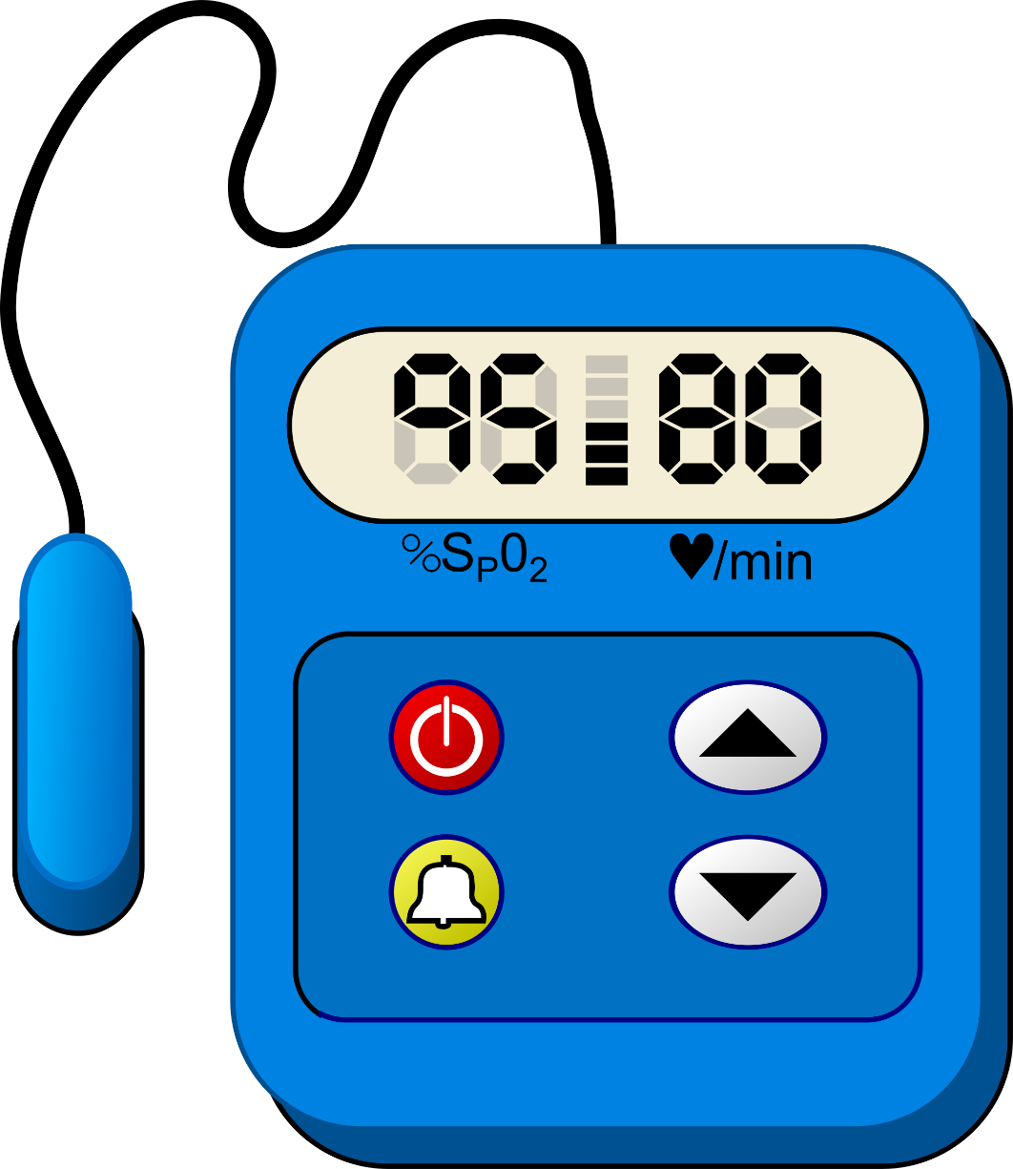
Atmospheric test confirmation
Authorised persons must confirm these atmospheric tests: »
Atmospheric testing is completed prior to entry. »
Repeat or continuous monitoring requirements are met and documented. »
Test equipment must be calibrated and certified

Slide 19
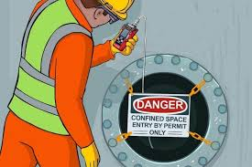
Trained and certified personnel
These personnel must be trained and certified:
Supervisors/persons planning a confined space entry
Persons entering the space
Stand-by persons
Persons conducting atmospheric testing
Persons using breathing apparatus
Rescue and First Aid personnel
Permit issuers and permit holders
Notes:
Common NZQA unit standard requirements:
Supervisors/Confined space planners – 17599 Plan a Confined Space Entry, 18426 Hazards of a Confined Space
Confined space entrants –18426 Hazards of a Confined Space
Stand by persons – 17596 Safety Observer, 18426 Hazards of a Confined Space
Atmospheric testing – 3058 Gas Testing, 25510 Operate an atmospheric testing device
Breathing apparatus user – 3272 Self Contained Breathing Apparatus
Rescue personnel – 14562 Specialist Rescue Confined Spaces
Personnel should also be trained in their work tasks within the space and the use of PPE (e.g. respiratory equipment).

Slide 20
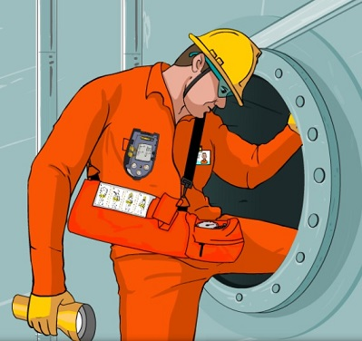
Prior to entering a confined space
Hold a thorough toolbox talk
Verify energy systems are isolated and de-energised
Identify any new hazards, e.g. nearby exhaust fumes
Check controls are in place
Conduct atmospheric testing
Establish positive communication
If conditions change, evacuate the space
Notes:
Hold a thorough toolbox talk with all personnel involved, including entrants, stand by persons, supervisors, rescue personnel. Review JSAs, permits, checklists. Discuss all controls, methods of communication, and the emergency response plan.
Verify energy systems are isolated and de-engergised – ensure lock out tag out has been applied and hot works have been eliminated where possible.
Identify new hazards – consider wind direction and anything that could contaminate the space, e.g. a nearby generator, consider all simultaneous operations.
Check controls are in place – test ventilation, lighting, check emergency response equipment, etc.
Establish positive communication - A positive communication system must always be established between people inside and the stand-by person/s.

Slide 21
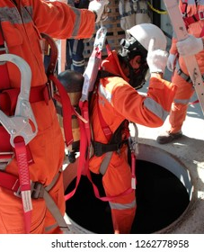
Emergency Rescue Requirements
Have an emergency recovery plan
Rescue equipment must be available and checked before work starts.
Check access points are large enough to enter and exit and allow rescue.
Test the rescue plan to ensure it is effective.
A stand-by person must be placed at the access point whenever a person is inside the space.
Emergency recovery plan must be in place.
Notes:
Emergency recovery plan:
An emergency recovery plan must be developed to adequately respond to the potential emergencies specific to the confined space.
The emergency recovery plan must be communicated to the relevant site personnel.
Rescue equipment
This must be inspected prior to use and tested according to the manufacturers requirements.
Immediate access to equipment must be planned before entering the space.
Equipment may include:
Gas detectors
Torches
Tripod and winch
Stretcher
Safety harness
Rescue lines
Breathing apparatus

Slide 22
Further information
Australian Standard 2865: Confined Spaces sets out requirements for confined space work
https://www.worksafe.govt.nz/topic-and-industry/planning-entry-and-working-safely-in-a-confined-space

