Slide 1


Drugs & Alcohol
Impairment

Slide 2

Impairment
Evidence between drug levels and impairment is sparse.
On top of that, effects of drugs, including alcohol, vary from person-to-person.

Slide 3

Factors that may affect drug levels and impairment include:
Amount of drug consumed
Time over which drug was consumed (e.g. how many alcoholic drinks were consumed across a fixed time period)
Use of other drugs and medication
General mood
Body fat percentage and weight
General health
Tolerance to drugs and alcohol

Slide 4
Other Factors that can cause impairment
fatigue
prescribed medications
pre-existing health conditions
heat
noise
work-related stress.
It is important to ensure the health and safety of the worker and those around them.

Slide 5

Absence of Drugs or Alcohol
Absence of drugs or alcohol does not mean there is no impairment.
The simplest example of this is a hangover, where perception, behaviour and reflexes are altered – even if the person blows 0.000% blood alcohol concentration.
This Photo by Unknown Author is licensed under CC BY-SA

Slide 6

What to do?
If a worker appears impaired, ensure they are out of harms way and that they do not pose a risk to others.
Determining reason for impairment should occur after the worker is safe.

Slide 7
Identifying factors of impairment
    Slurred speech,
    Unusual or varied moods,
    Coordination issues, reaction times, sensory perception
    Presence of key odours,
    Erratic behaviour, personality changes
    Frequent absenteeism or lateness – especially if it is out of character,
    Physical signs – dilated pupils, bloodshot eyes, lethargy,
    Irritability,
    Impaired judgment, perception and decision making

Slide 8
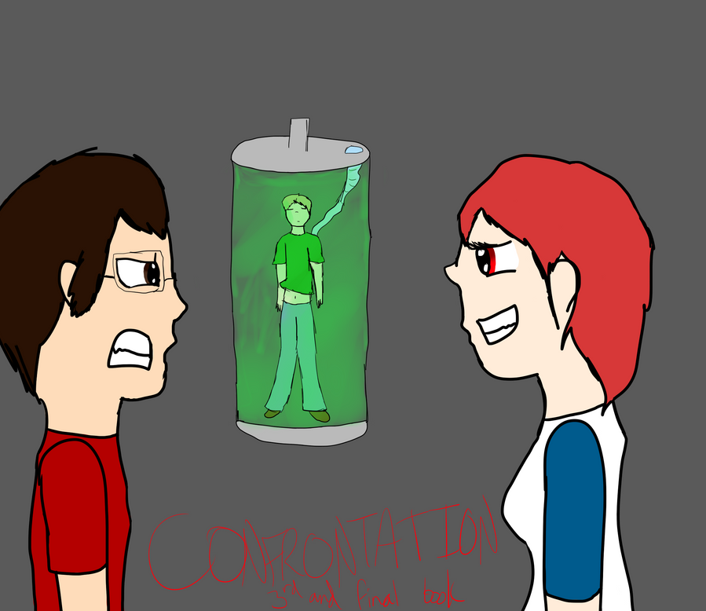
Training for designated staff members to approach possibly impaired workers is an important strategy to have within a workplace.
Making accusations of possible causes for impairment of the worker should be avoided.
tread carefully, as there may be legitimate reasons for symptoms suggesting substance abuse (e.g., red eyes or lethargic response)

Slide 9
approach methods

Slide 10
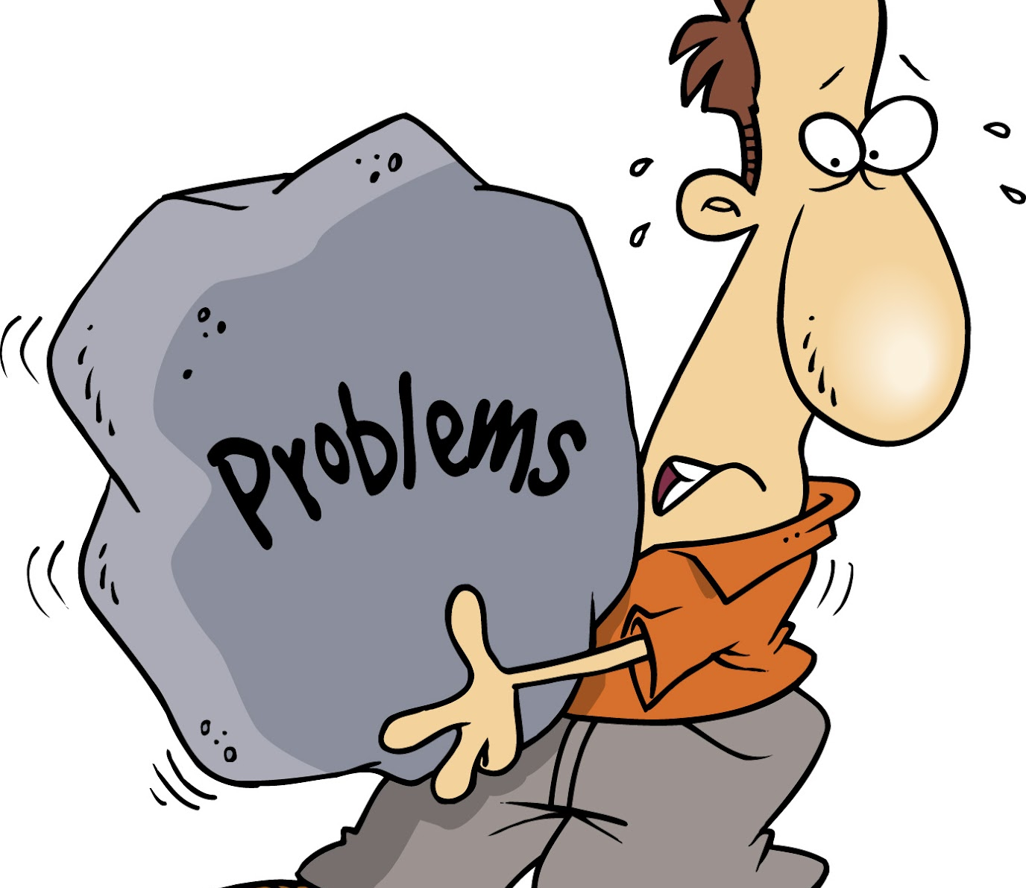
Employee coming forward of their own volition
In the absence of misconduct, supervisors should not “agree” with the employee that he or she has a problem, as again, supervisors are not chemical dependency specialists

Slide 11

Offer Support
Provide information for an employer’s Employee Assistance Program
Ensure awareness of the Rehabilitation programme if available
Supply information regarding available leave
Provide information for any support groups in locality
Get help to initiate a structured process for your work colleague to be able to get back to work

Slide 12
Drug & Alcohol Policy
A robust policy will ensure that staff have good guidance and support around procedures that also includes probable and reasonable cause factors to ensure that testing can take place.
The below link on our website may give you help with your Drug & Alcohol policy
https://besafe.nz/drug-alcohol-protocols/

