Slide 1



The Process of Design

Slide 2

What is Process of Design?
Process in Design is regarded as creative problem solving ( Koberg, 1981) through a series of steps or a sequence of activities, which lead from initial concept to realization.
Notes:
Reference: www.sciencedirect.com/topics/engineering/design-process

Slide 3


How does it evolve?
Define the problem
Conduct research
Brainstorm and conceptualize
Create a prototype
Build and market your product
Product analysis
Improve

Slide 4
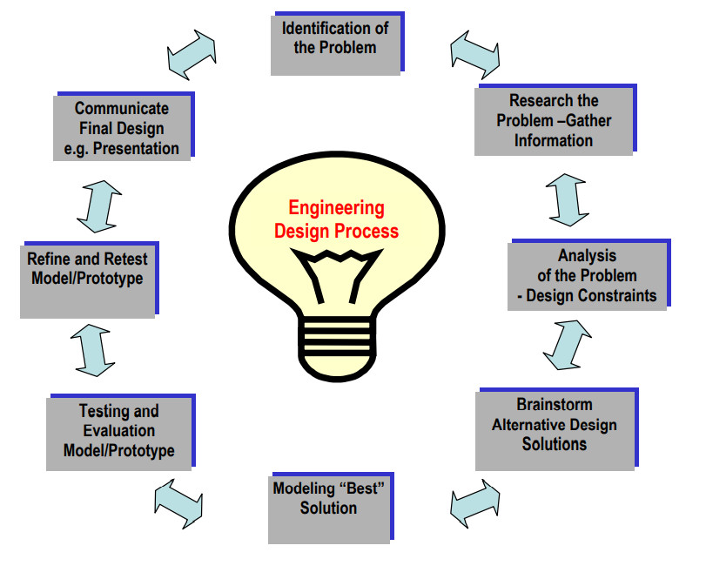

Slide 5
Define the Problem
Who, what, where, and why?
Who is experiencing the problem?
What is the problem? Where does the problem present itself?
Why does it matter?
Notes:
Who is experiencing the problem? In other words, who is your target user; who will be the focus of your problem statement?
What is the problem? Based on the observations you made during the empathize phase, what are the problems and pain-points that frequently came up? What task is the user trying to accomplish, and what’s standing in their way?
Where does the problem present itself? In what space (physical or digital), situation or context is the user when they face this problem? Are there any other people involved?
Why does it matter? Why is it important that this problem be solved? What value would a solution

Slide 6

Conduct Research
Brainstorm and Conceptualize
.
Having an array of people communicating about and working on a project can ensure the team avoids any negative outcomes.
When team members are working together, they can plan for, identify and resolve any potential challenges together. This can allow them to create satisfactory products or outcomes

Slide 7
The Process of Design
– A critical aspect to Health & Safety
Decision-makers in your organisation, as well as designers must understand the crucial link between health and safety and good design.
While designers have a legal obligation to design safety into a workplace, it is also your responsibility to provide the designer with sufficient information so they can understand your needs and incorporate the safety features you need in your project.

Slide 8

WorkSafe NZ
https://besafe.nz/health-safety-by-design

Slide 9
https://www.youtube.com/watch?v=Gbxg4ZjfDY8
Demystifying Health & Safety in Design

Slide 10




Thank you
If you have any questions, don’t hesitate to reach out to us.
How to contact us:
www.besafe.nz
besafe@besafe.org.nz
lois@besafe.org.nz
021 1984 897

Slide 11


Brought to you by:

