Slide 1
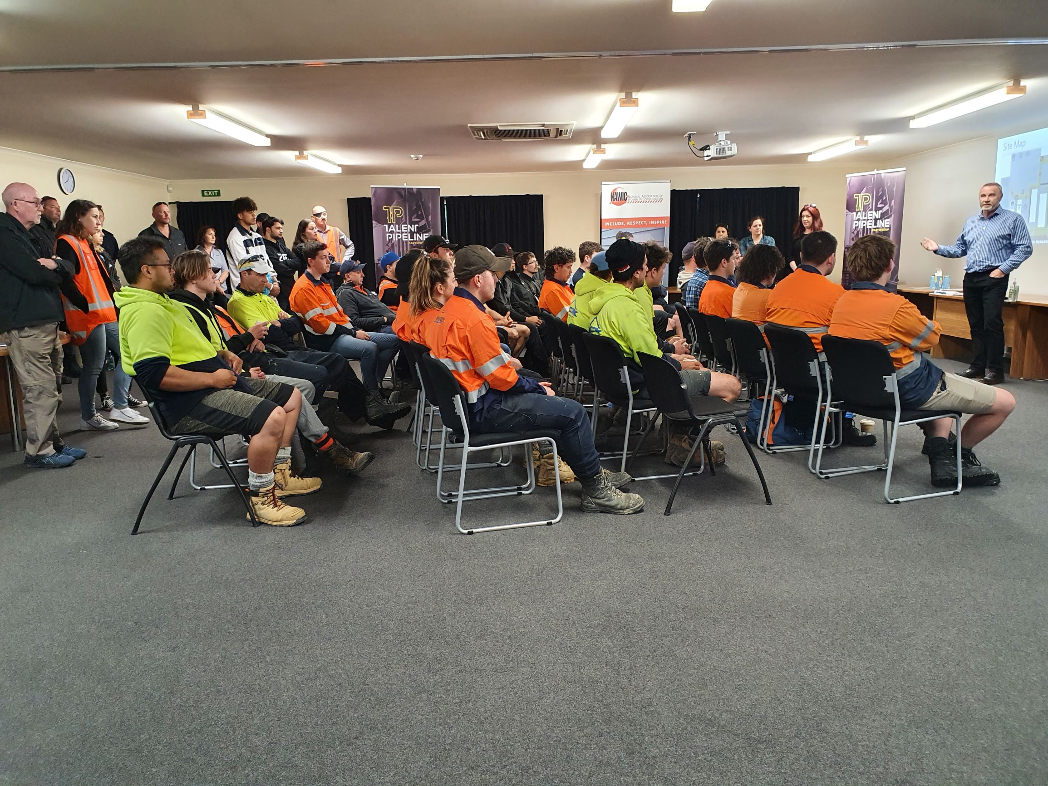

JSA & TOOLBOX SESSIONS
Best Practice

Slide 2
JOB SAFETY ANALYSIS
A safety tool that can be used to define and control hazards associated with a certain process, job, or procedure.
JSA – BEST PRACTICE
A Teams based Risk Assessment Tool
Notes:
It is a systematic examination and documentation of every task within each job to identify health and safety hazards, and the steps to control each task.
.

Slide 3

Creating an Effective Tool
Establish the Context/Triggers for a JSA – is this an appropriate tool for this work
Ensure people are trained on how to fill out and put in place an effective JSA
An effective JSA breaks the activity down into key steps for hazard assessment
Identify controls for each risk including qualifications/training of team members
Relevant – Updated in real time
Do a Site Walk Around – to ensure team members understand the job at hand

Slide 4

JSA Is a Live /Working Document
Move away from preformatted JSA forms with emphasis on “blank sheet” to better capture management of change.
Focus not on the known written standard input to JSA, but what has changed, what do you feel about the task
Need to get people involved and actively thinking about the tasks and risks.
Look for “tell tale” signs before work starts
A good JSA is not a tick box exercise, ensure good engagement
of team members involved & they ALL understand the JSA.

Slide 5

Finally………
Remember - new workers to the site need to be signed onto the JSA
Leave enough room for signatures.
Ensure team members sign only when they understand the JSA.
If the JSA is generic, make sure any non inclusive activities are scratched or any names are deleted.
Seek engagement and feedback from all team members
Make sure your JSA is reviewed by Management for quality purposes

Slide 6
The basic idea of a toolbox meeting (also known as a toolbox talk) is to conduct a meeting for discussing safety topics related to a particular job or project, such as safe work practices and worksite risks.
TOOLBOX SESSIONS – BEST PRACTICE

Slide 7

An Effective Tool-Box Session
Communication is interactive and engaging
Present the toolbox for the audience
Person leading is trained and competent and heading up the job.
Involve key stakeholders
Option to have ad hoc/additional toolbox talks. e.g. Where any significant changes take place
TOOLBOX SESSIONS – BEST PRACTICE

Slide 8
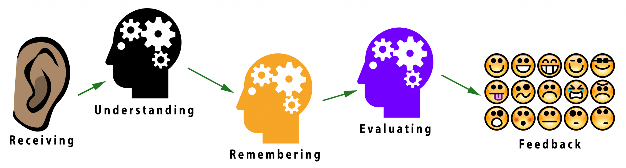
Team Members understand their roles
Discuss and ensure you have the correct tools/resources for the job.
Keep the questions open ended to encourage participation –
How are we going to do it?
What can go wrong?
How are you going to prevent it from going wrong?
Have subject matter experts (SME) on hand for safety expertise/discussion.
Reference any JSA/SOP’s available

Slide 9

Understanding & Communication
The toolbox is a good place to ensure personnel know their role and understand what is going on
Invite other contractors/workers where there is multiple works happening
Workers not required for the task at hand need to be informed/advised – risk of interference
Keep an eye on any team member who is having little input, ask questions in relation to their understanding of the task ( do this gently so not to undermine confidence)
An effective Tool box meeting should be sharp & to the point with verbalized questions to personnel undertaking the task

Slide 10
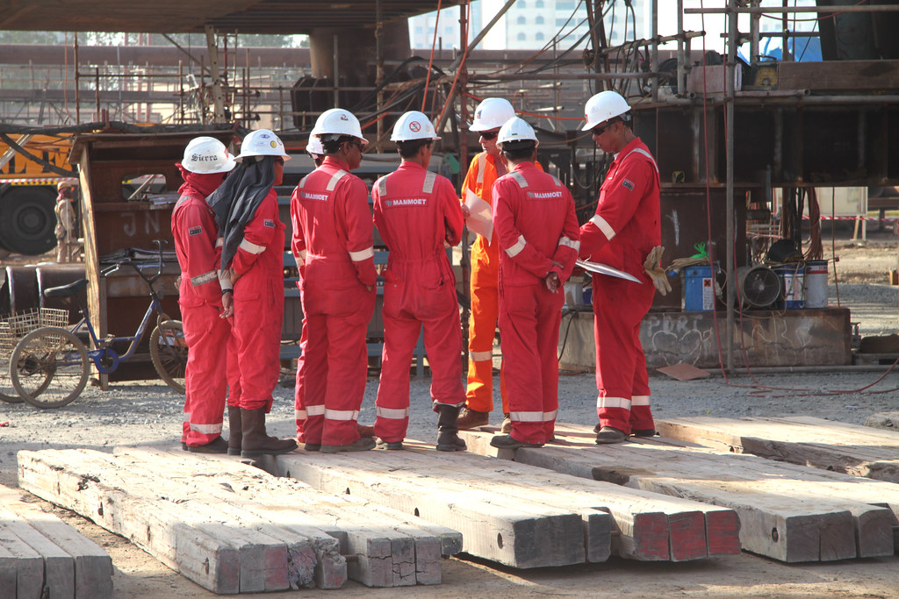
Give ownership to the workers – keep accountability
Keep toolboxes talks intimate – its their toolbox
Make sure there is fear-free feedback
Keep the talk relevant
Allow opportunities for questions around safety concerns and seeking clarification
End Tool Box talk on positive note
Ensure the meeting form is signed by those on the job

Slide 11




Thank you
If you have any questions, don’t hesitate to reach out to us.
How to contact us:
www.besafe.nz
besafe@besafe.org.nz
021 1984 897

