Slide 1
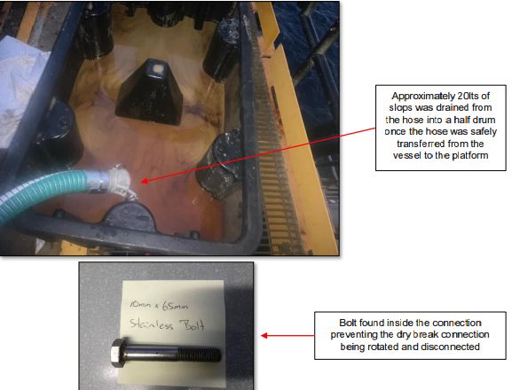
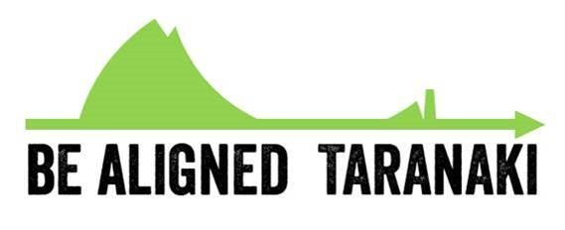
Near Miss – Dry break coupling would not release
DATE:
SHARED LEARNING: INCIDENT INVESTIGATION OUTCOME
Use this area to insert pictures, drawings and other illustrations
Activity:
Incident Description:
After transferring slops from a supply vessel, the dry break coupling would not release. The coupling would only turn half of the required amount to be able to disconnect. The problem was a bolt found inside the dry break connection which prevented it from being rotated and disconnected
Potential Outcome:
This incident had the potential to cause serious injury
Lessons Learned:
Excellent communication between the vessel and platform crews.  Great call to stop the job when things did not go according to plan, agree a plan and reassess the potential hazards and risks.  Good understanding of potential risks, and controls effectively implemented
If something changes stop the job, step-back 5x5 and reassess the task.  Ensure clear communication methods are in place and are effective.  If in doubt, ASK.
Causes (Immediate, Root Causes):
The fitting could have been damaged during disconnection, and slops could have spilled to deck.  The job was stopped, and a plan was agreed between the vessel and platform crews to fix the issue:  The male fitting on the vessel manifold was removed, the end of the hose was sealed to prevent dripping, and the entire package was transferred to the platform to resolve.  On the platform, the end of the hose was lowered into a half drum and the remaining hose was laid out on the walkway to minimise the potential head of fluid in the hose.  The plastic bag and end cap were removed and approximately 20 litres of slops drained into the half drum without any loss of containment

