Slide 1





Slide 2

Men’s Health is not just about prostate or testicular cancer
These are two unique health concerns to men with over half of Health Research Council funding allocated to projects concentrating on these 2 types of cancer.
Prostate and testicular cancer combined, account for just 4.4% of all annual male deaths
Notes:
NZ Medical Journal

Slide 3
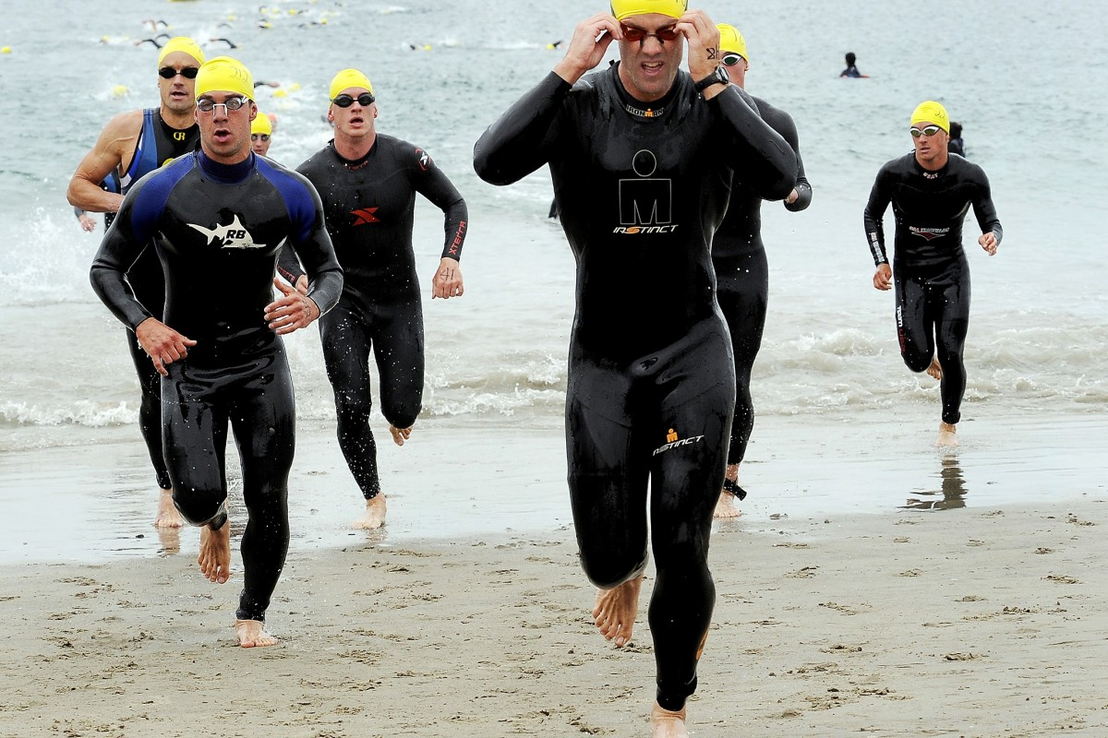
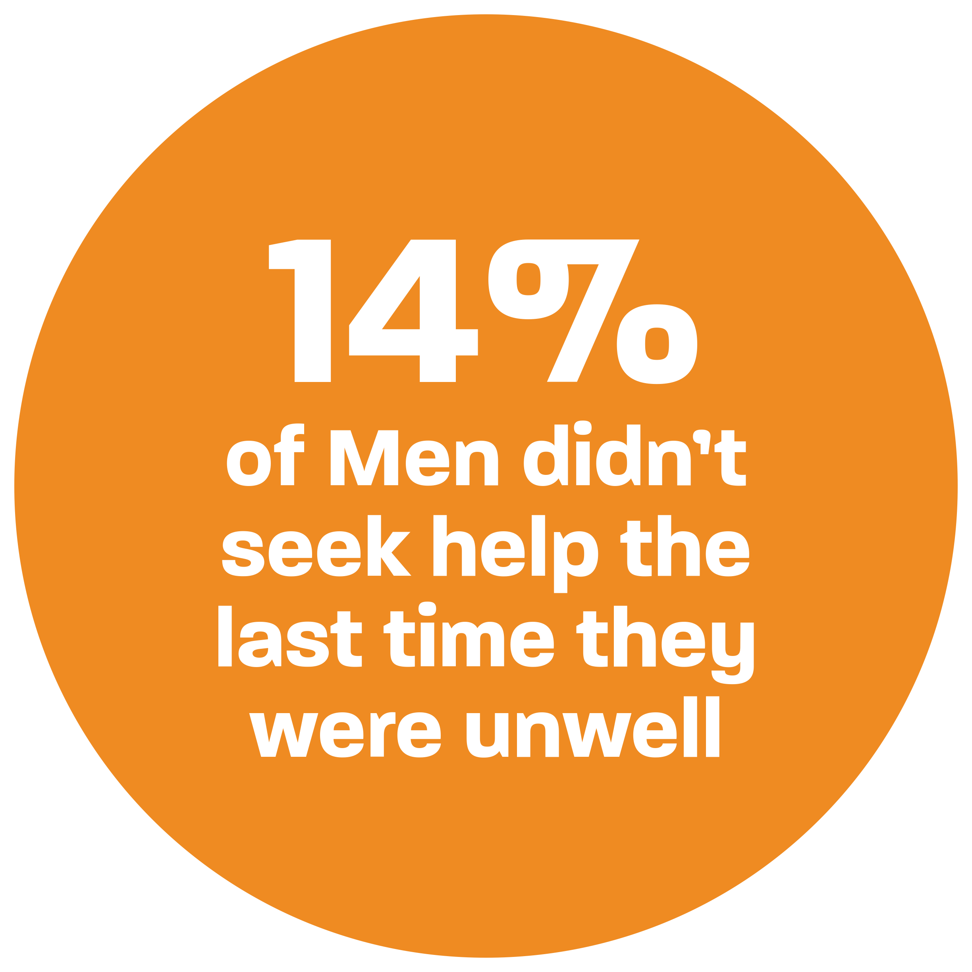
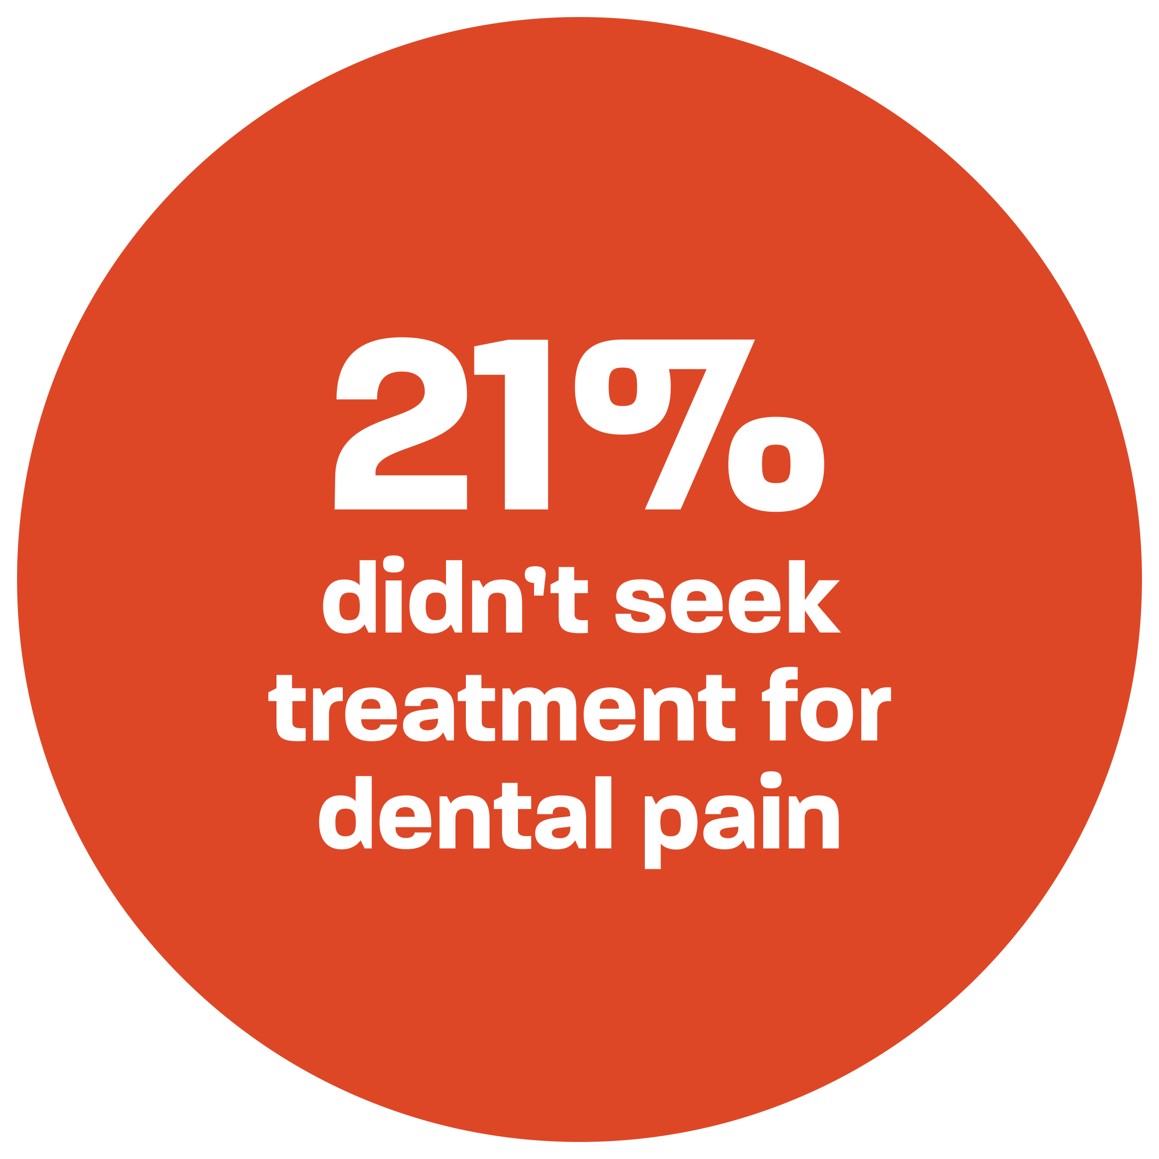
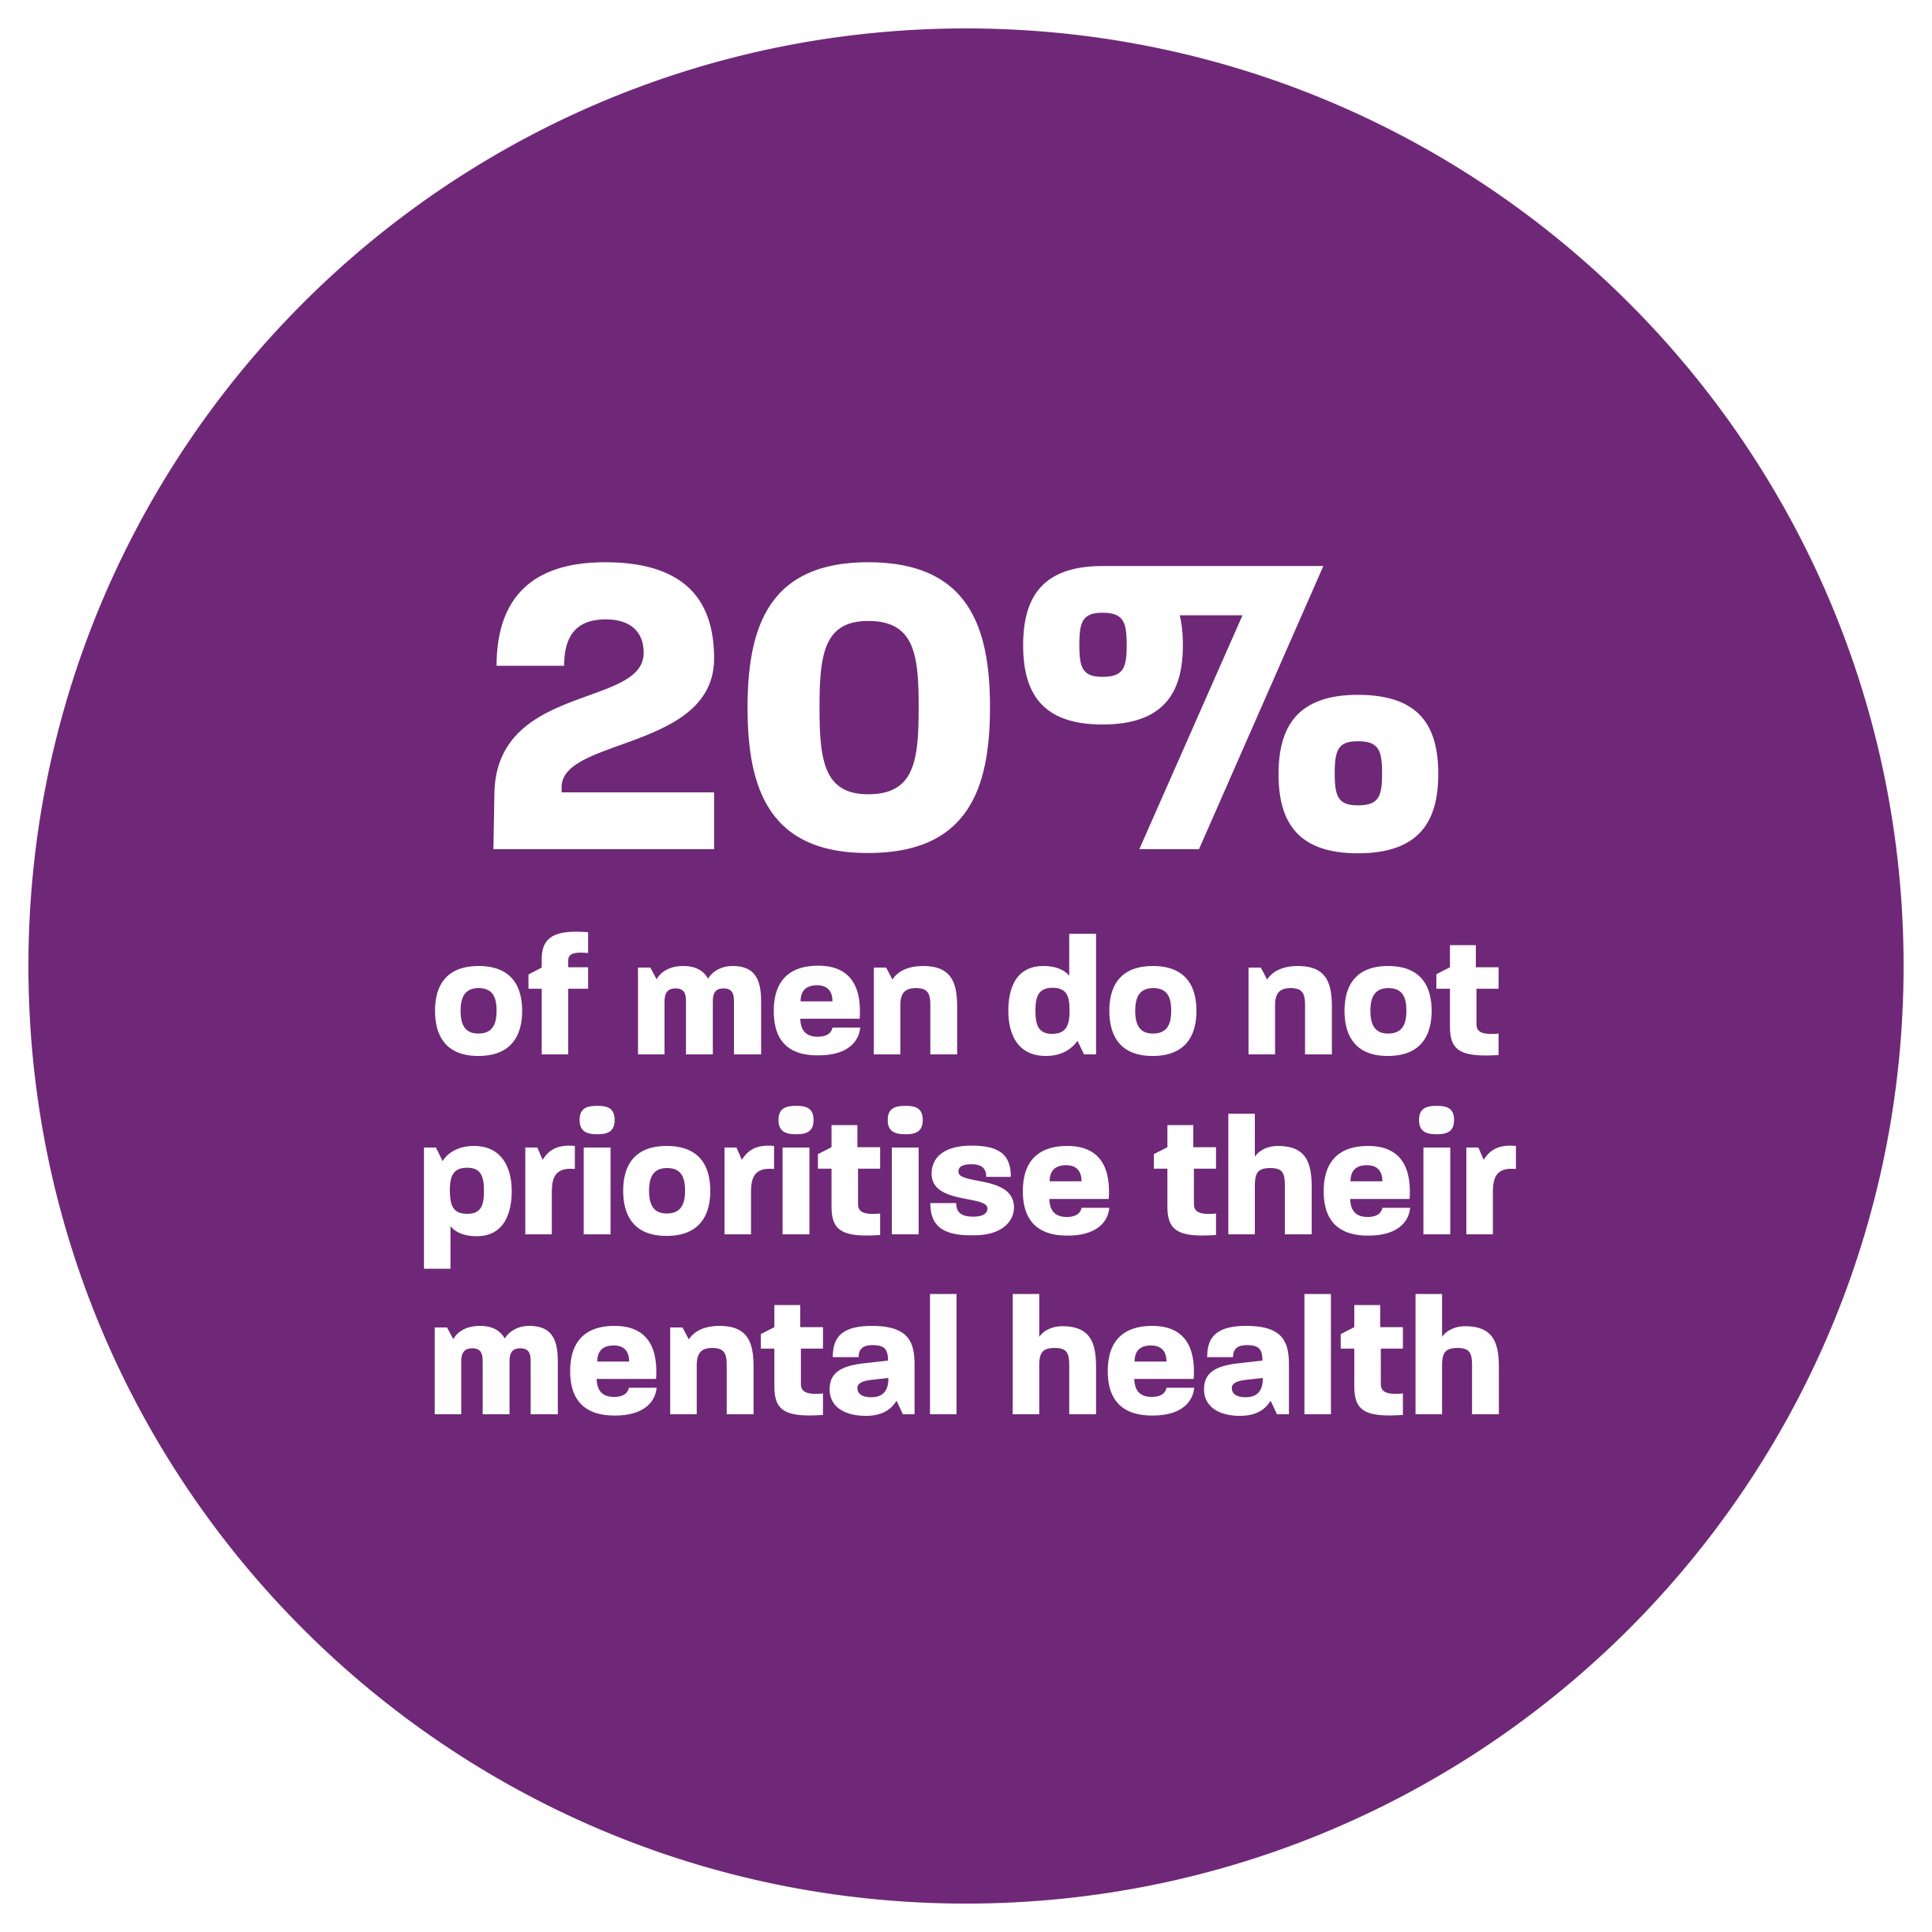
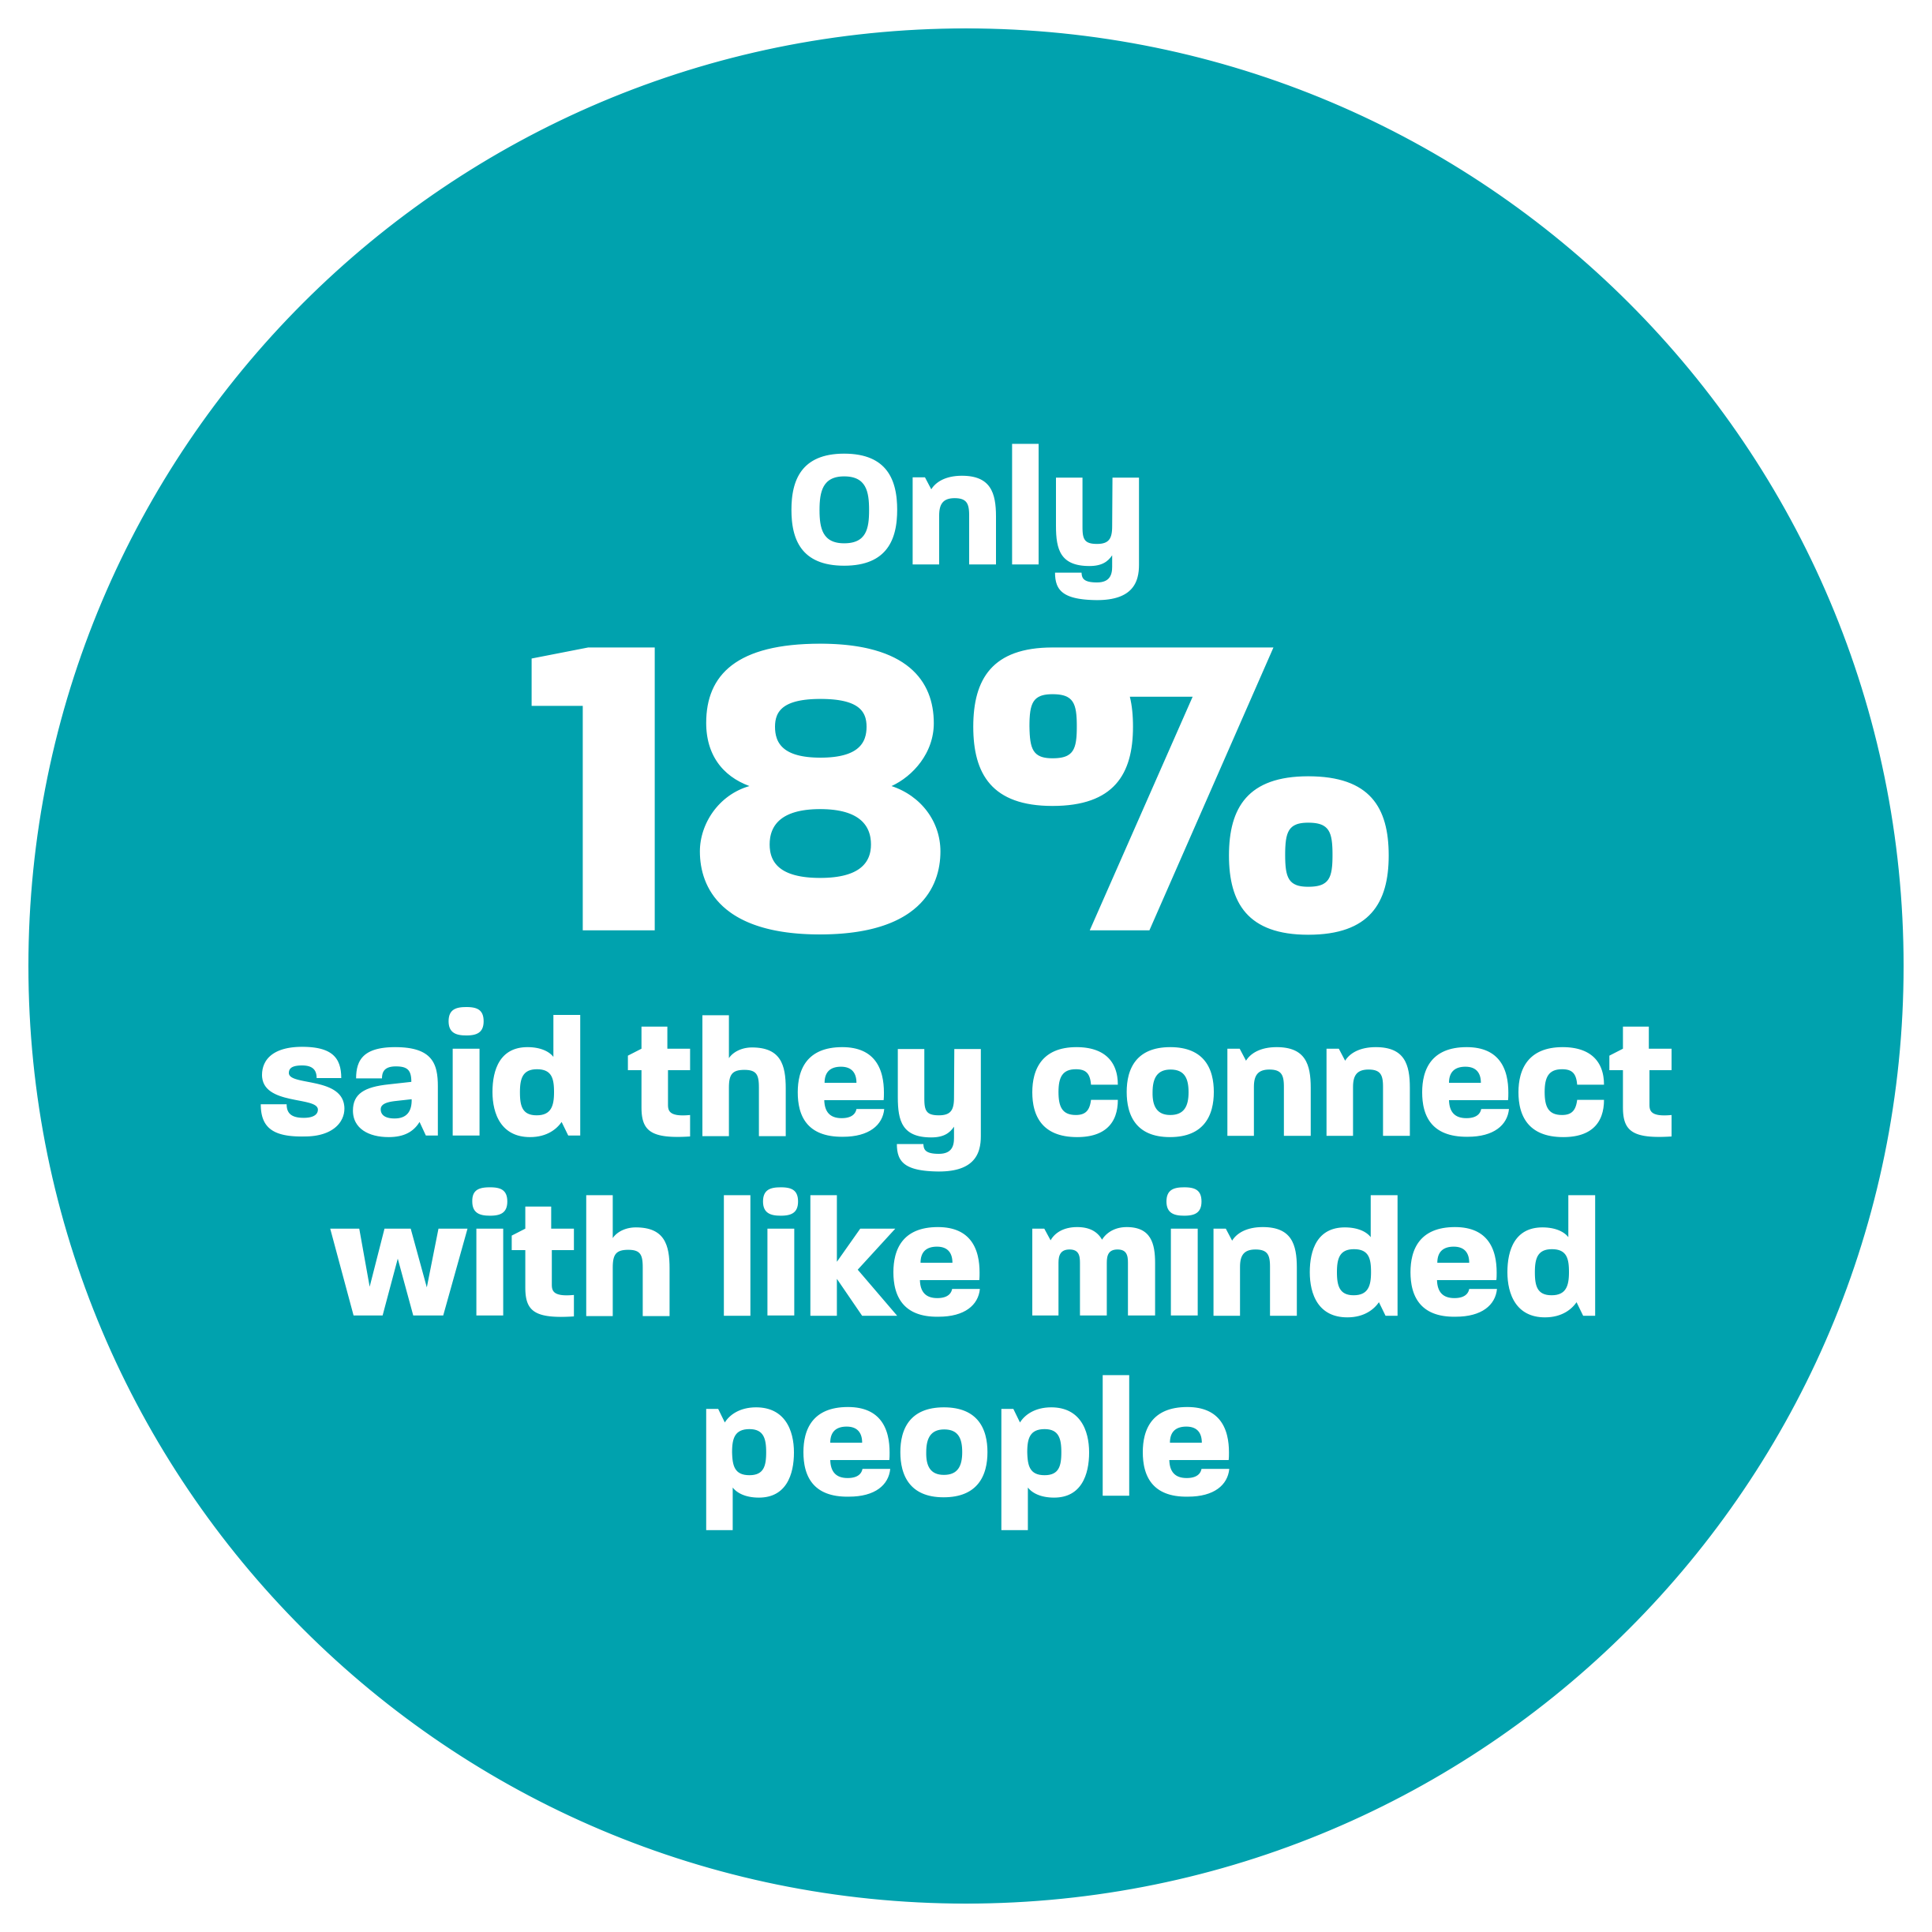
The “Grin and Bear it” Attitude… is alive and well
Notes:
Media Release - Southern Cross 28 September 2022

Slide 4

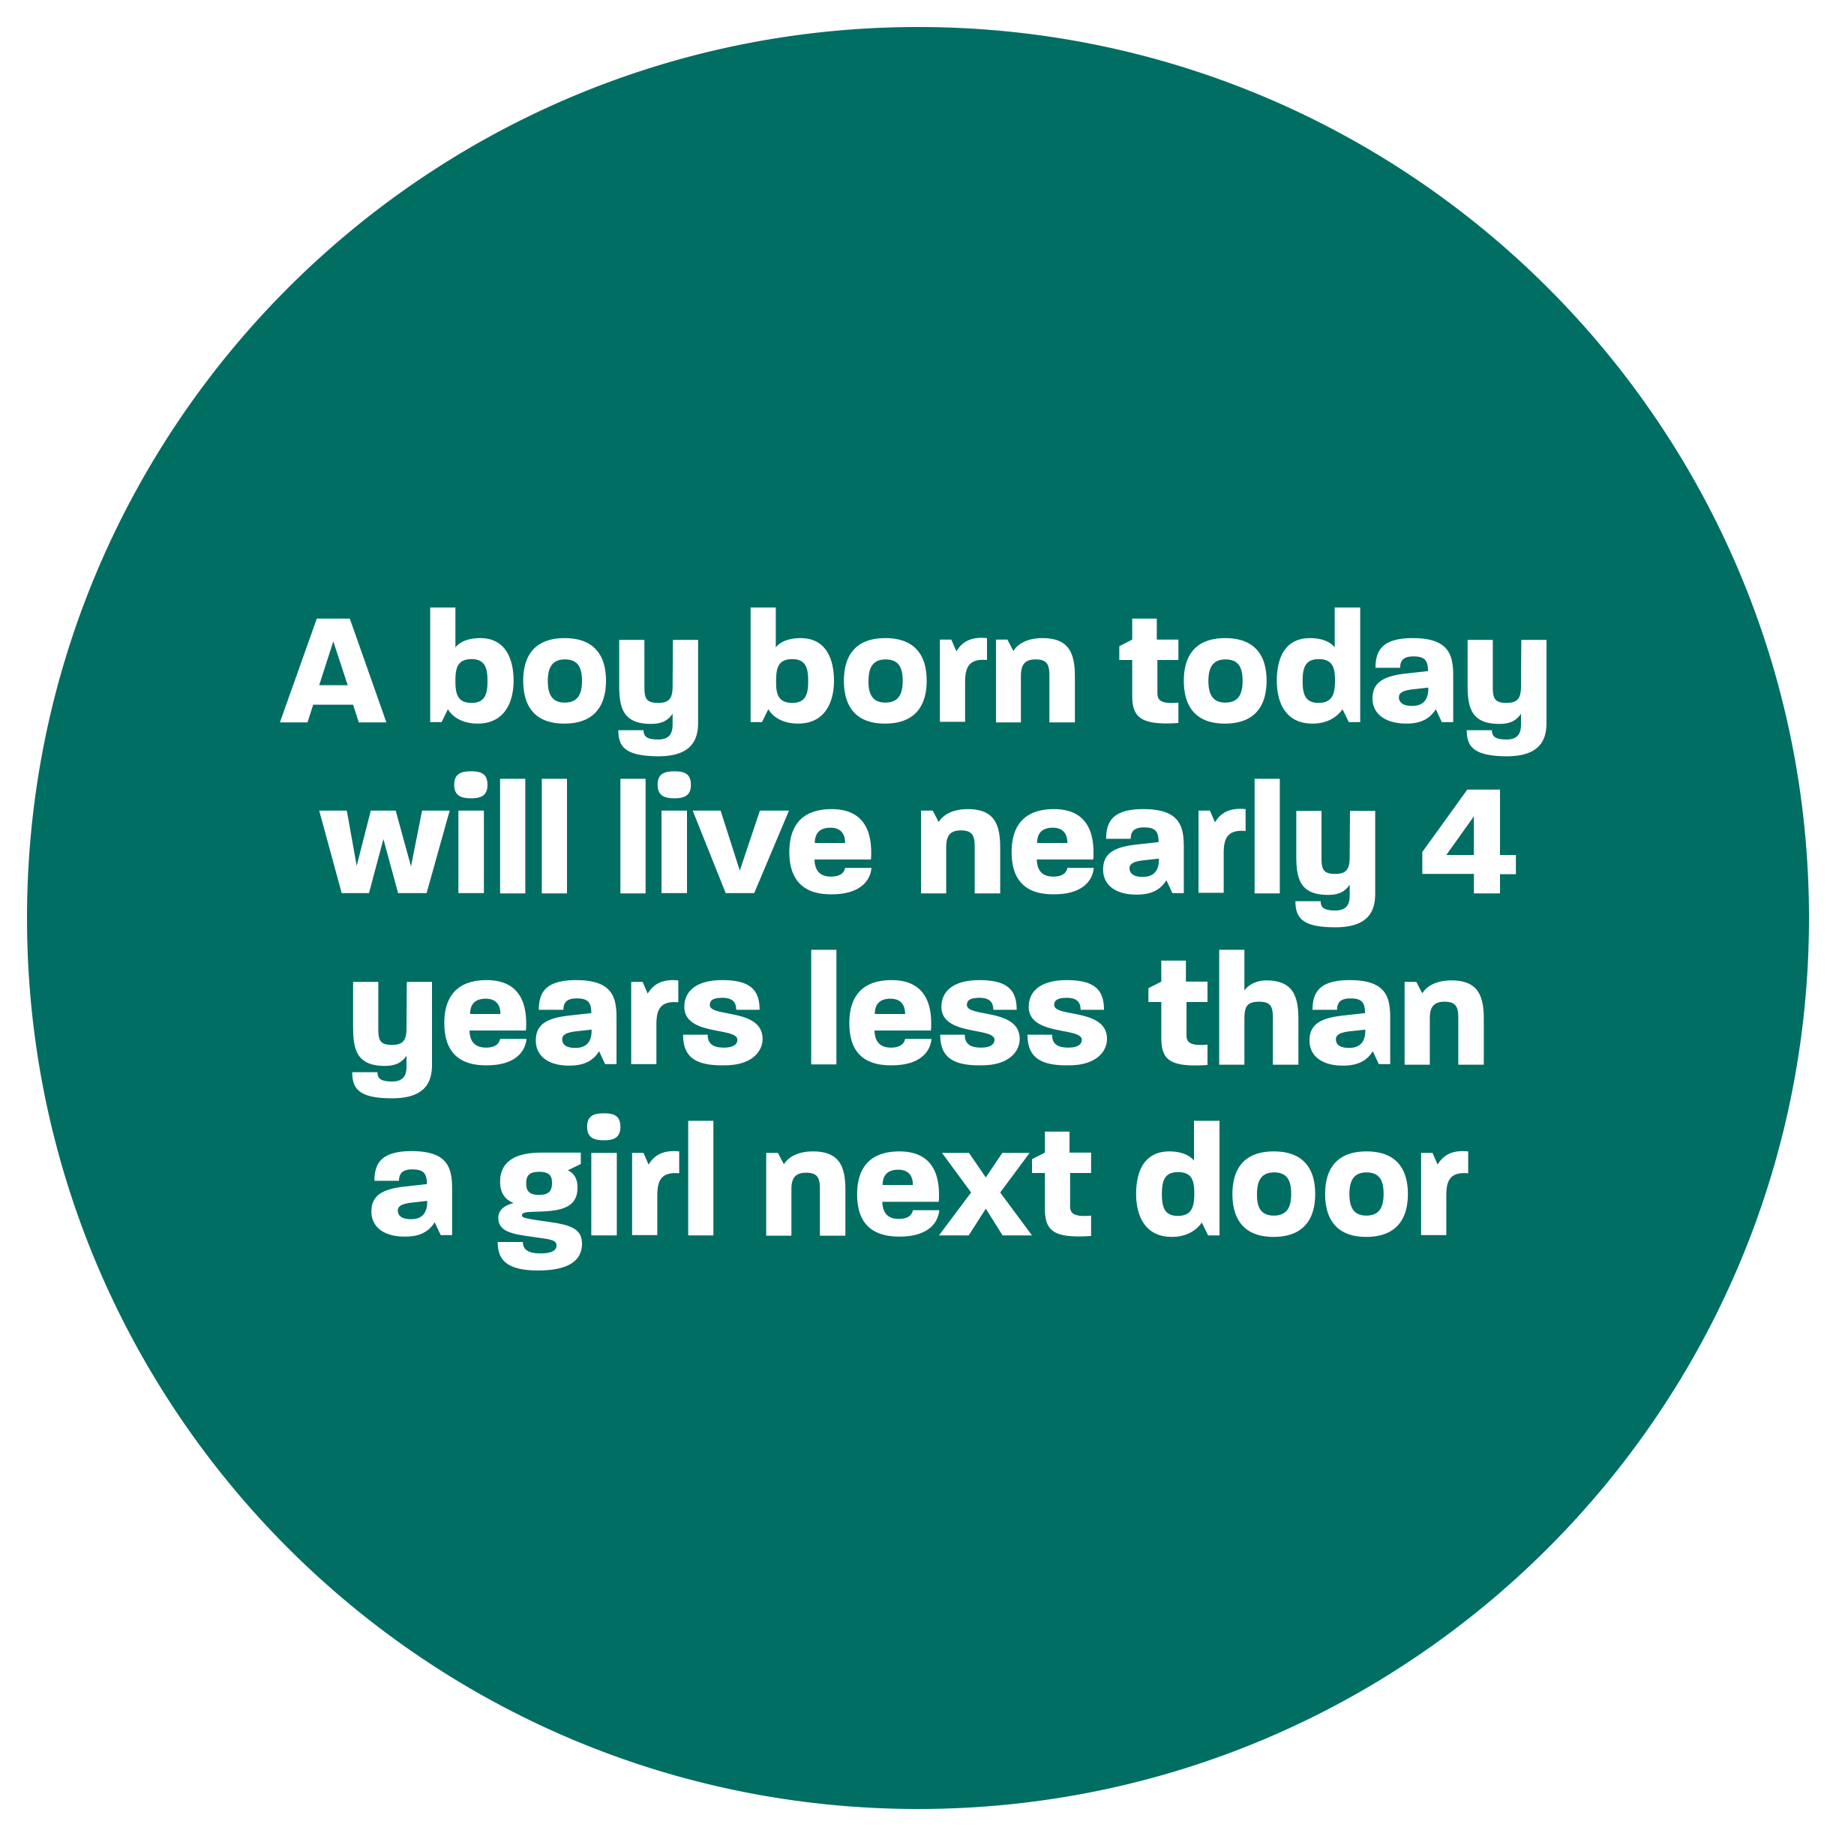
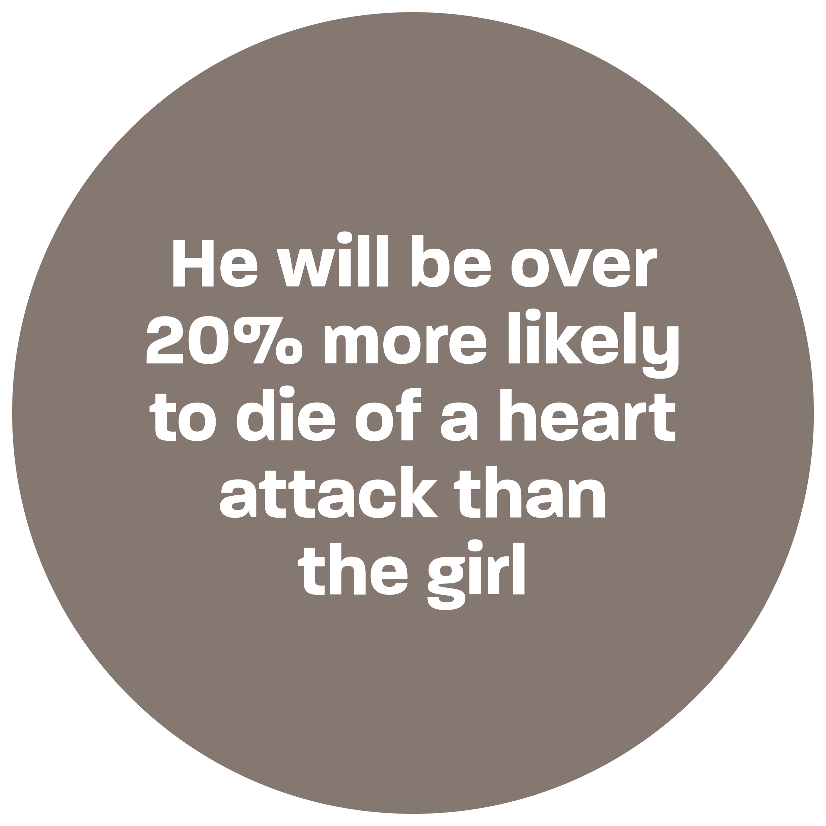
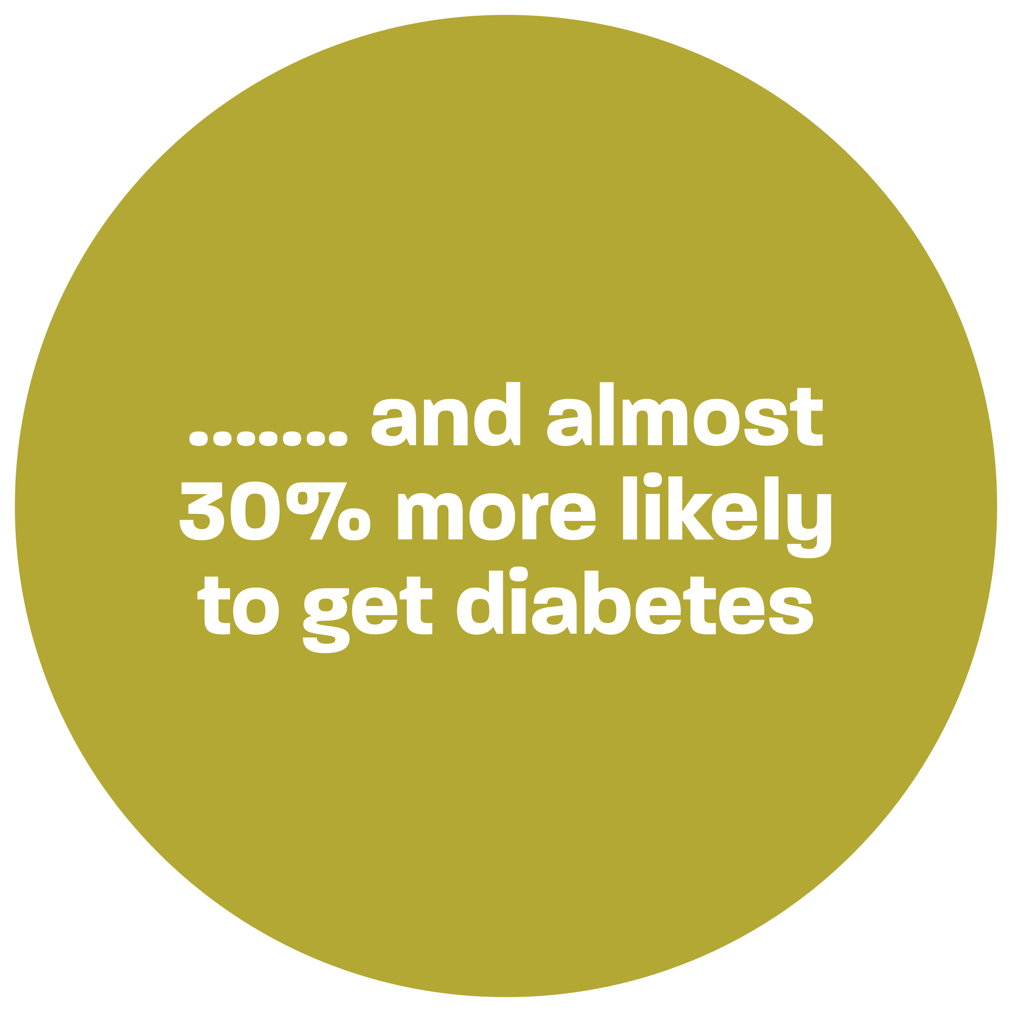
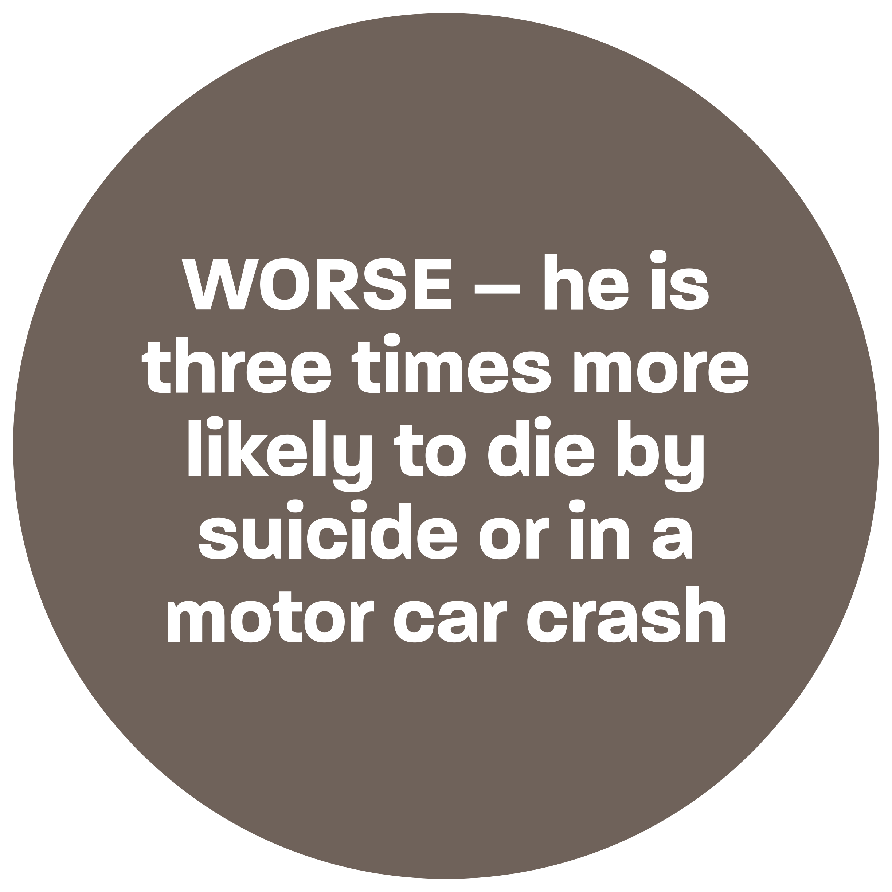
Men are on the backfoot from the start…
Notes:
Media Release - Southern Cross 28 September 2022

Slide 5
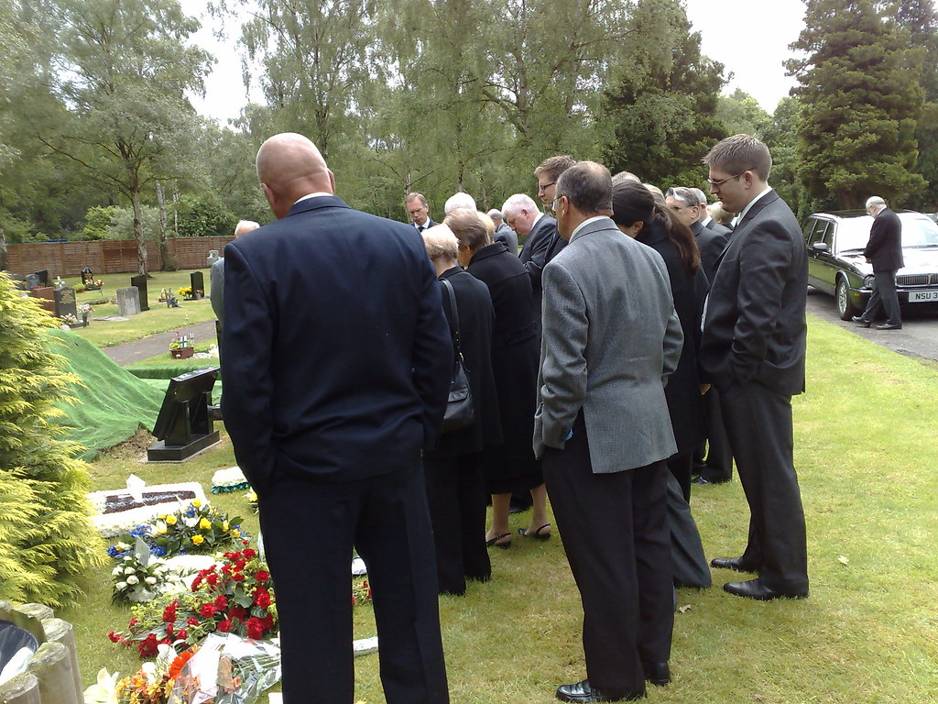
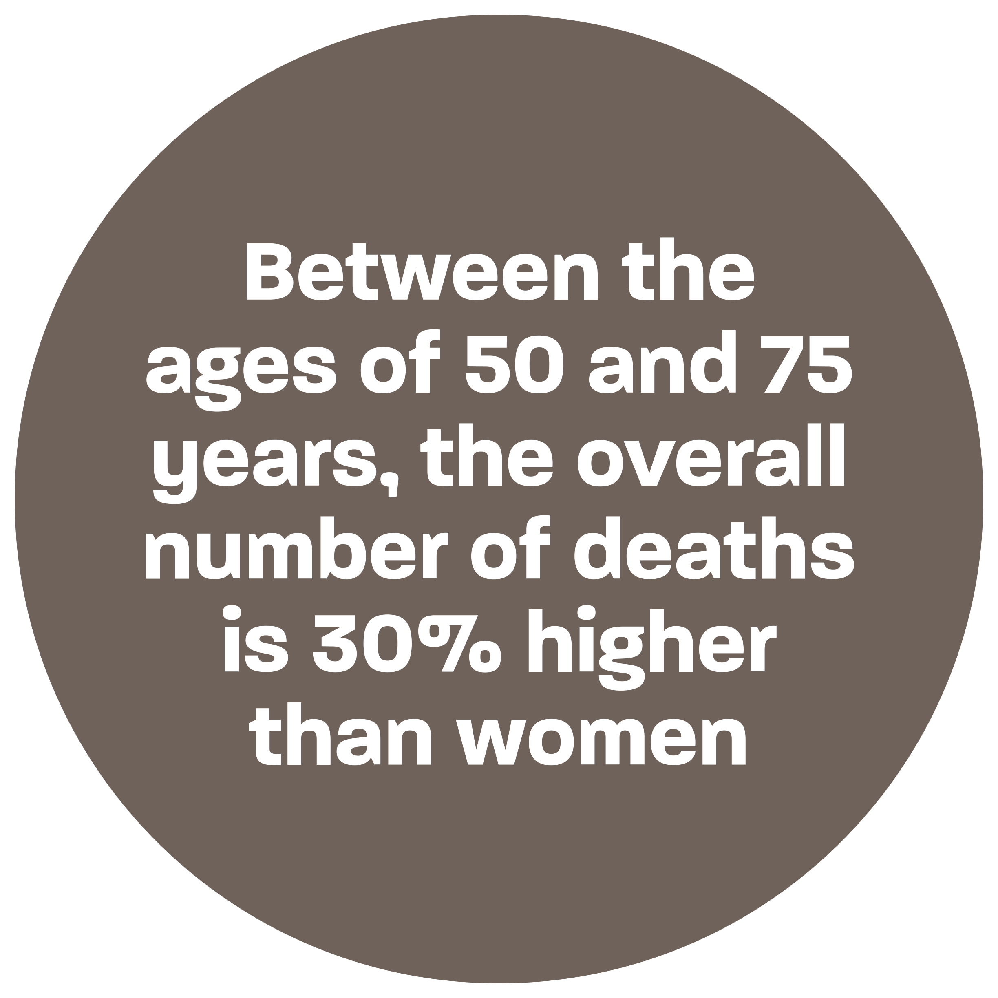
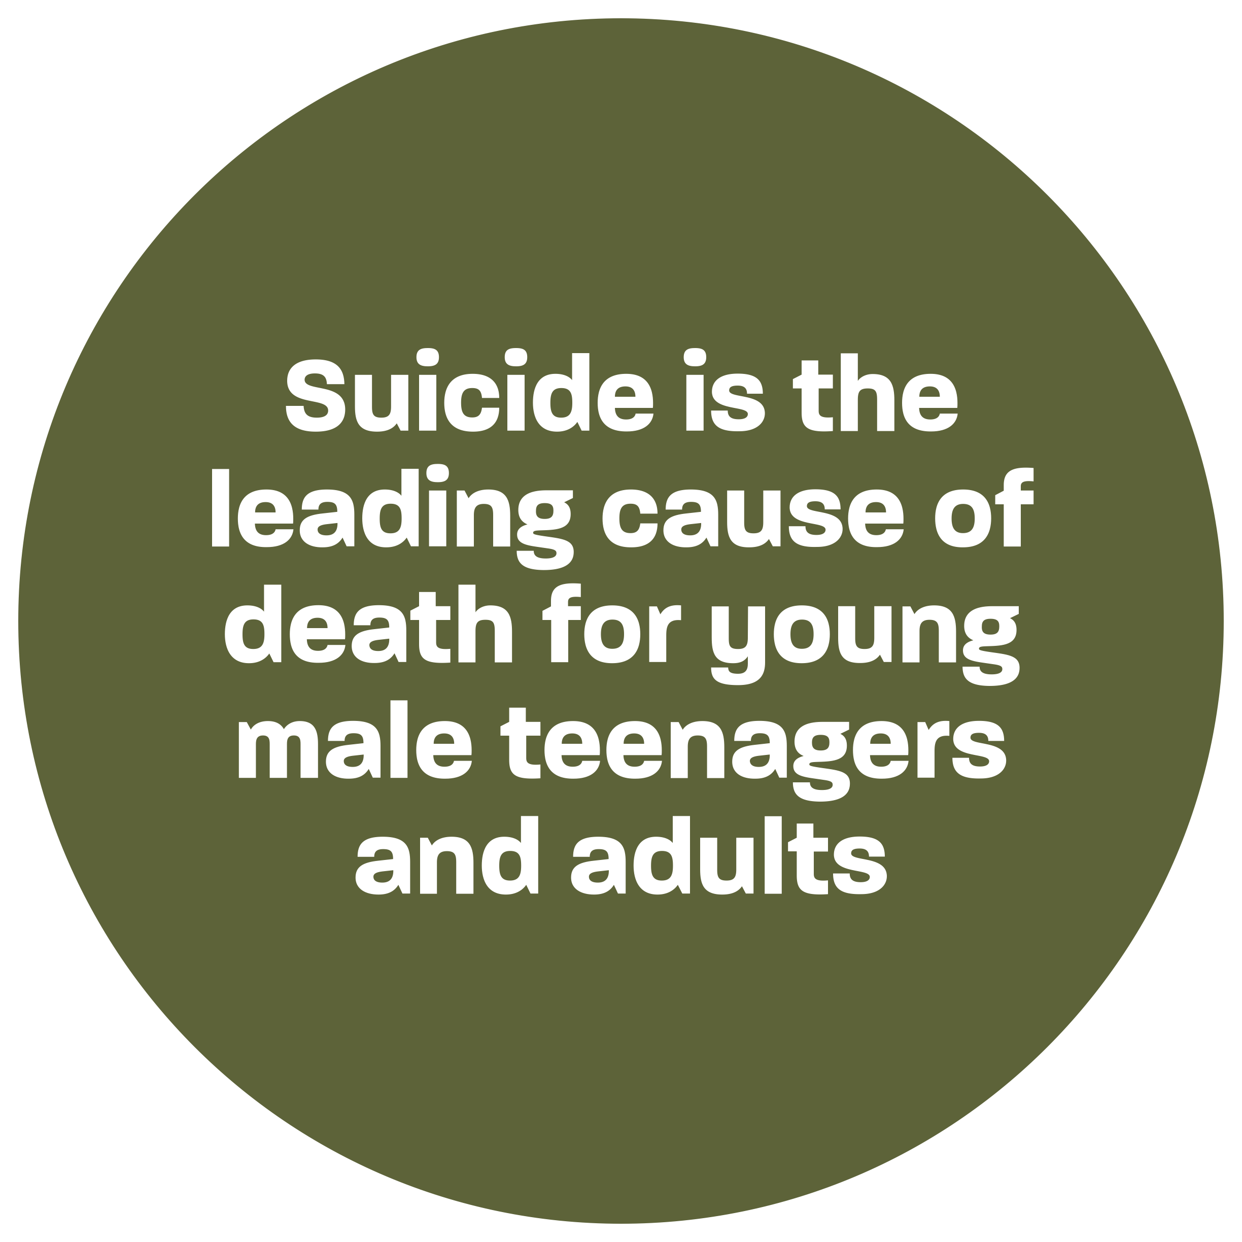
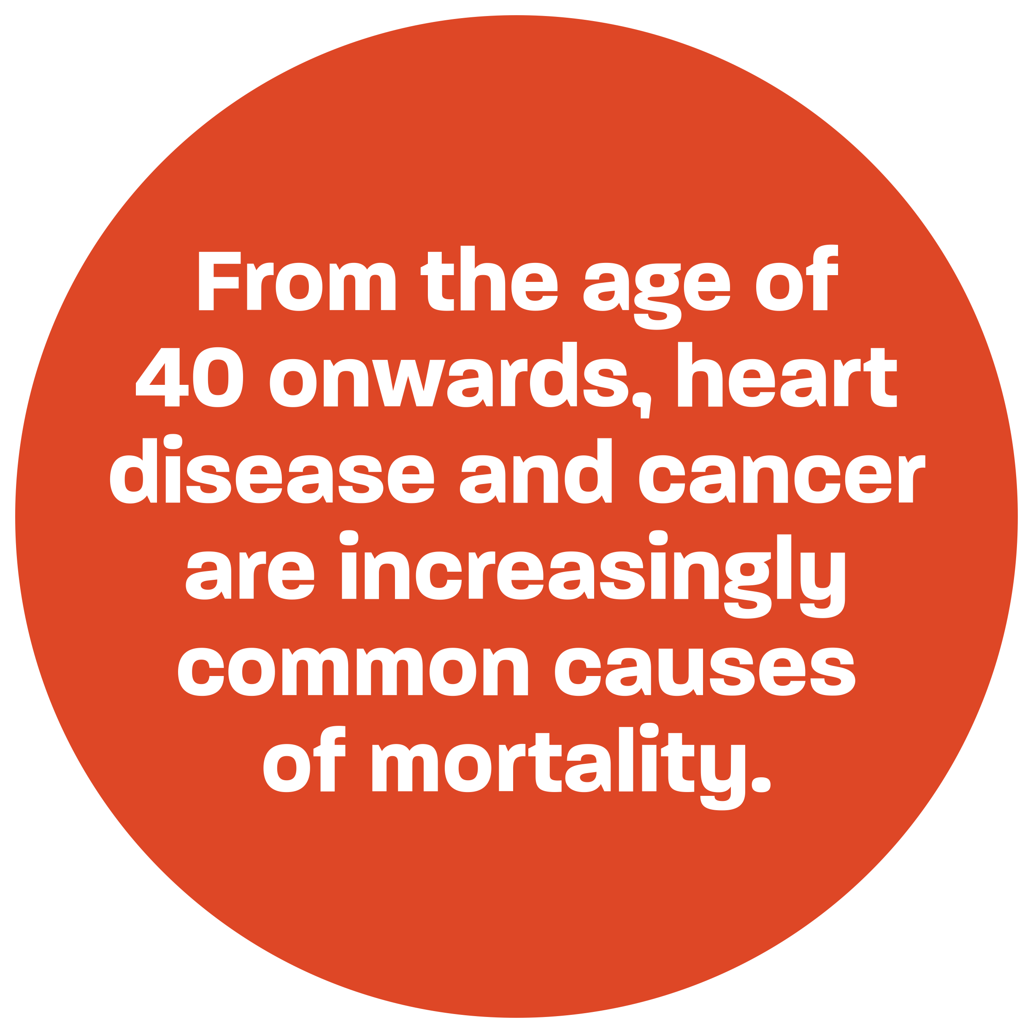
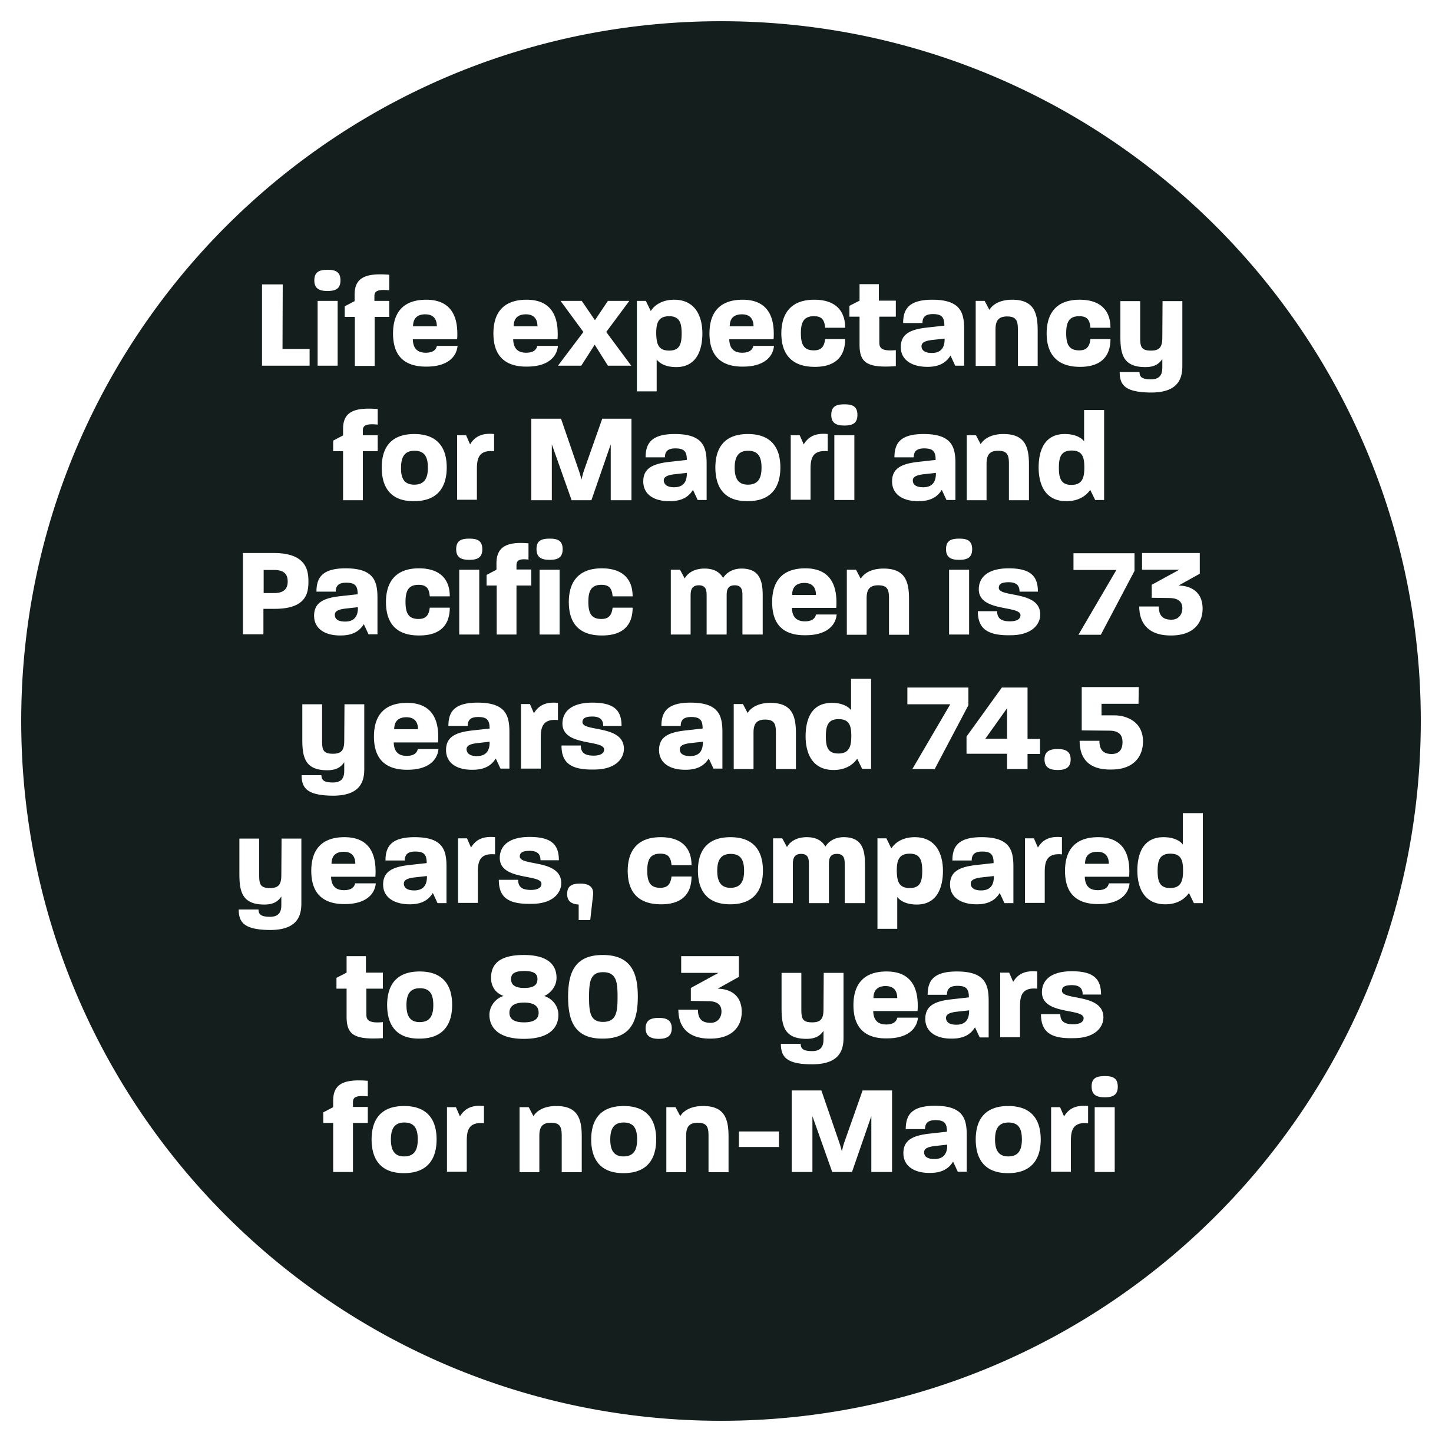
The picture only gets worse..
This Photo by Unknown Author is licensed under CC BY
Notes:
Media Release - Southern Cross 28 September 2022

Slide 6
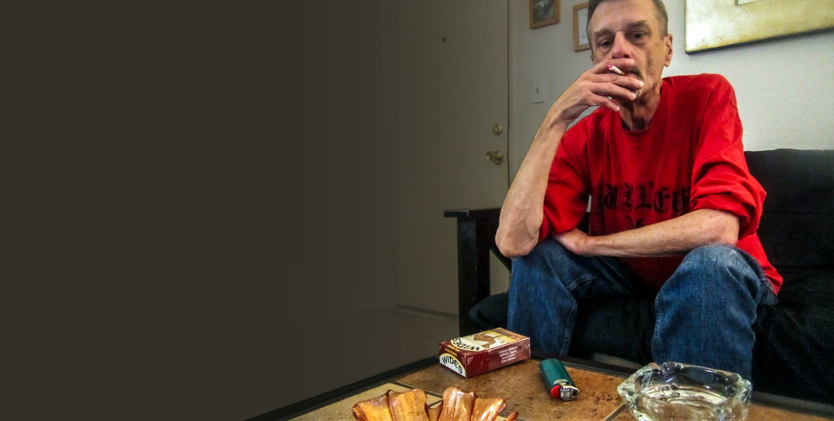
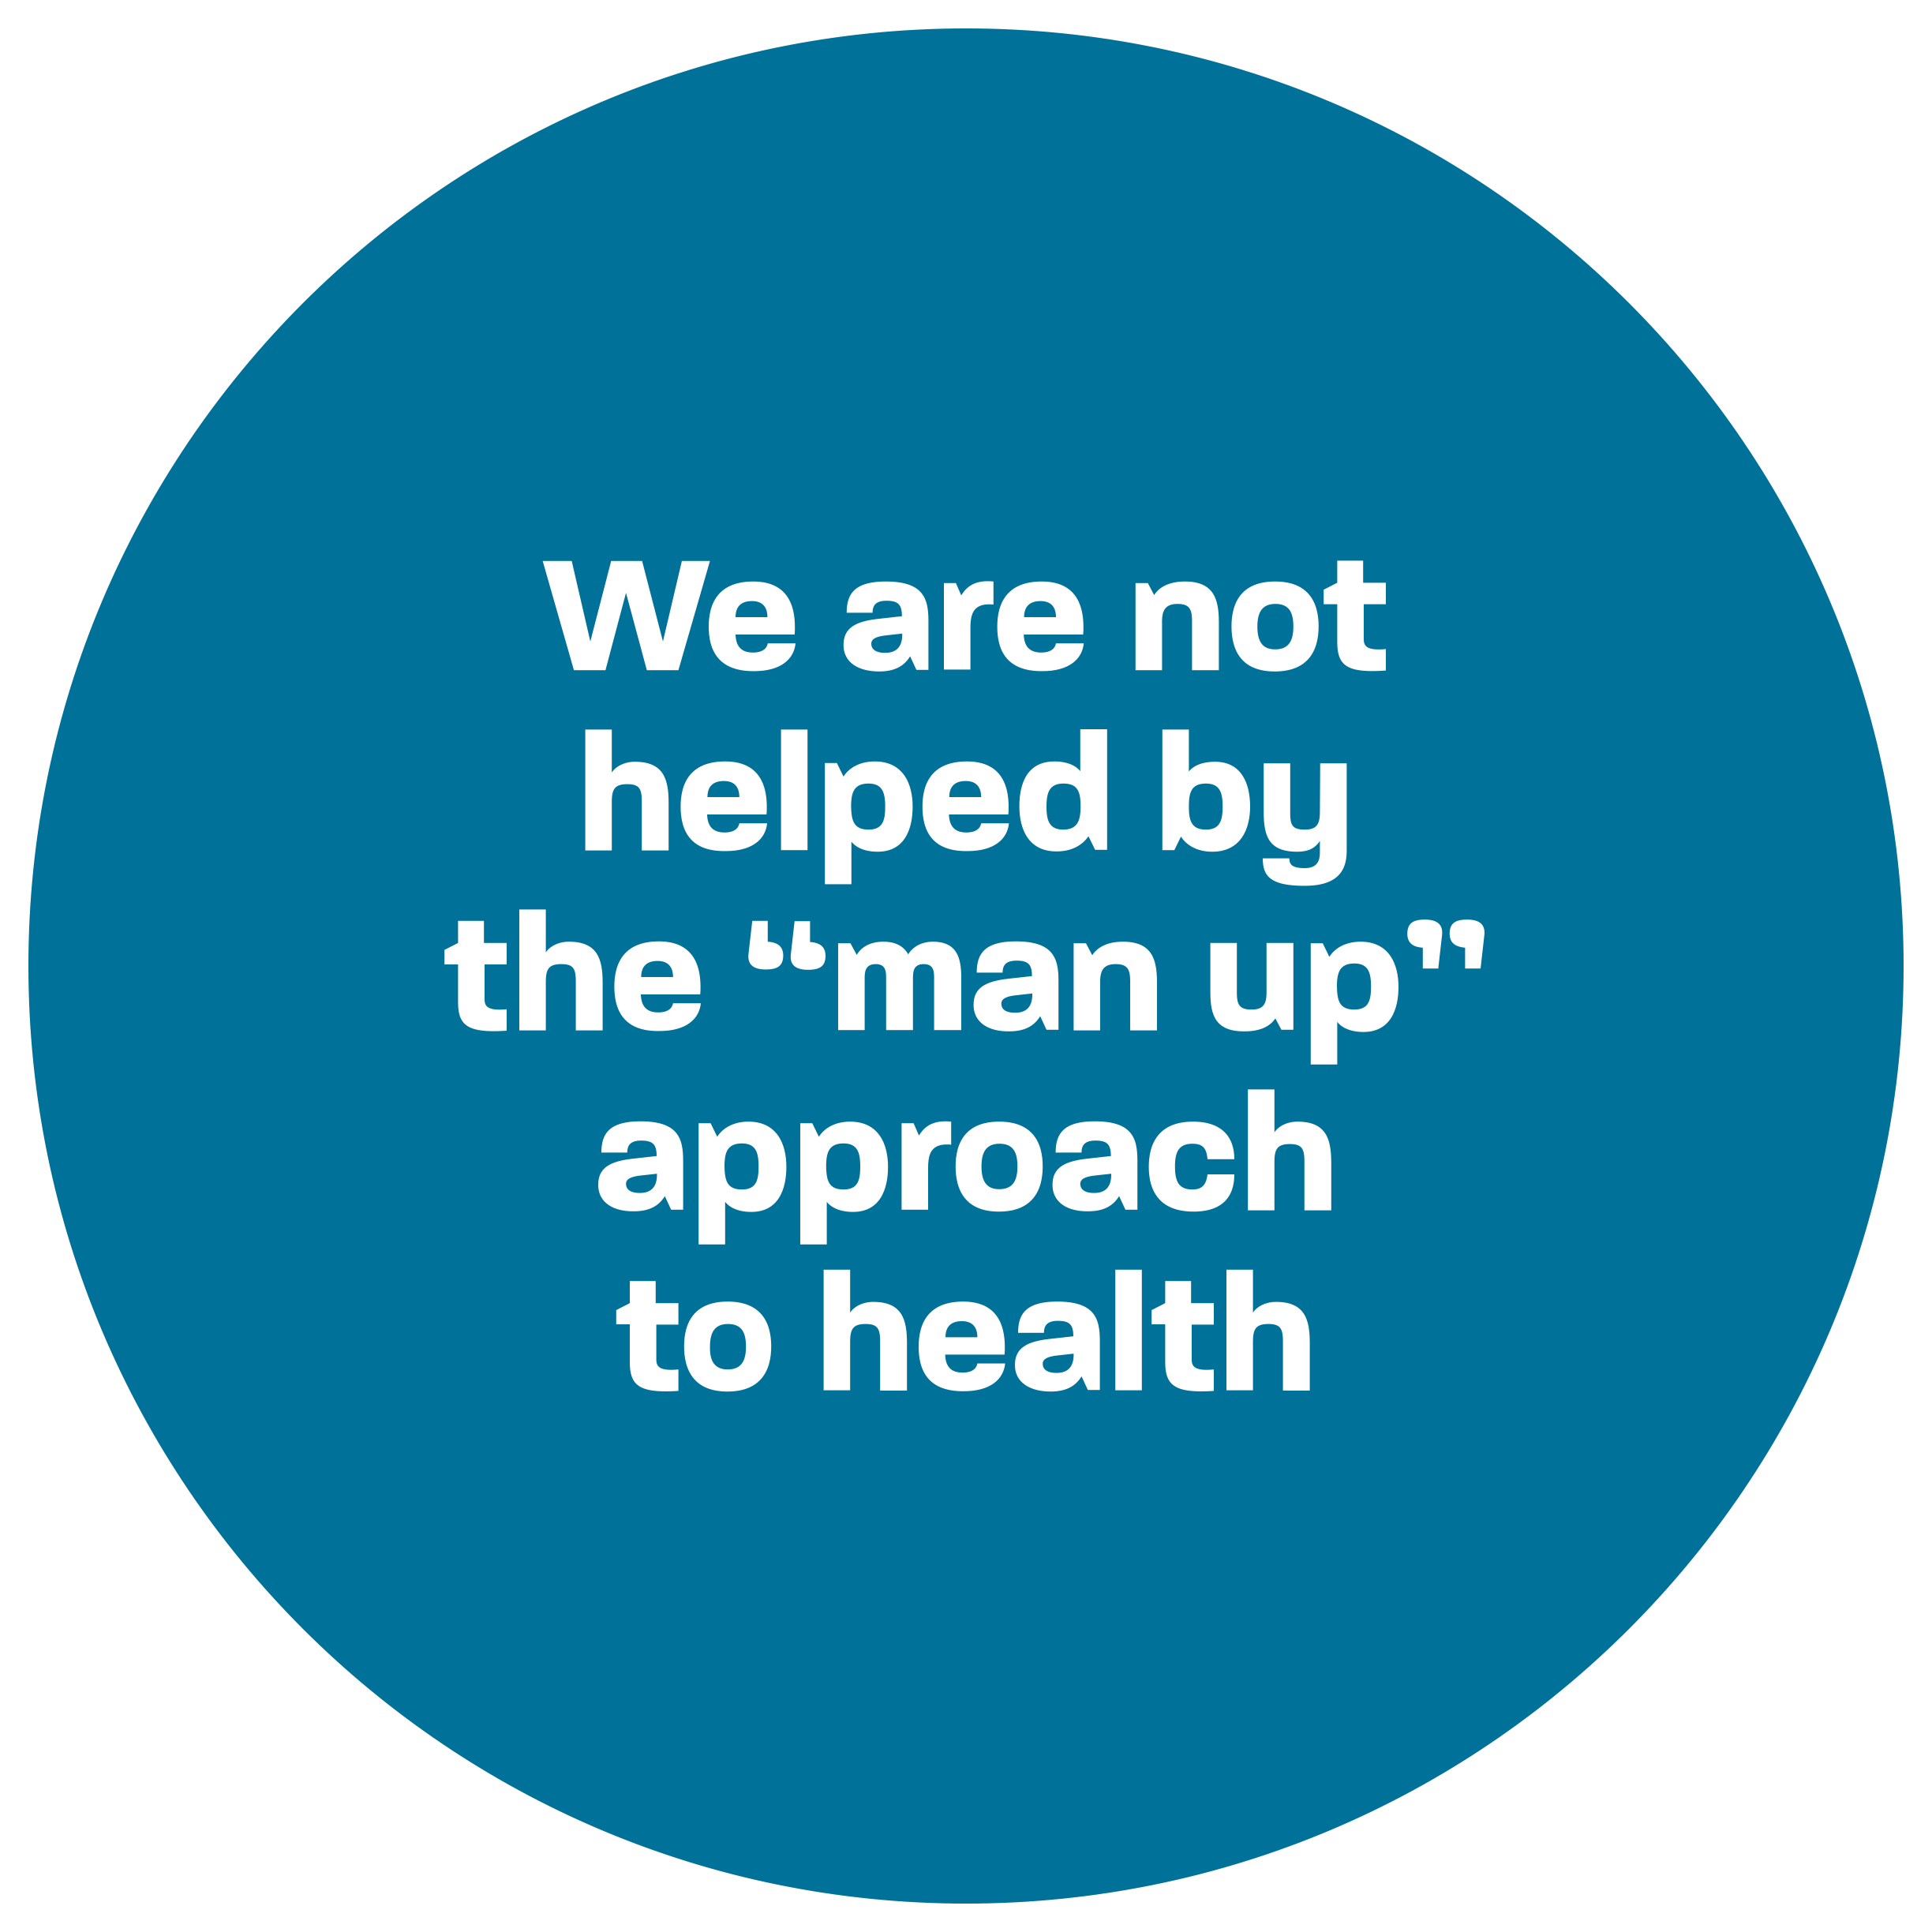
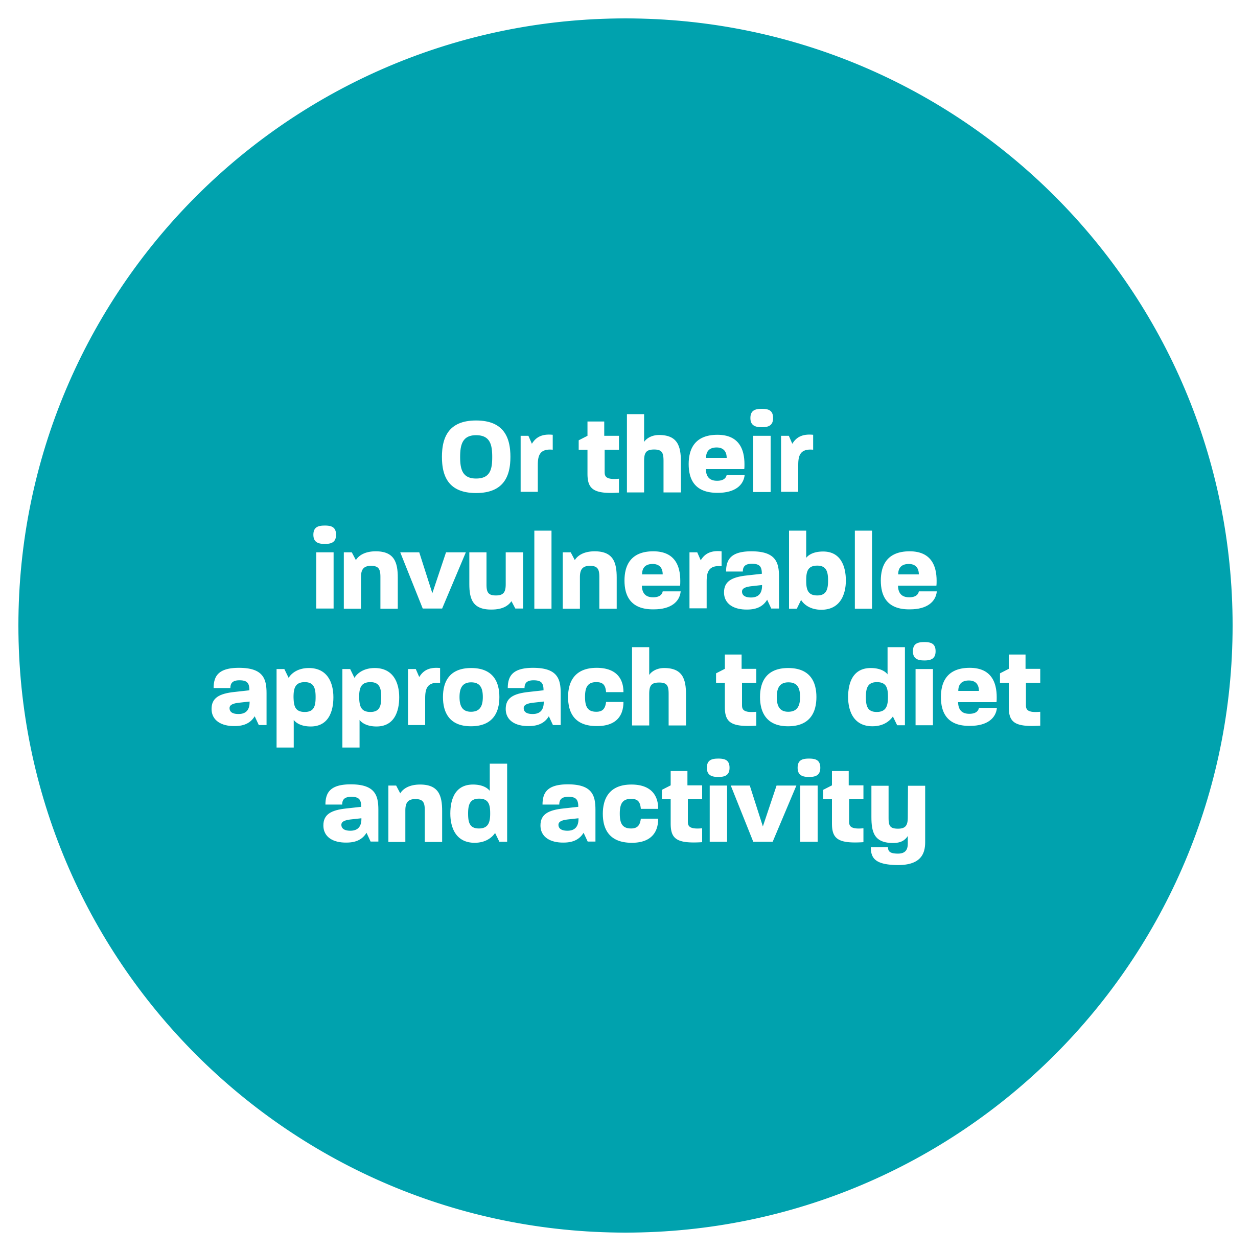
Biology, social expectations and systemic discrimination
For every $1.00 spent exclusively on women's health research, men’s health research received $0.06 cents
Notes:
NZ Medical Journal

Slide 7


Enabling Men to define what health means to them
It isn’t much different from Health & Safety is it???
Without active engagement from our men, these statistics are not going to improve.
As employers we have a captive audience of men 5 days a week

Slide 8

Without personal engagement nothing changes
To create change, we need the men in our lives/work space, to start engaging and be aware of themselves…
They cannot prioritise their health concerns if they do not understand what they are…
They need to be able to have the time and space to understand what “good health” means to them, both body and soul…

Slide 9

A business is their people??
If, as a nation we are failing to put the funding into research for Men’s Health – can we as employers, start to help in this direction?
We at BeSafe put the question/challenge out to all our businesses in Taranaki, what can we do in this direction? It won’t take too much either, the nation is not putting a great deal of emphasis on this.
Tell us what you have incorporated into your business for your MEN. We can share.

Slide 10




Thank you
If you have any questions, don’t hesitate to reach out to us.
How to contact us:
www.besafe.nz
besafe@besafe.org.nz
021 1984 897

