Slide 1
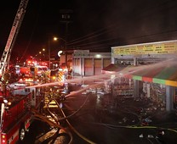


Emergency Prepardness

Slide 2
Every business or undertaking has an obligation to keep their workers and others safe
How the organisation handles the response to and recovery from an emergency can determine its future survival
Managing emergencies goes beyond ‘fire extinguishers, first aid kits and evacuation’
Emergencies: How prepared is your organisation?
Notes:
.

Slide 3
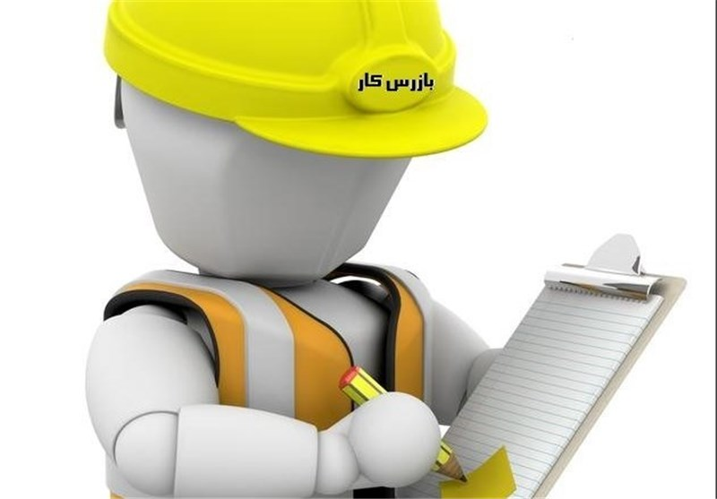
Regulatory Obligations
Workplaces and PCBUs needs to comply with legislation and regulation such as
Health and Safety at Work Act 2015
https://www.legislation.govt.nz/regulation/public/2016/0013/latest/DLM6727582.html
https://www.legislation.govt.nz/regulation/public/2016/0014/latest/DLM6243978.html
https://www.legislation.govt.nz/regulation/public/2016/0014/latest/DLM6243977.html
There are also many best practice guide that performance can be measure against
ISO31000 Risk management
AS3745 Planning for emergencies in facilities
ISO22301 Business continuity management

Slide 4
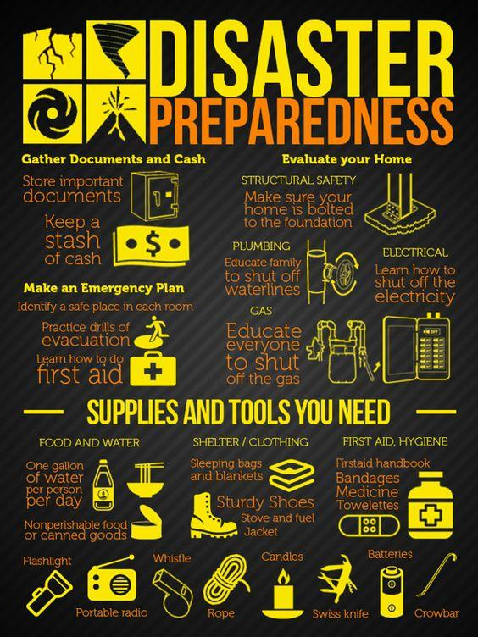
How Effective is your emergency system?
Emergency plans should be:
Bespoke to your organisation, activities, and workplace
Based on a comprehensive emergency risk assessment
Include specific guides to address each identified risk
Outline a management structure to support
Tactical (immediate lifesaving) response
Strategic (organisational reputation, liability and continuity) response
This Photo by Unknown Author is licensed under CC BY-SA-NC

Slide 5
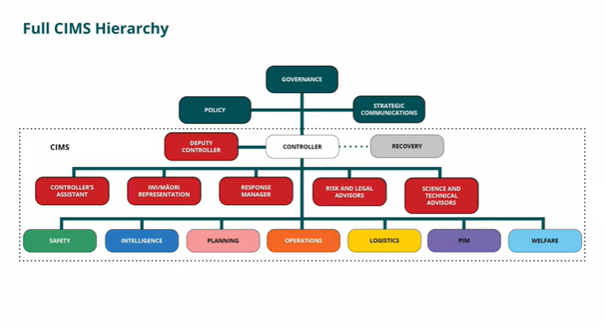
Is your management structure agile to respond to tactical & strategic issues?
Workplaces need to have arrangements to move people from relative danger to relative safety
Organisations need a management structure that looks at the bigger picture implications for the organisation
In New Zealand the Coordinated Incident Management System (CIMS) is used by emergency management agencies as a scalable structure that can expand to meet the needs of the situation
This can be tailored to your organisation and workplaces

Slide 6

Do you have a system to prioritise your response?
Many organisations across vastly different industries use PEARL
People
Environment
Asset
Reputation
Liability

Slide 7
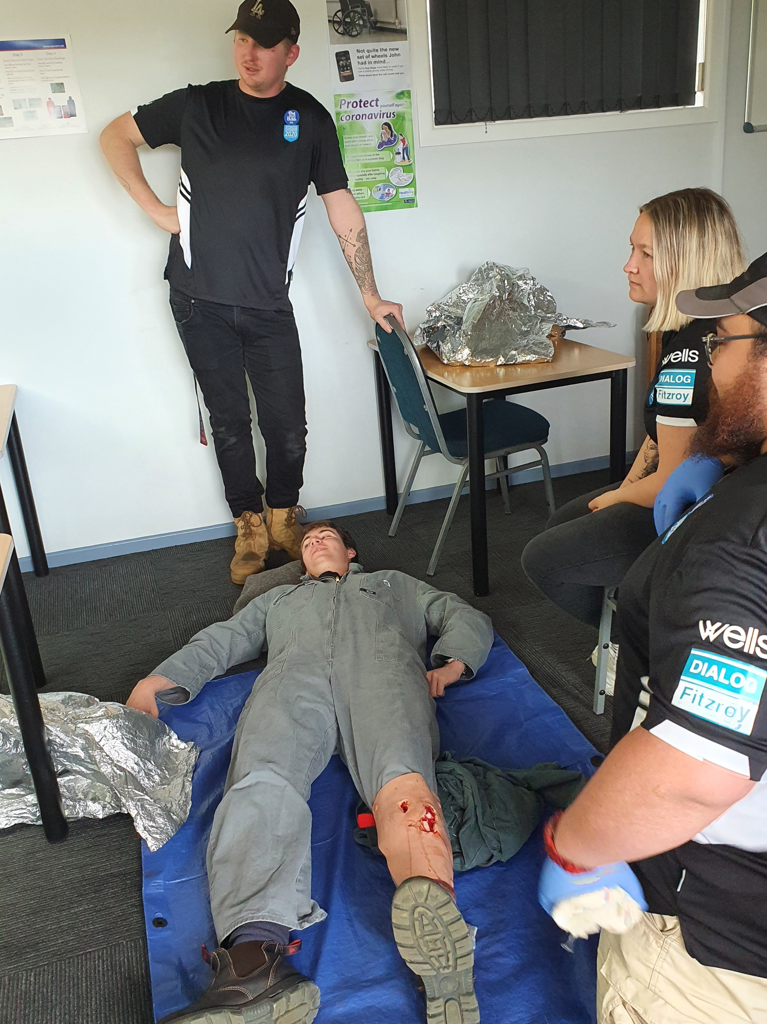
How well prepared are you to look after your people and loved ones?
Most organisations have an EAP provider or similar
If you had multiple injured people do you have a system to support the injured, their loved ones and your wider workforce?
In the worst possible scenario, if you lost a workplace colleague, would you and your organisation know what to do?

Slide 8
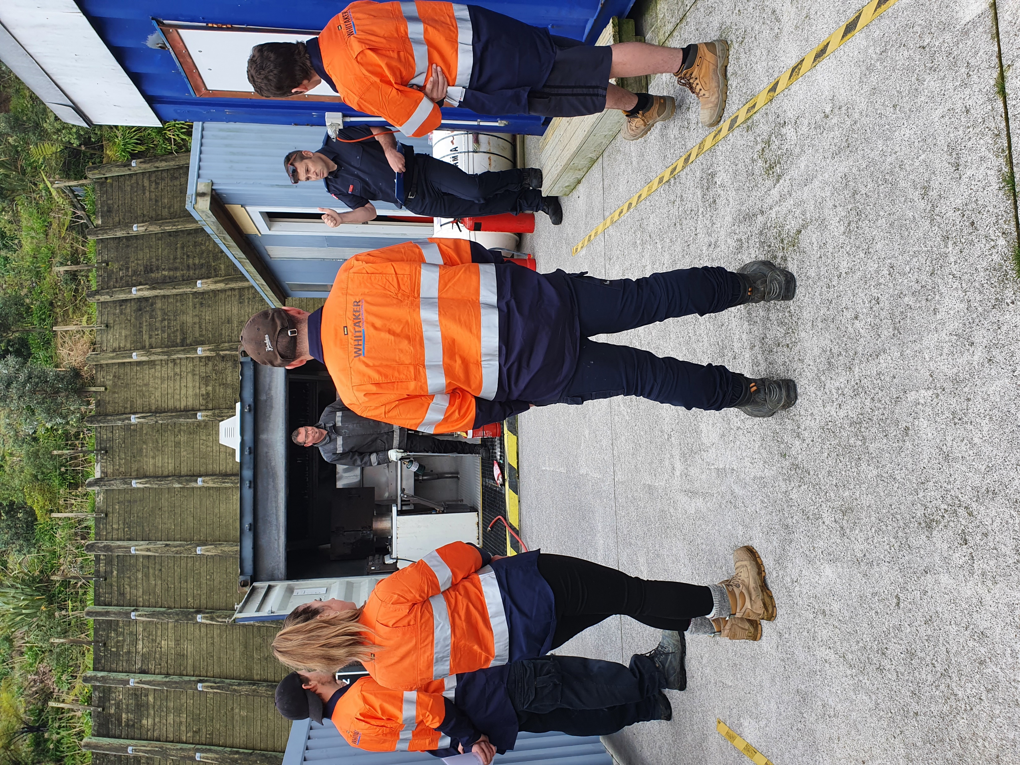
Are your people trained?
The general workforce needs to know how they will be told about an emergency and what to do when they are
The Emergency Control Organisation (Wardens/muster controllers) need to know what to do with the people affected by the emergency
The management team need to know how, when and where to come together and what role they will have to support the emergency response
Best practice after formal training is refresher training every two years to confirm retention of understanding and skills

Slide 9
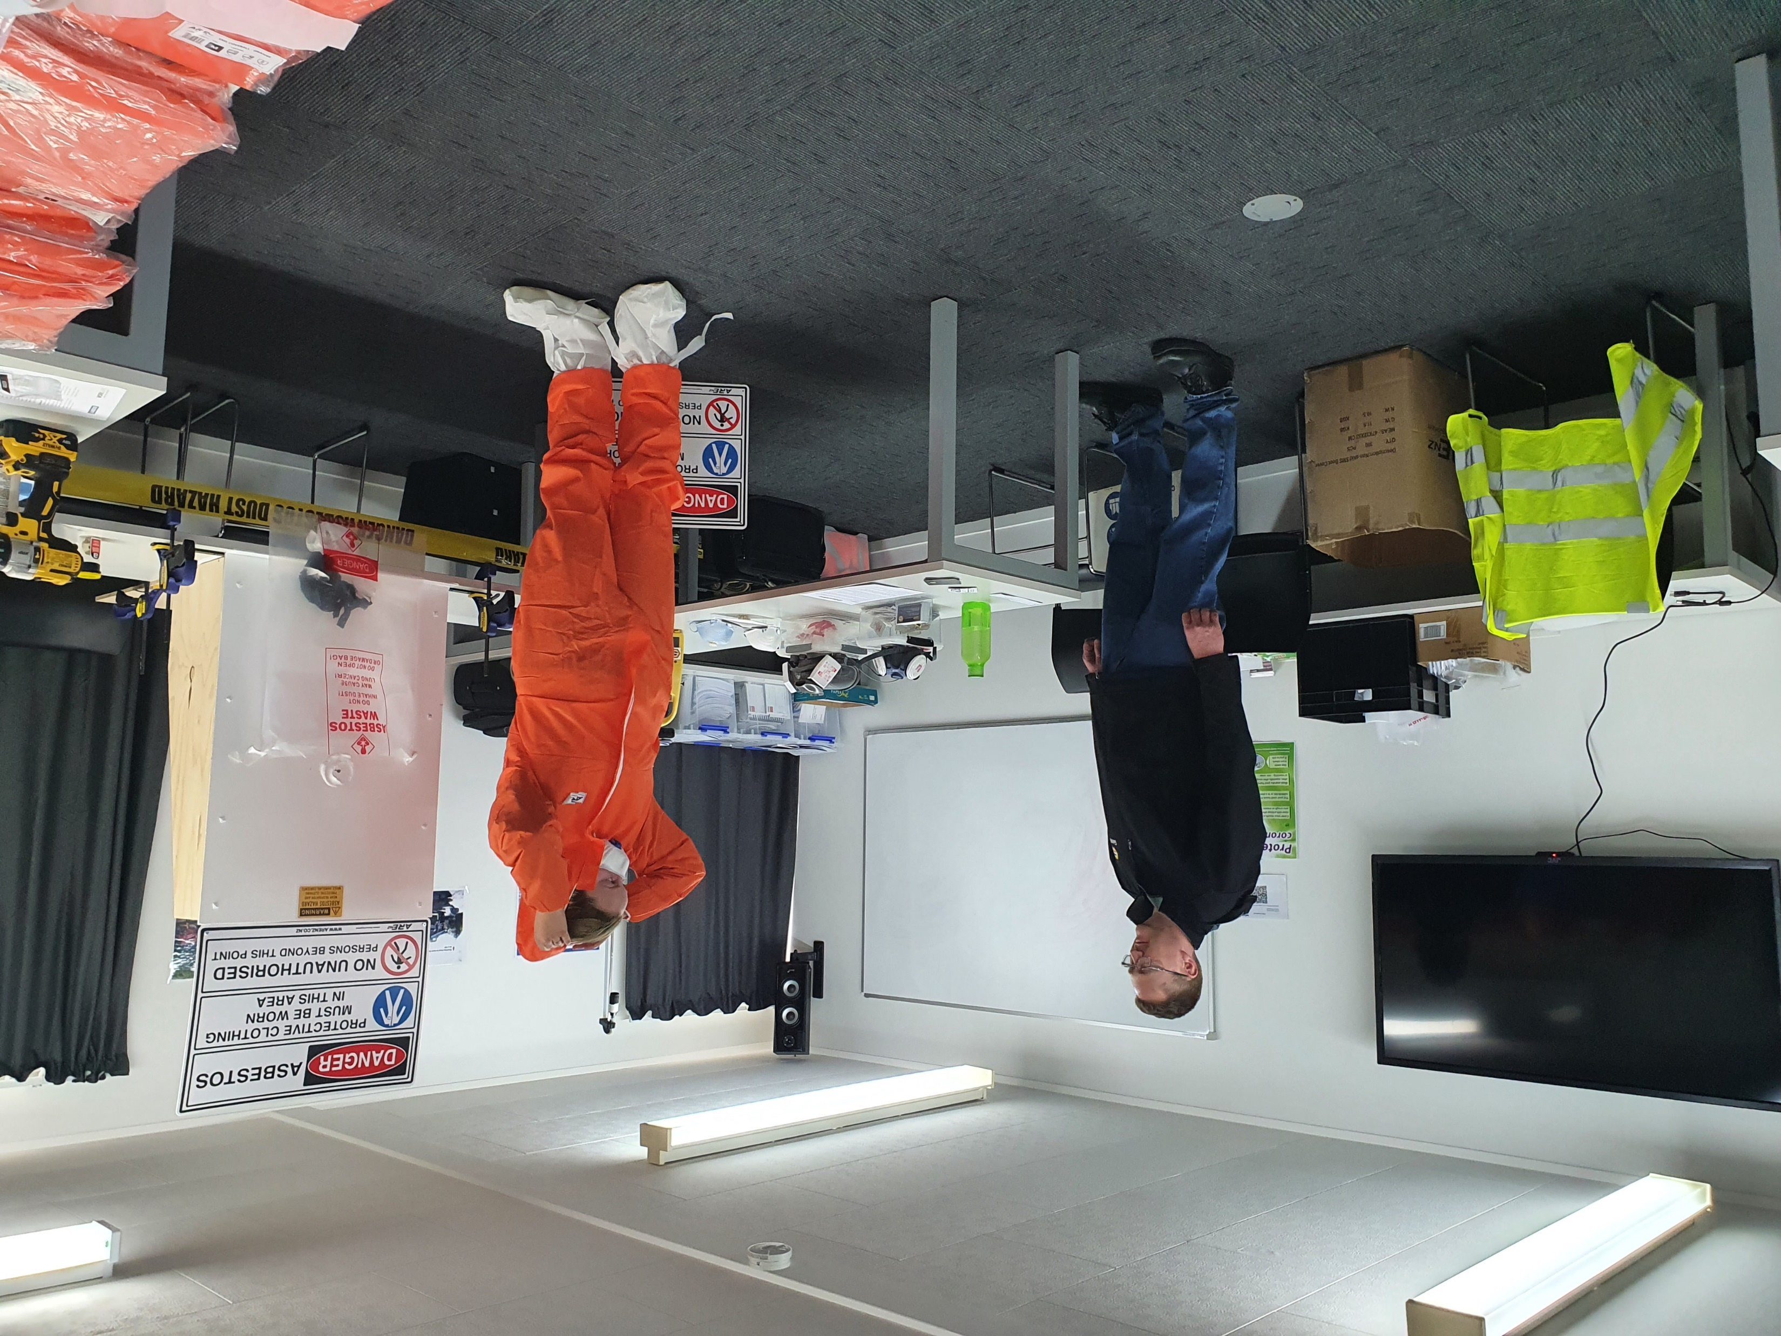
How often do you really exercise?
Organisations often run an annual evacuation drill or monthly workplace emergency exercise to meet regulatory compliance, but….
It is Better to practice, the way you mean to play!
Real exercises should stand up all levels of your emergency structure to allow them to practice with each other and push them to consider unexpected issues. That includes Executive Management!

Slide 10
Where to get help
https://beready.com.au/
https://www.civildefence.govt.nz/get-ready/
https://www.worksafe.govt.nz/topic-and-industry/major-hazard-facilities/mhf-guidance/emergency-planning

Slide 11
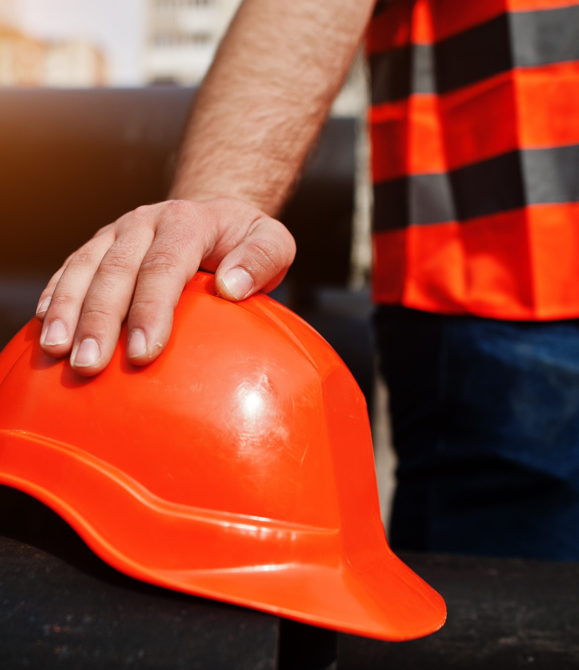



Thank you
If you have any questions, don’t hesitate to reach out to us.
How to contact us:
www.besafe.nz
besafe@besafe.org.nz
021 1984 897

