Slide 1
Safety Moment
BeAligned Working Group

Slide 2
Do you see what I see?
Have you ever questioned a sign or instruction because it doesn’t make sense to you? Or that it could mean something else to what is implied?​
It may have made sense to the person who prepared it, but does that mean everyone understands it the same…
This safety moment will help demonstrate how people may interpret what they see differently and how we should factor this in when communicating to each other.

Slide 3
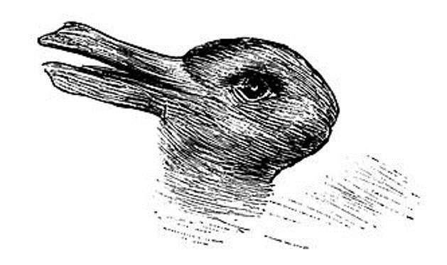
What do you see first?
Notes:
Duck or rabbit?

Slide 4
What do you see first?
Notes:
Dog or bird?

Slide 5
What do you see first?
Notes:
People or pillars?

Slide 6
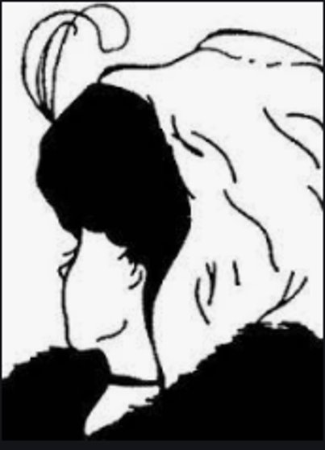
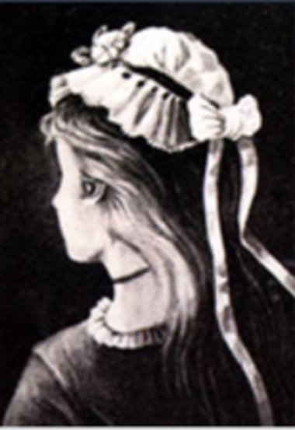
What do you see first?
Notes:
The young or old woman?

Slide 7
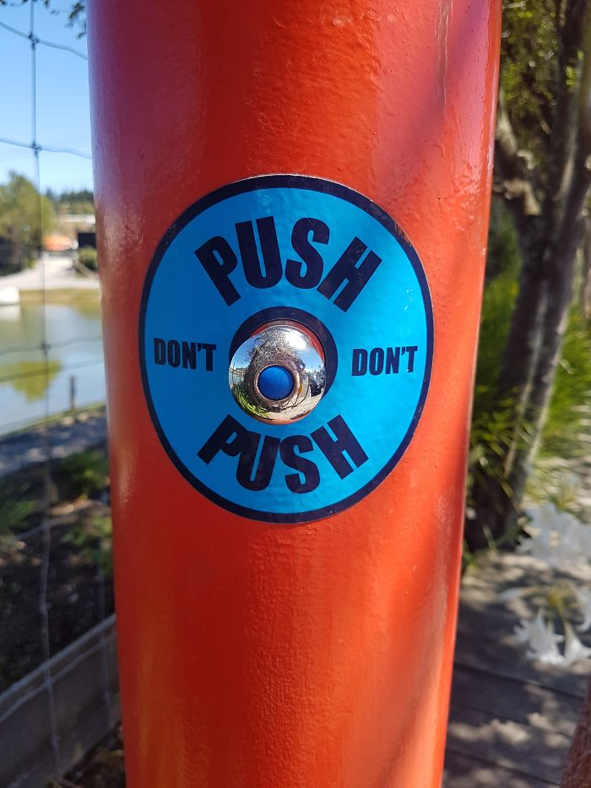
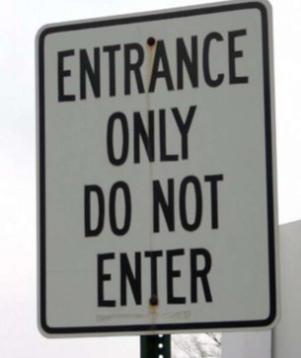
How would you interpret these signs?

Slide 8
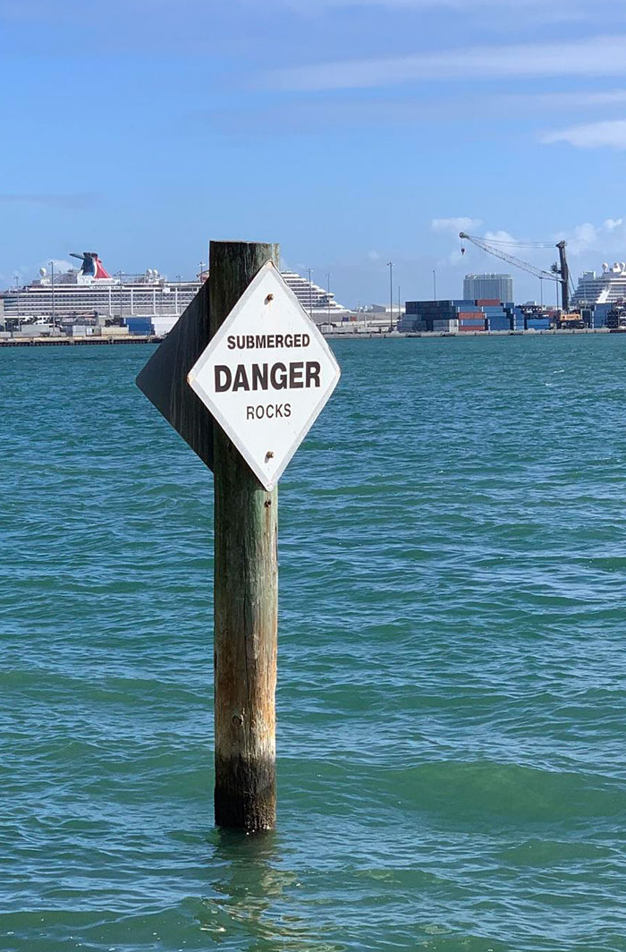
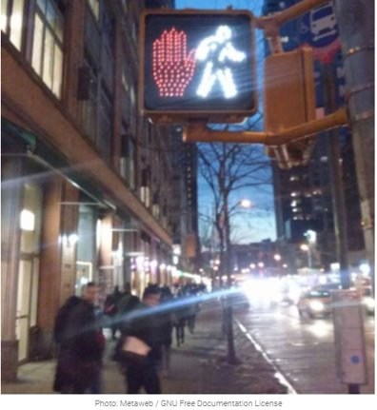
How would you interpret these signs?

Slide 9
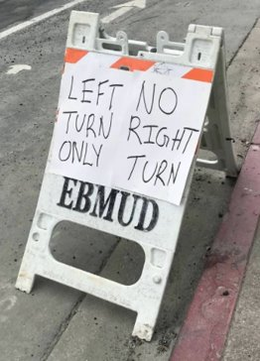
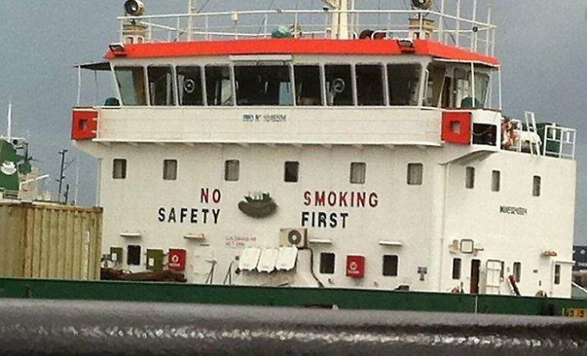
How would you interpret these signs?

Slide 10
People see things differently
How a person sees something may be different to how someone else sees things ​
A person’s values, beliefs, and experiences play a part in how people view and interpret things​
Don’t just assume because you understand, everyone else will ​
E.g., JHA’s, procedures, work instructions, signage​
Group discussion and peer-to-peer checking is important to make sure we are all singing off the same song sheet. ​
E.g., toolbox talks ​
If you are not sure, ASK! ​The only stupid question is the one that isn’t asked.

