Slide 1
Basic Fire Safety

Slide 2
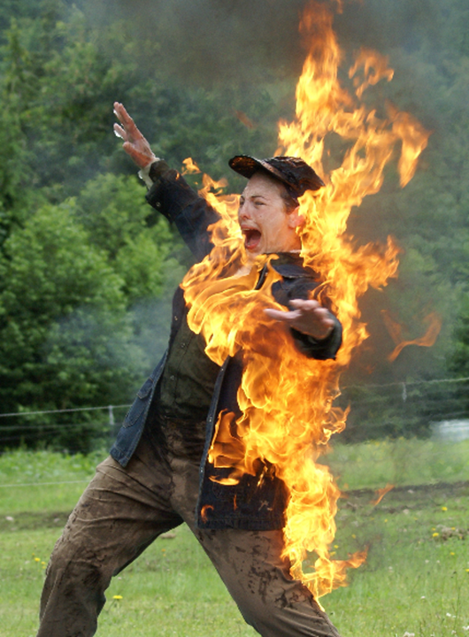
Emergency Response
In the event of a fire people will suffer from the fight or flight response.
The natural dump of adrenaline given when faced by an emergency situation will exacerbate this reaction.
In the event of a fire the trick is to Stay Calm!
Training in managing such situations will help an individual to react appropriately. People who we have spoken to who have been trained in these situations have all said how their remembrance of the training kicked in and helped them to react appropriately.

Slide 3
Emergency Response
Stay Calm
By knowing…
What to do
When to do it
How to do it
Why to do it

Slide 4
Fire Prevention
Fire prevention is one of our best tactics to deal with a situation before it has the chance to develop. The following points give us the best chance to avoid a situation occurring at our site or at home.
Ability to recognise fire hazards and correct them.
Smoke only in safe areas.
Good housekeeping.
Keep fire exits and doorways clear.
Seal flammable liquids.
Separate flammable liquids from oxidizing agents.
Correct extinguisher type for area.
Notes:
Recognize Fire Hazards
The best way to control fire is not to have one in the first place. Fire prevention is the best way that we can ensure that fire will not eventuate.
Recognize fire hazards and deal with them immediately.
LIST SIX FIRE HAZARDS CAN YOU SEE WITHIN THIS R0OM?
1._____________ 2._________________ 3._________________
4._____________ 5._________________ 6._________________
Smoking Areas
Have areas that are safe set aside for smokers. Allowing smoking anywhere would be extremely dangerous. If we stopped smoking within petrochemical plants this would pose a bigger danger. Hardened smokers would still try and smoke, and the place they would choose to smoke would be the areas that are hidden or isolated. Usually in these areas we store dangerous goods or flammable materials.
House Keeping
Always ensure that work areas are kept clean and tidy. Rubbish left laying around will help spread a fire fast. Dust and dirt that has accumulated on steel girders will ignite through the conduction of heat.
Fire Exits & Doorways
Ensure all fire exits are kept clear so as to allow people to escape safely in the event of an emergency. Don’t have boxes or rubbish covering exits or stored in alleyways. As people leave in an emergency the boxes will get knocked over and block the escape route causing panic.

Slide 5
Advantages & Disadvantages of Extinguishers
Quick Action
Portable
One Person Operation
Located Close to Hazard
Short Duration
Short Penetration
Not Universal
Reliability Suspect
Notes:
5

Slide 6
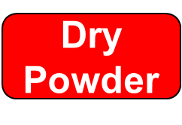
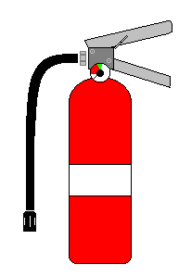
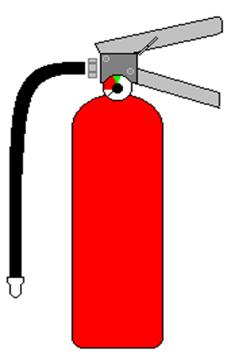
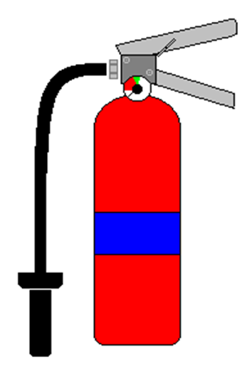
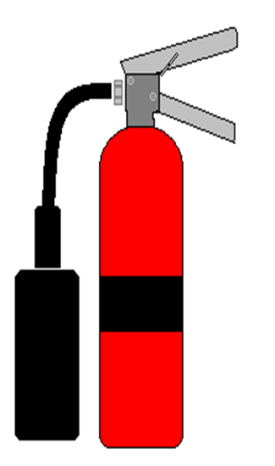
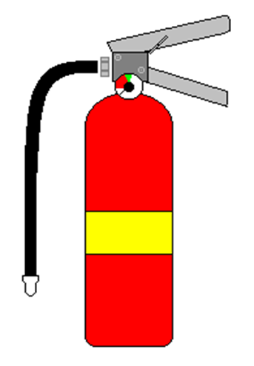
Types of Fire Extinguishers
CO2

Slide 7
Operation of Fire Extinguishers
Check the pressure gauge and ensure it is in the green and pull the pin.
Test the extinguisher. A full squeeze of the handle towards the fire gives us information on whether the extinguisher works, what type of extinguisher we are using and how far it goes.
Aim at the base of the fire.
Squeeze the trigger.
Sweep This is particularly important if using a dry powder extinguisher to push the media to where it needs to be.
P
Pin, Pressure
T
Test
A Aim
S Squeeze
(S) Sweep

Slide 8
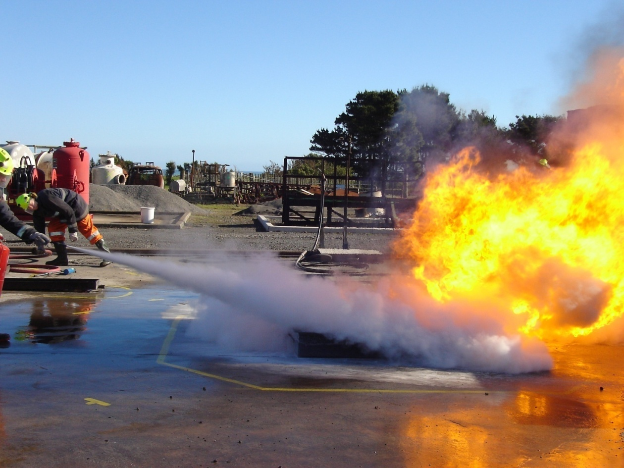
Fire Extinguishers
Remember it is important when faced with a fire to raise the alarm first, shout, use manual call points or dial 111.
If the situation deteriorates or you are not able to extinguish the fire leave the area shutting doors behind you to slow the growth; never turn your back on the fire.
Notes:
8

