Slide 1
Managing Fatigue
Jill Manaia, South Taranaki District Council
October 2023
Notes:
This presentation refers to general fatigue and the effects of fatigue on drivers.
Mostly the presentation refers to the effects on people who are driving for work, but there is a huge population that are driving for non-work purposes, and who may be equally fatigued and on the road.

Slide 2
What is fatigue
A state of physical and mental exhaustion that results in the loss of alertness
Notes:
Fatigue is not an “either or” condition. High levels of physical fatigue will produce mental symptoms as well. Extreme mental fatigue will have an effect on the physical function of an individual.

Slide 3
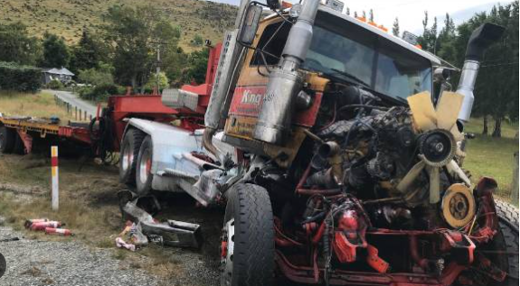
Fatigue related crashes
Rates of fatigue related crashes trending down since peak 2013 (death and serious injury only)
3% of fatal truck crashes and 8% fatal car crashes related to fatigue – probably under reported
Percentage varies over time of day
Head on or lost control type accidents
Overtaking/lane changes
Notes:
Fatigue is a factor in many road crashes and is probably under-reported and under-detected.
The percentage of fatigue involvement in non death or serious injuries has never declined – it continues to climb.
While there has been a downwards trend in death and serious injuries fatigue involvement, there is an indication that the last 2 years have shown an upward trend.
The types of incidents where fatigue is a factor are rollover, single vehicle lane departure and impact or head on.

Slide 4
The size of the problem
In 2021 there were...
21 fatal crashes
69 serious injury crashes
422 minor injury crashes
… where fatigue was a contributing factor
Likely to be underreported
25 killed, 92 serious injuries, 533 minor injuries
Notes:
While the percentage of fatigue involved incidents sounds low, the actual impact on people, families and communities is high.

Slide 5
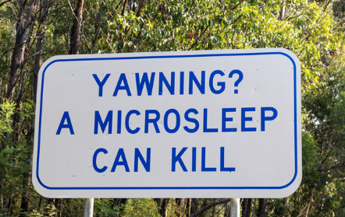
A fatigued driver
Will have driven some time without a break
May be reliant on external factors to keep awake
May have had disturbed/inadequate sleep the night(s) before
May suffer from a sleep related condition
May be a shift worker or commercial driver
May be driving during risk periods
May be unaware of fatigue related symptoms
Notes:
Common strategies including pills, opening windows, music, coffee or stimulant drugs only mask the basic impairment due to fatigue
You may be cold (windows) and tired
Wired (stimulants) and tired
Distracted (music) and tired
But you are still tired, fatigued and impaired.
Shift workers and commercial drivers will be more likely to be driving during the times that our body’s circadian rhythm say we should sleep.
Disturbed sleep may be from insomnia, sleep apnoea, prescription medications, small children/babies, gaming/television/computer use, sleep apnoea. Assuming that fatigue is due to poor management of sleep is an oversimplification.
Most people if asked if they are fit to drive will say they are okay. Discount the seriousness of their fatigue levels.

Slide 6
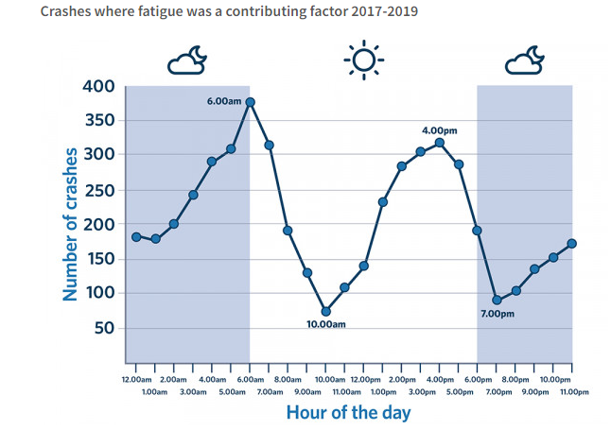
Risk Periods
Notes:
As referred to in previous slide. Maximum sleepiness periods due to circadian rhythm are 3-6am and 3-5pm.

Slide 7
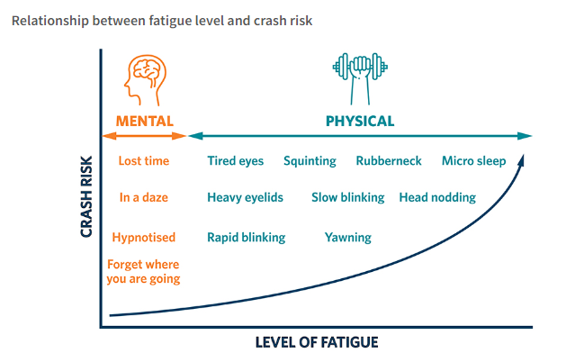
Fatigue and Crash Risk
Notes:
As we become more fatigued, the number of fatigue related symptoms increase, as does the risk of accident. If you are fatigued enough, the body’s need for sleep will override our want to be awake and completing activities. Micro-sleeps – periods where the body is functionally asleep for periods of 15 seconds or less. Eyes may be open or shut. You may have little or no recall of these microsleep periods.
A vehicle will travel a considerable distance in the period of a microsleep.

Slide 8
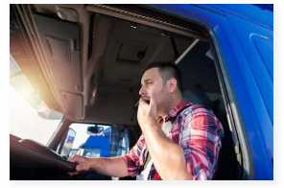
Signs of fatigue
Nodding off
Difficulty keeping eyes open/blurred vision
Feeling "spacey" or "fuzzy"
Clumsiness
Slowed reflexes
Tailgating / poor speed control/drifting
Tunnel vision on task
Poor risk assessment /judgement
Increased errors
Reduced memory
Grumpiness and moodiness / road rage
Microsleeps
Notes:
A summary of some of the signs and symptoms of fatigue. Some of these are specific to driving situations (call attention to the death rattle of impacting the rumble strip or gravel on the side of the ride to indicate lane departure).
Also call attention to going through towns with no recall of this – especially when commuting. Where is your attention ? What would be your reaction to an unexpected hazard during that period of reduced function?
Note the impaired judgement. Asking the person if they are okay to drive – probably the worst person to make that call.

Slide 9
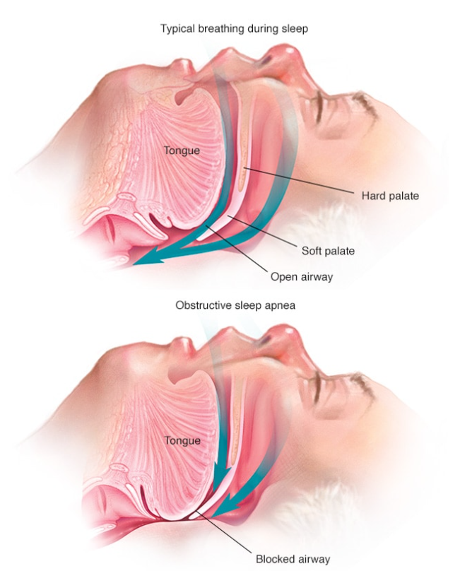
Sleep Apnoea Risk Factors
Obstruction of airway during sleep
Male
Over 40
Medical conditions
Short thick neck
Lifestyle – alcohol, smoking
Obesity
Family history
Notes:
Sleep apnoea is an important source of sleep disturbance and fatigue. Often combined with chronic snoring.
It is a physical condition where the muscles of the tongue and surrounding structures relax and block the airway. The person will then suffer low oxygen levels in the blood and brain and will partially wake. This may happen many times in a minute or night. This prevents deep sleep, disrupts the sleep cycle, and lowers brain oxygenation and functions.
The person may be sleeping, but will wake tired and unrefreshed. Will have a tendency to doze off through the day or in front of the tv. Mood affected.
These are the risk factors for sleep apnoea. Does this sound like a typical driver in commercial situation?
Auckland Buses monitored their drivers for microsleeps – a frightening number of these were occurring. Studies indicated the drivers involved all suffered from sleep apnoea.
Commercial drivers fear being diagnosed with sleep apnoea as this may result in suspension of licence.
Sleep assessments are the way to diagnose this condition – can be done through Te Whatu Ora, but Eden Sleep in New Plymouth can do these quickly and at a minor cost ($145).
Treatment will depend on the severity of symptoms, and may be funded if the condition is severe.

Slide 10
Laws around fatigue – Commercial related driving
Health and Safety at Work Act 2015
Section 30 – Management of risks
Section 36 – Primary duty of Care
Manage risks
Provide a safe environment
Provide safe systems of work
Section 45 - Duties of workers
Notes:
Fatigue is a known hazard in the workplace, particularly on the road.
Travel and driving may be another critical risk.
All these sections impose duties to manage hazards to as low as reasonably practical level of risk. Including driving and fatigue.
Workers too have a duty to make sure that no action or inaction on their part results in harm to themselves or others – so a vehicle crash from unmanaged or poorly managed fatigue would be a failure. But unlikely to result in WorkSafe follow up.

Slide 11
Managing the Risk of Fatigue
Education and training
Roster management and design
Driving assessments
Hours of work management. Travel Policy
Medical surveillance – Medical conditions, sleep apnoea
Support sleep studies
In cab monitoring
In cab alerting
Management of alerts
Driver management Breaks and nutrition
Fatigue Management Plan
Notes:
There is no one solution for a company to manage fatigue. In a number of cases courts and coroners have been critical of companies that do not have a fatigue management plan appropriate to their situation, and company risk profile.
So:
Have a plan, and publicise this to your team(s)
Educate and train your workforce around fatigue and fatigue management. Encourage self reporting, and have a plan on what to do for any self reports. But don’t rely just on worker’s judgement and training alone
Manage your rosters/hours of work to minimise fatigue. There are specialists who can help measure and advise. Think about other factors such as travel to work/
if the worker is likely to have another job. Also think about any factors that are likely to increase fatigue eg high heat/cold/intense concentration requirements.
Does your workplace have a travel policy to support staying away for another night instead of driving/travelling back after a full day of seminars/functions?
Undertake regular health surveillance including sleep history, physical factors, medications. If the driving team understand why, and that a fatigue diagnosis is not the “end of the road” for their job, they are more likely to be more honest and compliant with the need for surveillance.
If a sleep apnoea risk is indicated, support the referral and cost of sleep studies.
In cab monitoring and alerting (seat shakes) will help prove microsleeps are occurring and the need to manage to the workforce. But the company will need to have a response plan for these – communication, a policy around removing the person from driving that day or longer, a mechanism to retrieve a fatigue impaired driver.
Good hydration and nutrition are important for maintaining good general health and minimising the risk factors for fatigue and sleep apnoea. Do your drivers get breaks? How can they access good food during night hours or where adequate parking is available? Do the drivers understand these factors?

Slide 12
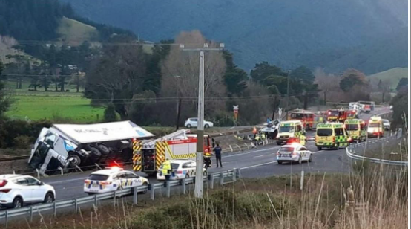
NZ Case Law – Fatigue related
Worksafe NZ v Michael Vining Contracting Ltd [2018]
Freight Lines Ltd (2015)
Maritime : Wild Fish NZ (2018)
Waka Kotahi - numerous
Notes:
There have been a number of prosecutions around fatigue and consequences. More are underway.
WorkSafe – Michael Vining Contracting Ltd – agricultural contractor – worker had worked 197 hours in a fortnight, 16.75 hours the day before the fatal accident where the worker lost control of a large tractor and crashed.
Freightlines Ltd – similar.
Sea: Maritime prosecution where a boat was under control of a very fatigued 19 year old, where control was lost and the boat was wrecked.
Waka Kotahi – numerous prosecutions for driving accidents where fatigue is identified as a factor.

Slide 13
Resources
WorkSafe Fatigue guidance
Driver fatigue | Waka Kotahi NZ Transport Agency
Fatigue Management Advice for employers | Waka Kotahi
Health and safety, fatigue - Maritime NZ
Fighting Driver Fatigue | NZI
Effects Of Fatigue And Minimizing Strategies #SDT
Notes:
Here are some great resources, but there are many more.

