Slide 1
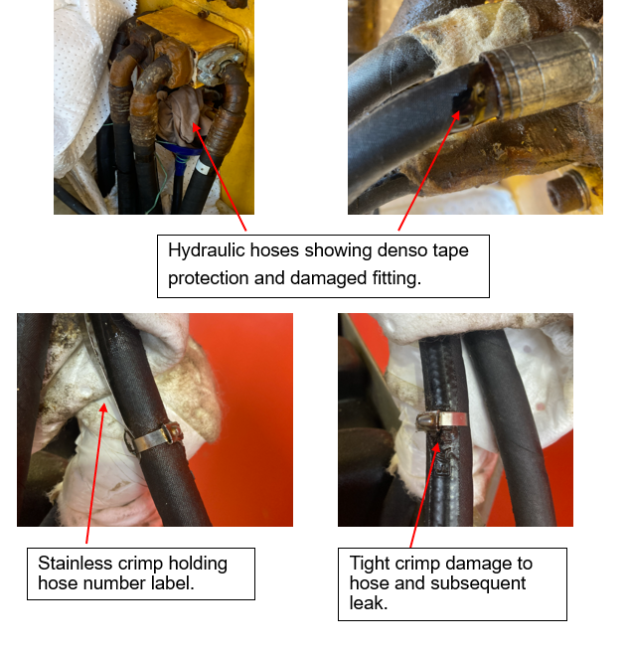
Hose Failures
DATE:
SHARED LEARNING: INCIDENT INVESTIGATION OUTCOME
20/12/2022
Use this area to insert pictures, drawings and other illustrations
Activity:
Incident Description:
Two recent incidents involving hydraulic hose failure are worth looking at in more detail.
In one case the hydraulic hose had denso tape obscuring the fitting and the other it appears the stainless-steel hose crimp for securing the hose number label has compromised the hoses integrity.
Potential Outcome:
Any spills in the offshore environment require time and resources to clean up and return areas to a safe operational standard.
Can result in having to report to regulators if spill is large enough or reaches the sea around the platform.
Increased scrutiny from regulators from spill incidents and potential future fines.
Lessons Learned:
Planned hose inspection regardless of type should be comprehensive and include visual and physical handling (where possible) of the whole hose.
Removal frequency of fittings protection like denso tape should be factored into these inspections as part of work planning and PM closeout.
Causes (Immediate, Root Causes):
Most site powered equipment use hoses to provide power and cooling.
Too often the hoses are in hard to get to places which makes routine inspection difficult.
Hose protection can sometimes make it difficult to observe hose and fitting terminals.
Attaching fittings (labelling) to hoses needs to be done with utmost caution to avoid compromising the hoses integrity. Does it need to go here?

