Slide 1
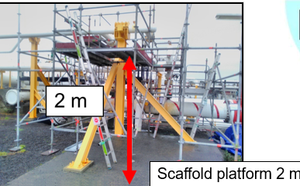
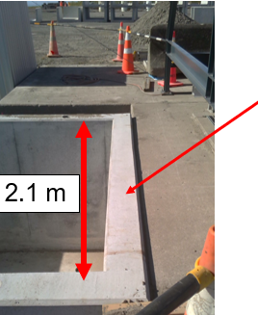

Working at height without Correct PPE
DATE:
SHARED LEARNING: INCIDENT INVESTIGATION OUTCOME
19/04/2024
Use this area to insert pictures,
drawings and other illustrations
Activity:
Incident Description:
Three workers were observed by multiple people kneeling on the edge of a 2.1 m deep cellar without fall protection in place. Two workers were not wearing gloves and had an un-taped ring on their left hand. The Load didn’t land as the team had planned resulting in people moving to an unsafe position
Potential Outcome:
All three workers were exposed to a risk of serious injury from a fall to depth above 1.8m, Two workers hands were also at risk of injury without gloves being worn and jewellery not removed or taped. No-one recognised the fall to depth hazard
Lessons Learned:
If you see workers exposed to hazards intervene and stop the job. Re-assess the situation review the JHA using the 5x5 process.
Always wear gloves as per site requirements, tape up or remove jewellery.
Review and use Project hazard registers to assist with developing JHA’s specific to the task.
Causes (Immediate, Root Causes):
When significant changes occur, stop the work, step back 5x5, discuss the situation with the Permit Issuer and agree & implement additional controls before proceeding.
Always be aware of the risks associated with working at height, falling from one level to another this includes falling from ground level into a pit, cellar etc.

