Slide 1
Presentation to ‘BeSafe’ Trailer Safety Workshop
Principal Investigator
Dick CORBIDGE
30 April 2024
Notes:
Introductions

Slide 2
Introductions
Principal Investigator Dick CORBIDGE
Health & Safety Inspector
Specialist Interventions (SI) – H & S workplace incident investigations – Serious Injury and fatal
Notes:
I will not be making reference to that incident directly but will talk about many of the common factors which contribute to such tragedies

Slide 3
Specialist Interventions
Four Areas across NZ
Area 1 – Auckland & Northland
Area 2 – Central North Island
Area 3 – Wellington
Area 4 – South Island
Each Area:
Manager plus a Deputy Manager larger Areas
Principal Investigator
Investigators (numbers vary)
Notes:
Discuss the number of investigators available
Bombay Hills – Hamilton – Whakatane – across to New Plymouth

Slide 4
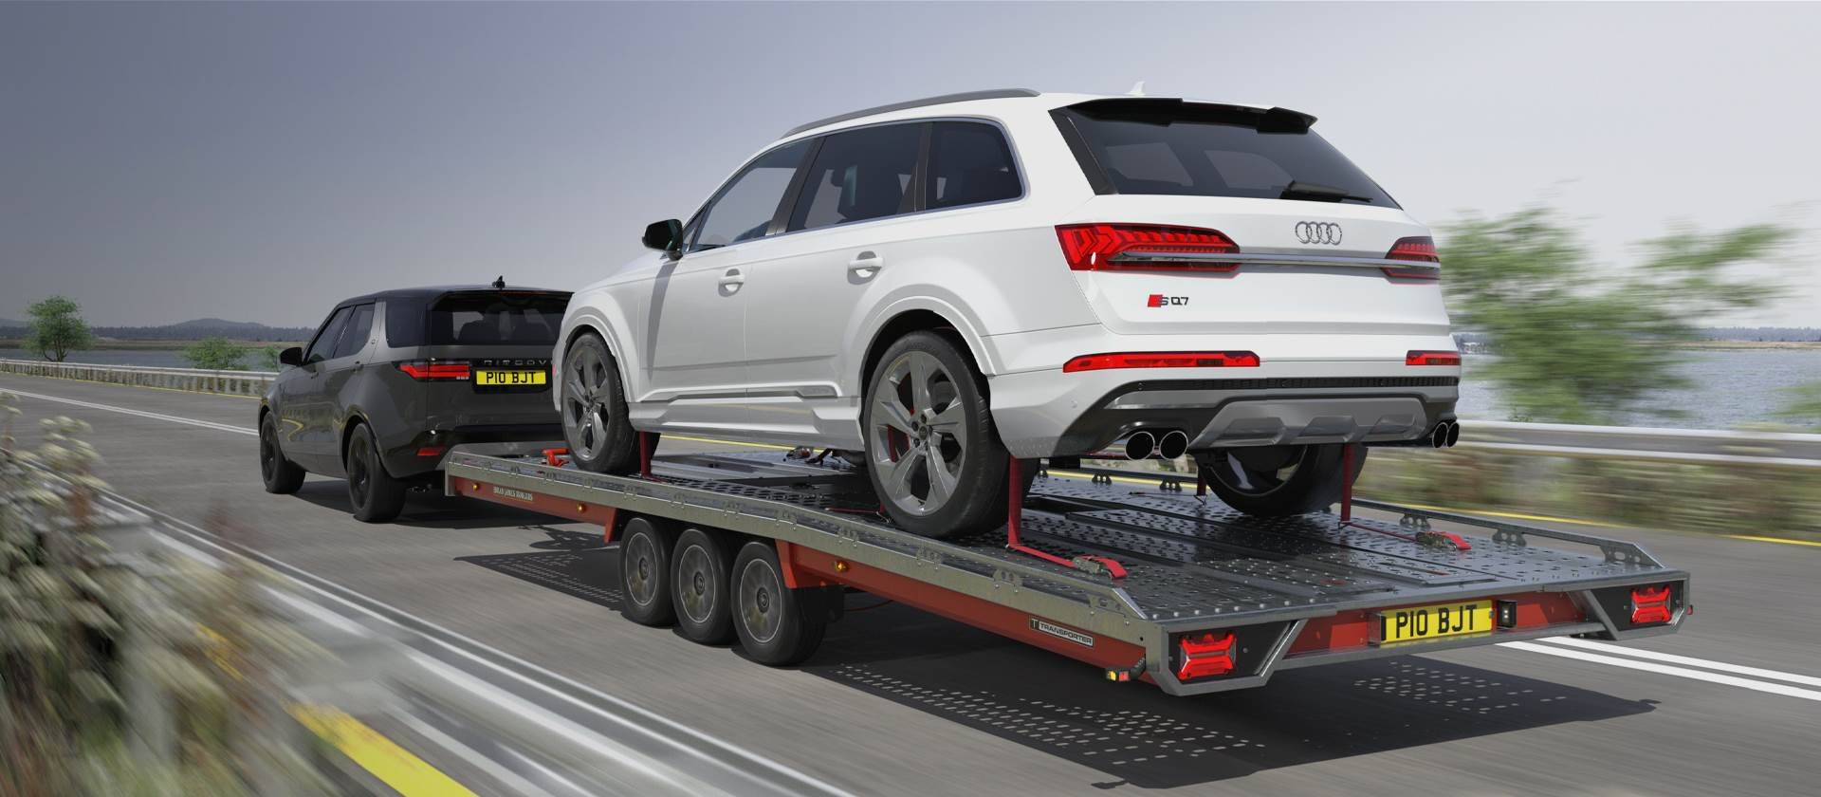
Trailer Safety
Viewpoint from a WorkSafe investigation
Our process – HSWA 2015
Information requests s168
Witnesses interviewed
CCTV
Expert knowledge
Review of the evidence
Decision as to how to resolve the matter
Notes:
This is an oversight; it is not a comprehensive list of what not to do or what to do. This is an appreciation of some the factors you should be considering when using a trailer.
S168 requests training records, service /maintenance records, employment records, purchase agreements, safe systems of working, Standard Operating Procedures, purchase or lease agreements

Slide 5
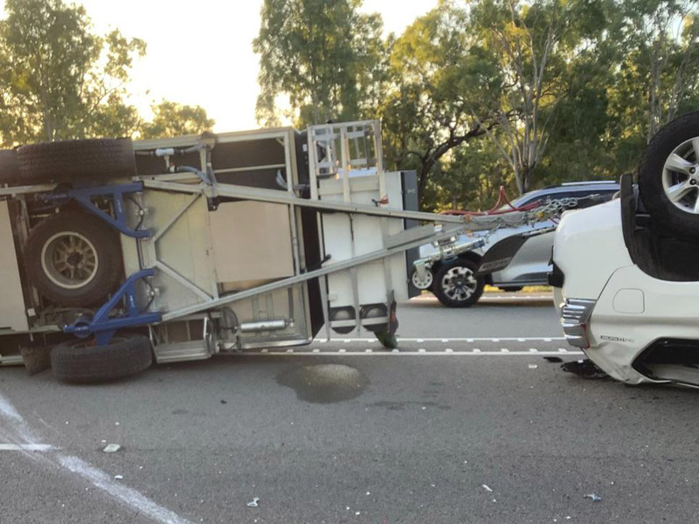
Major cause of fatal trailer incidents
Trailer sway
Contributing factors of sway –
Overloading
Incorrect tyre pressures
Incorrect torque on the wheel nuts
Incorrect load distribution on the trailer
Speed
Lack of training
Notes:
We will be talking about these factors in more detail as the presentation progresses.
Usually, a combination of these factors results in the trailer swaying

Slide 6
Investigation topic Training
ABC of training
A Assume nothing
B Believe nobody
C Confirm everything
Induction
Level of training
Fitting to tow bar
Reversing
How to load
How to secure the load
Notes:
If the correct training has been provided and evidenced, the PCBU has complied the training aspect of an investigation.
If you’re going to do something, do it well.

Slide 7
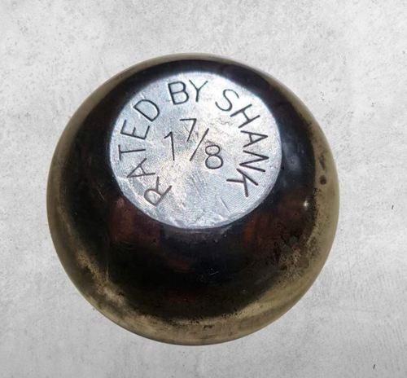
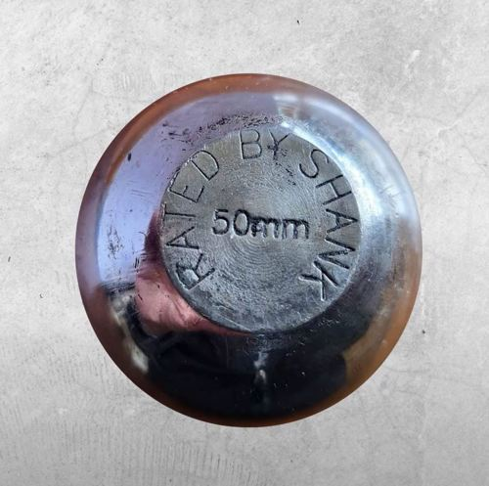
Investigation topic Tow bar & ball
Size of tow ball
1 7/8 – Generally towing up 1350kg
50mm – Generally towing up 3500kg
Weight capacity of tow bar – Weight ratings
Electrical connection
Safety chain
Notes:
The standard 1 ⅞ tow ball is a commonly used size that fits most trailers, caravans and boats. These particular tow balls are usually good for towing up to 1350kg. In most cases, the standard 1 ⅞ tow ball has a 47.6mm diameter and is secured with a bolt and nut.
Arguably more common is the 50mm tow ball. These tow balls are also good for towing anything from a loaded furniture trailer through to a flat deck trailer loaded up with heavy machinery. 50mm tow balls are generally good to tow up to 3500kg. As the name suggests, this tow ball is 50mm in diameter. In most cases, they’re secured with a locking mechanism.

Slide 8
Investigation topic Vehicle & Trailer capabilities
Vehicle
Ensure the vehicle is capable of towing the trailer (underpowered vehicles particularly up hill can be dangerous)
Trailer
Weight capacity
Condition
Load
Straps, ropes and fasteners are in good condition
Check load periodically to ensure it remains secure
Notes:
Overloading is the biggest cause of damage to trailers, it can stress the welds, bend the axles, add pressure to your drawbar which may cause bending, increase pressure on tires causing blowouts and most worryingly the more weight you carry you greatly increase your stopping distance when braking suddenly, the extra weight causes extra momentum which can be horrific in the wrong circumstance.

Slide 9
Investigation topic Tyre pressures
Under inflation –
Heat build up leading to tyre failure
Makes cornering more difficult (Stiffness)
Trailer less stable on the road, general handling, vehicle pull braking distances become greater
Can contribute to trailer sway
Rapid wear of the tyres
Over inflation –
Distort the shape of the tyre
Less traction especially in wet conditions
Tyre wears quicker
Vehicle bounce
Notes:
Underinflated tyres experience more deflection and hence increased heat build-up which can lead to tyre failure. This did not occur in this case. Underinflation also reduces the cornering stiffness of the tyres which means that greater slip angles are required to generate the same amount of lateral force. This will reduce the yaw damping ratio and make the vehicle more susceptible to trailer sway. Because we don’t have cornering stiffness data for these specific tyres it is difficult to quantify this effect. There is very little published data for any tyres on the effect of inflation pressure on cornering stiffness.

Slide 10
Investigation topic Wheel nuts torque
Incorrect torque on the wheel nuts can cause sway
Uneven torque can cause stress on individual studs
Wheel movement (wobble)
Wearing of the wheel studs
Stud holes on the wheel can become elongated
Incorrectly torqued nuts reduces the load capacity
Notes:
The recommended torque values expect all the nuts on the wheel to be torqued to the same value so that the stresses are evenly distributed around the wheel. The actual torque values were not only low but varied significantly from nut to nut around the wheel which will result in localised areas of high stress. Furthermore, the weight capacity of the wheel determines the number of studs required and their size. The torque value for nuts pretensions the studs so that when a lateral loading cycle is applied, the maximum tension value does not exceed the yield stress of the stud and the minimum tension value does not go negative. Thus, the stress associated with the recommended torque value is approximately half the yield stress of the stud regardless of the wheel loading.

Slide 11
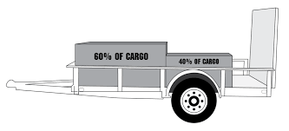
Investigation topic Load type/weight & positioning/distribution
Notes:
When loading a trailer, where should you put the weight? The simple rule to follow is to place 60% of the weight in front of the axle and 40% behind. It doesn't matter if you're loading a single-axle, double-axle or triple-axle trailer, the 60/40 rule still applies.

Slide 12
Investigation topic Speed
All the aspects of speed can contribute to trailer sway
Passing vehicles – high sided trucks
Gusty conditions
Bumpy roads
Drive slower down hill

Slide 13
Investigation topic Gross Vehicle Mass (GVM)
Gross Vehicle Mass (GVM) is the term used to describe the total weight a vehicle can safely operate at. Gross vehicle mass includes the combined weight of the vehicle tare weight (Unladed weight) and its load
For example, if a 7m x 4m 1200kg GVM Trailer has a tare weight (unladed weight) of 200kg, therefore the maximum payload the trailer can carry is 1000kg or 1 tonne (1200kg-200kg).
How do know my trailer’s GVM?
There are several ways to check your trailer’s GVM,
check the New Zealand motor vehicle register
ask your mechanic at your next Warrant of Fitness or service
call the manufacturer, depending how old your trailer is, they may have records on your model
Make sure you also check your trailer's tare weight at the same time, the manufacturer may have this information, or you can find local weigh stations online, try your local truck stop or mechanic or tyre service centre. Rubbish tips and scrap metal businesses may also be able to weigh your trailer for you as well.
Notes:
Prevent overloading situations

Slide 14
Investigation topic Trailer Classes and Weight Restrictions for towing
Understanding the regulations around towing for different weights and different trailer classes is key for safe towing.
The important ones are:
0-750kg – no brakes required.
0-2000kg – no brakes required.
2001-2500kg – brakes required.
2501-3500kg – specific brakes required.
Notes:
When deciding whether or not your trailer needs brakes, you should consider the tow vehicle capacity for unbraked trailers, the trailer unladed weight as well as the Gross Vehicle Mass (GVM) of your trailer.
The GVM is the total weight of your trailer including its contents when it is loaded ready for use.
If your trailer has a GVM that exceeds your tow vehicle's capacity for unbraked trailers, then brakes are required. It is important to ensure that you have adequate braking power to safely handle any situation while

Slide 15
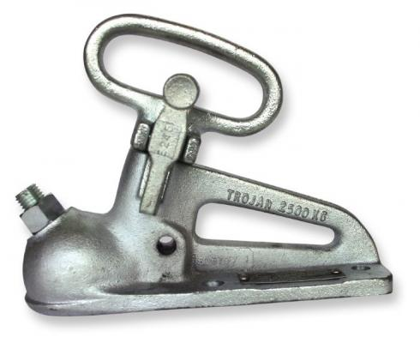
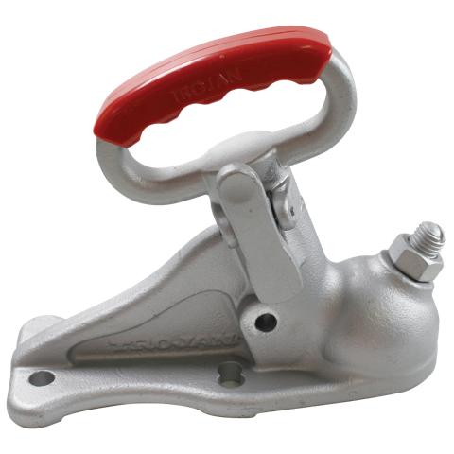
Investigation topic Coupling or hitch types
Duo Fit Trailer Coupling
Fits both 50mm & 1 7/8 tow balls
Note:
weight rating
Notes:
Four elements to consider when using a trailer
Size and rating of the tow ball
Weight Rating of tow bar
Coupling size and weight rating
Weight Rating of trailer
A 50mm Coupling will fit over a 1 1/8 tow ball, BUT it is too big and could bounce off

Slide 16
Investigation topic Maintenance
General condition of the trailer
Tow bar
Tow ball
Tyre condition
Tyre Pressures
Wheel nuts torque
Electrics
Deck
Cages
Drop sides/ends
WOF up to date (often get forgotten)
Serviced regularly

Slide 17
Questions/ Discussion

