Slide 1
The State of the Nation’s Health and Safety in 2024
Mike Cosman, MInstD
Cosman Parkes Ltd

Slide 2
Outline
Where have we come from?
What’s changed since HSWA 2015?
Are things getter better or worse?
Government review of HSWA
WorkSafe’s new strategy
Taskforce 2.0
From the Courts
Opportunities and risks
Discussion

Slide 3
Our history
50 years ago, we killed people quickly in mines, quarries, forests, construction, factories, fishing and farming
We killed people slowly with asbestos, agrichemicals, dust, fumes and vapours
We harmed people’s hearing and mental health (but didn’t acknowledge it)
We blew up mines and had structures collapse
We introduced ACC as a no-fault insurer to care for those we harmed
We had enquiries and new legislation in 1992, 1999 and 2015

Slide 4
Today
We still kill and harm people in the same industries and largely in the same way –but less often,
We also harm them in some new ways
Violence and aggression in retail
Engineered stone
Viruses
Cyber bullying and sexual harassment
We work longer and harder and the distinction between work and non-work is narrowing
The gap between treatment for ACC compensated injuries and non-occupational ill health has widened as we failed to implement part 2 of the Woodhouse Report
As a society, we have normalized a level of harm and no longer worry about it –until it happens to one of us. Then we demand ‘Justice’
We are confused about what ‘good looks like’ and overwhelmed by our own Blue Tape.

Slide 5
Has HSWA 2015 changed anything?
4 influences on business required strengthening:
Governance
Workers
B2B
Regulator
Complete and modernise the regulatory framework
Regulate high hazard facilities
Increase incentives and deterrents
Greater focus on physical and mental health risks
Mainstream health and safety as a critical success factor, not just a compliance obligation

Slide 6
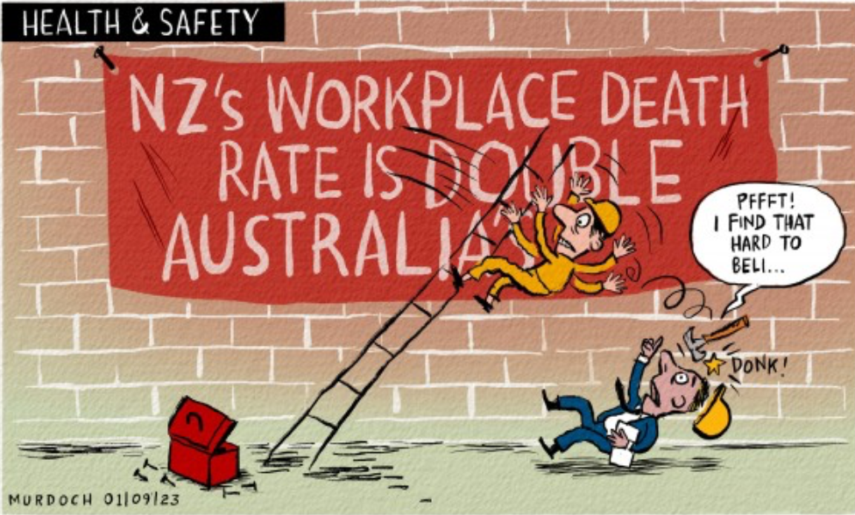
How are we doing?

Slide 7
2023 Economic Analysis
In 2022, New Zealand’s work toll conservatively cost us $4.4 billion.
While we are making progress, it is slow.
Our fatality rates are where the UK was in the 1980s and twice that in Australia.
If we could improve our performance to match that of Australia, we would reduce our costs by nearly $1 billion per annum.
The size of the prize is large in human, social and economic terms.

Slide 8
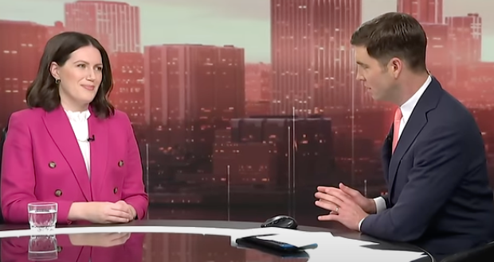
Minister van Velden –Review of Health and Safety
“The compliance burden on some businesses is excessive”
“My priorities are to simplify and clarify”
“People tell me they are spending all this time putting up posters to try and show we are keeping our workers safe, but they are not sure if they are doing the right thing”
“The review of health and safety will be very wide and encompassing.”
“We will consult business and workers as widely as possible”
“WorkSafe hasn’t been performing its role”
Australia has double the ratio of inspectors and half the deaths –”We will look at this. Not sure if increasing the ratio of inspectors to workers will make a difference.”
Should we follow Australia's ban on engineered stone?–”need to take time to consider-not wanting to be reactionary”

Slide 9
How can BeSafe Taranaki contribute to the review?
What would you keep, change, get rid of?

Slide 10
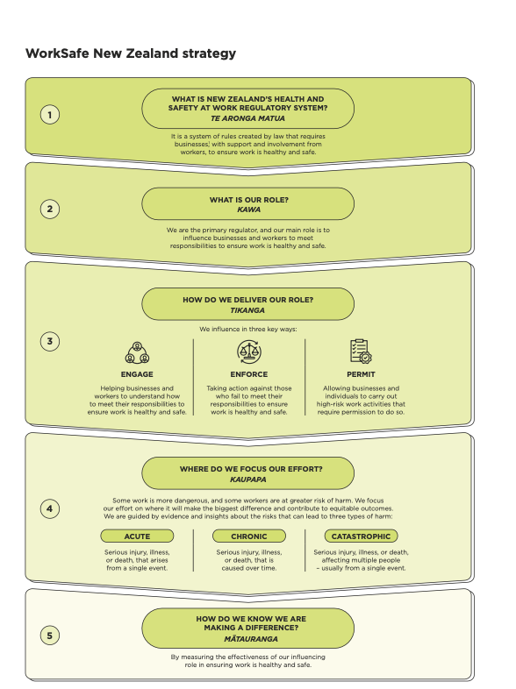
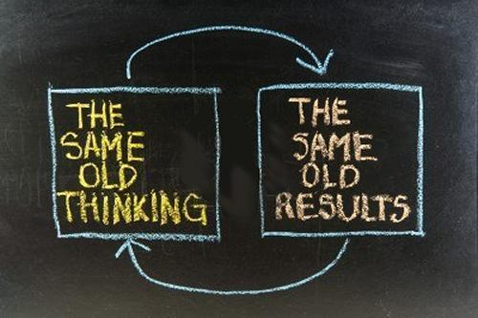
WorkSafe’s ‘new’ Strategy

Slide 11
Hot off the Press! Taskforce 2.0
New Zealand has not learnt from its past health and safety failures
We have no national plan of action to focus government and businesses shared efforts
90% of businesses, industry leaders and stakeholders surveyed want to see the government prioritise improvements to NZ's health and safety performance
The Health and Safety Act is fit for purpose - it's the supporting regulations, guidance and regulator follow-through that are the changes to address
There is an absence of central coordination and ownership from government and crown agencies.

Slide 12
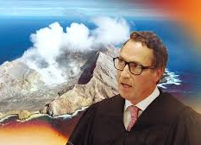
From the Courts
Whakaari
POAL ex CEO
Salters Cartage
Overlapping duties

Slide 13
Opportunities and risks
Are we addressing inequitable outcomes?
Māori and Pasifika
New migrants
Young workers
Older workers
Occupational health
Climate ready?
Hydrogen
LI Batteries
Weather/sea level risks
Access to competent advice?
Supporting SMEs in our supply chains and communities?
Can we declutter without reducing essential controls?
Share best practice better to stop reinventing wheels?
Engage our workers better?
Develop better co-regulatory models between industry and WS?
ESG pressure from investors?
What else?

