Slide 1

JSEA
Job Safety & Environmental Assessment Training

Slide 2
JSEA Training
Introduction
Elements of the JSEA document
Application of the JSEA Process
Establishing the risk
Residual Risk Acceptance
Determining task steps
Establishing the Uncontrolled risk score
Controls
Establishing the Controlled risk score
Recovery Actions

Slide 3

Introduction
Why do we have to change?
Current document does not comply with legislative requirements.
A requirement to establish Raw (uncontrolled) & residual (controlled) risk for work activities.
Ensure that management understand the significant risks workers undertake & their controls.
Notes:
Under the Health and Safety at Work Act 2015, you are required to identify & risk assess hazards likely to result in injury or illness to yourself, other workgroups or members of the public.
Part 2 Health and safety duties. Subpart 1—Key principles relating to duties.
Element 30 - Management of risks.
(1) A duty imposed on a person by or under this Act requires the person—
(a) to eliminate risks to health and safety, so far as is reasonably practicable; and
(b) if it is not reasonably practicable to eliminate risks to health and safety, to minimise those risks so far as is reasonably practicable.
Subpart 3—Duties of officers, workers, and other persons
44 Duty of officers
(1) If a PCBU has a duty or an obligation under this Act, an officer of the PCBU must exercise due diligence to ensure that the PCBU complies with that duty or obligation.
(2) For the purposes of subsection (1), an officer of a PCBU must exercise the care, diligence, and skill that a reasonable officer would exercise in the same circumstances, taking into account (without limitation)—
(a) the nature of the business or undertaking; and
(b) the position of the officer and the nature of the responsibilities undertaken by the officer.
(3) Despite subsection (1), a member of the governing body of a territorial authority or regional council elected in accordance with the Local Electoral Act 2001 does not have a duty to exercise due diligence to ensure that any council-controlled organisation (as defined in section 6 of the Local Government Act 2002) complies with its duties or obligations under this Act unless that member is also an officer of that council-controlled organisation.
(4) In this section, due diligence includes taking reasonable steps—
(a) to acquire, and keep up to date, knowledge of work health and safety matters; and
(b) to gain an understanding of the nature of the operations of the business or undertaking of the PCBU and generally of the hazards and risks associated with those operations; and
(c) to ensure that the PCBU has available for use, and uses, appropriate resources and processes to eliminate or minimise risks to health and safety from work carried out as part of the conduct of the business or undertaking; and
(d) to ensure that the PCBU has appropriate processes for receiving and considering information regarding incidents, hazards, and risks and for responding in a timely way to that information; and
(e) to ensure that the PCBU has, and implements, processes for complying with any duty or obligation of the PCBU under this Act; and
(f) to verify the provision and use of the resources and processes referred to in paragraphs (c) to (e).

Slide 4
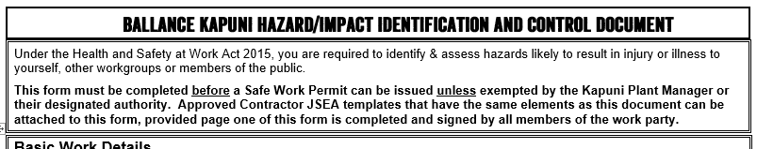
JSEA Document
the JSEA document is made up of the following elements:
Context:

Slide 5
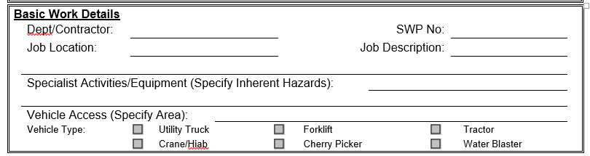
JSEA Document
Basic Work Details:
Notes:
Minor administrative changes applied.

Slide 6
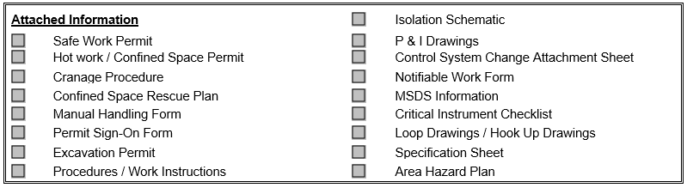
JSEA Document
Attached Information:
Notes:
Minor administrative changes applied.

Slide 7
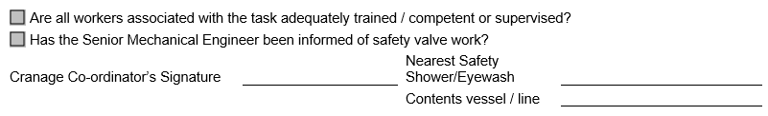
JSEA Document
Additional Information:
Notes:
Minor administrative changes applied.

Slide 8
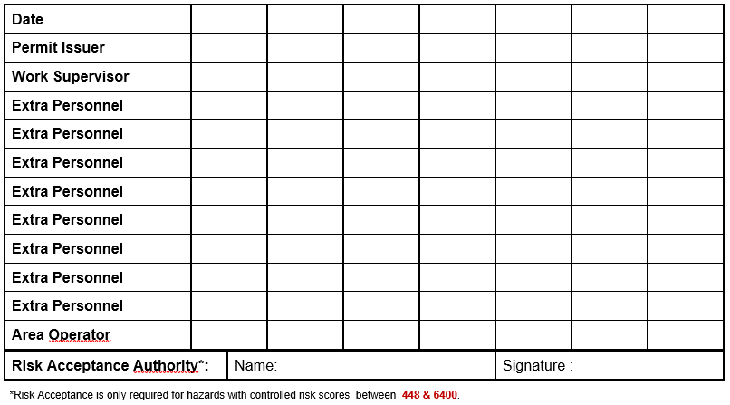
JSEA Document
Signing/Acceptance:
Notes:
Addition of extra personnel & Risk Acceptance Authority.
Risk Acceptance Authority is only required when residual/controlled risks are in the “Red Zone” (Scores of between 448 & 6400).

Slide 9

JSEA Document
Risk determination:
v
Consequence
Likelihood
‘s
Notes:
the JSEA document is made up of the following elements:
Consequences
Catastrophic: Multiple fatalities and/or multiple permanent disabling injuries, occupational illnesses and/or disease occurring either on site or off site from the actions of the business. Reportable to Regulatory authority. FATAL RISK
Spill or release that triggers a national civil defence and/or an emergency management response. Results in prosecution and has extensive and possibly irreversible impact on receiving environment and habitats. FATAL RISK
Major: Single fatality / life threatening injury or permanent disablement through occupational illness and/or disease occurring either on site or off site from the actions of the business. Reportable to Regulatory authority. FATAL RISK
Very noticeable and regionally significant spill or release. Breaches resource consent, or results in prosecution. Major impact on receiving environment and habitats. Extremely difficult to clean up.
Serious: Other Notifiable Event. Serious injury or serious occupational illness (LTI) with long term health effects and long term absence or moderate irreversible disability, requiring hospitalisation. Reportable to Regulatory Authority.
Noticeable localised spill or release that breaches resource consent, or results in prosecution. Serious impact on receiving environment and habitats. Difficult to clean up.
Moderate: LTI or MTI. Serious but reversible (temporary) injury / occupational Illness / health effect not requiring hospitalisation. Not reportable to Regulatory authority.
A FAC -noticeable, but not really obvious, spill or release that discharges off-site and needs to be reported to a Regional Council (e.g. exceeds consent trigger). Moderate impact on receiving environment and habitats.
Minor: Injury/occupational illness requiring first aid treatment only.
A minor spill or release where either some leaves site (e.g. gas, odour, or dust) and may result in an external complaint, or is more difficult to clean up because it has entered soil or water. Minor impact on receiving environment.
Insignificant: Contact with hazard but no injury/illness that requires treatment.
A spill or release that remains on-site and does not cause an impact and is cleaned up (e.g. hydraulic oil spill inside a building or leak in a bund). Insignificant impact on receiving environment.
Likelihood
Almost certain: Can be expected to occur in most circumstances; A similar event has occurred a number of times in this company; A very complex process with minimal controls, checks and balances are in place; Numerous impacting factors outside control of organisation;
Likely: Can be expected to occur at some time; Similar event has previously occurred at this site; Previous audits/reports indicate regular non-compliance with controls; Complex process with some controls, checks and balances in place; May have some impacting factors outside control of organisation;
Possible: Might occur at some time; May have previously occurred in this industry within AU/NZ/UK or Canada over the last two years; Previous audits/reports indicate occasional non-compliance with controls; Complex process with extensive controls, checks and balances in place; No impacting factors outside control of organisation;
Unlikely: Could occur at some time; May have previously occurred in this industry somewhere in the world at some time; Previous audits/reports indicate no non-compliances with controls; Non-complex process; Extensive checks and balances in place; Layers of controls in place and regularly monitored;
Highly Unlikely: Highly unlikely to occur. May have previously occurred in some industry, somewhere in the world at some time; Previous audits/reports indicate no non-compliances with process or controls; Non-complex process; Extensive checks and balances in place; Layers of controls in place and regularly monitored;
Vary Rare: Extremely difficult for it to occur; Theoretically possible but only in extreme circumstances; Similar events not known to have occurred in industry, but is plausible; No previous incidents of non-compliance with controls or process; Extremely simple process; Extensive checks and balances in place; Multiple layers of controls in place and regularly monitored;

Slide 10
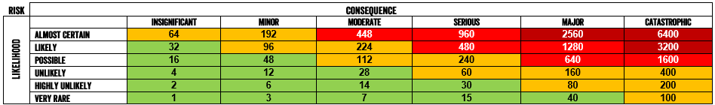
JSEA Document
the JSEA document is made up of the following elements:
Risk determination:
Notes:
Consequences
Catastrophic: Multiple fatalities and/or multiple permanent disabling injuries, occupational illnesses and/or disease occurring either on site or off site from the actions of the business. Reportable to Regulatory authority. FATAL RISK
Spill or release that triggers a national civil defence and/or an emergency management response. Results in prosecution and has extensive and possibly irreversible impact on receiving environment and habitats. FATAL RISK
Major: Single fatality / life threatening injury or permanent disablement through occupational illness and/or disease occurring either on site or off site from the actions of the business. Reportable to Regulatory authority. FATAL RISK
Very noticeable and regionally significant spill or release. Breaches resource consent, or results in prosecution. Major impact on receiving environment and habitats. Extremely difficult to clean up.
Serious: Other Notifiable Event. Serious injury or serious occupational illness (LTI) with long term health effects and long term absence or moderate irreversible disability, requiring hospitalisation. Reportable to Regulatory Authority.
Noticeable localised spill or release that breaches resource consent, or results in prosecution. Serious impact on receiving environment and habitats. Difficult to clean up.
Moderate: LTI or MTI. Serious but reversible (temporary) injury / occupational Illness / health effect not requiring hospitalisation. Not reportable to Regulatory authority.
A FAC -noticeable, but not really obvious, spill or release that discharges off-site and needs to be reported to a Regional Council (e.g. exceeds consent trigger). Moderate impact on receiving environment and habitats.
Minor: Injury/occupational illness requiring first aid treatment only.
A minor spill or release where either some leaves site (e.g. gas, odour, or dust) and may result in an external complaint, or is more difficult to clean up because it has entered soil or water. Minor impact on receiving environment.
Insignificant: Contact with hazard but no injury/illness that requires treatment.
A spill or release that remains on-site and does not cause an impact and is cleaned up (e.g. hydraulic oil spill inside a building or leak in a bund). Insignificant impact on receiving environment.
Likelihood
Almost certain: Can be expected to occur in most circumstances; A similar event has occurred a number of times in this company; A very complex process with minimal controls, checks and balances are in place; Numerous impacting factors outside control of organisation;
Likely: Can be expected to occur at some time; Similar event has previously occurred at this site; Previous audits/reports indicate regular non-compliance with controls; Complex process with some controls, checks and balances in place; May have some impacting factors outside control of organisation;
Possible: Might occur at some time; May have previously occurred in this industry within AU/NZ/UK or Canada over the last two years; Previous audits/reports indicate occasional non-compliance with controls; Complex process with extensive controls, checks and balances in place; No impacting factors outside control of organisation;
Unlikely: Could occur at some time; May have previously occurred in this industry somewhere in the world at some time; Previous audits/reports indicate no non-compliances with controls; Non-complex process; Extensive checks and balances in place; Layers of controls in place and regularly monitored;
Highly Unlikely: Highly unlikely to occur. May have previously occurred in some industry, somewhere in the world at some time; Previous audits/reports indicate no non-compliances with process or controls; Non-complex process; Extensive checks and balances in place; Layers of controls in place and regularly monitored;
Vary Rare: Extremely difficult for it to occur; Theoretically possible but only in extreme circumstances; Similar events not known to have occurred in industry, but is plausible; No previous incidents of non-compliance with controls or process; Extremely simple process; Extensive checks and balances in place; Multiple layers of controls in place and regularly monitored;

Slide 11
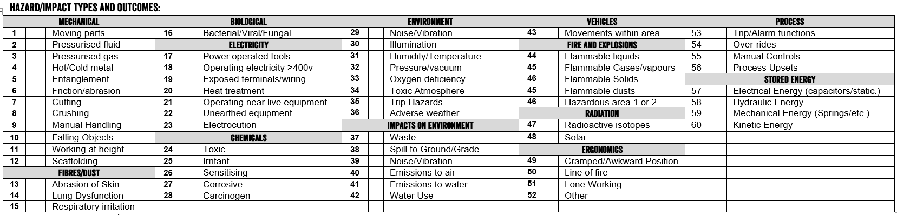
JSEA Document
Hazard/Impact Types & Outcomes:
Notes:
Minor administrative changes applied.

Slide 12
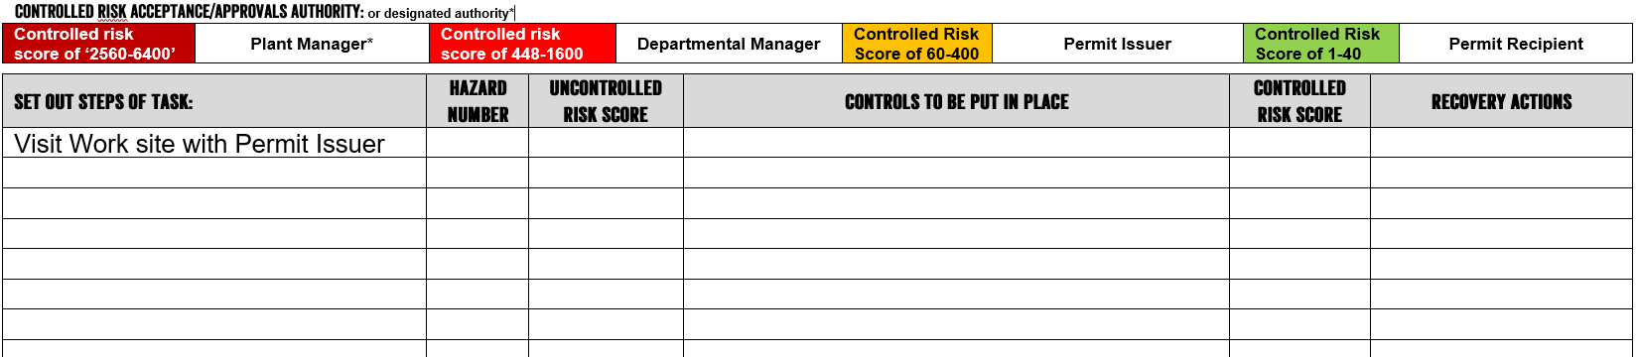
JSEA Document
Controlled Risk Acceptance/Approvals Authority & Risk Analysis:

Slide 13
JSEA Process
Plan the Work
Prepare for the work
Undertaking work
Review
Work instruction developed.
2nd Review & update of JSEA.
Note: Desktop activity with review by team.
Permit Issuer & Permit recipient (PR) visit site
New Hazard identified
Workgroup notifies PR & assesses risk of new hazard & controls
Create 1st Review of JSEA for the job.
(High level assessment)
Note: Desktop activity.
3rd Review & update of JSEA.
Note: Handwritten/edited review.
Source approval from appropriate approval authority.
Permit Recipient notifies appropriate Approval Authority of change.
Identify required approval authority
Permit Recipient briefs workers of JSEA contents.
Apply for Permit or review permit details.
OR

Slide 14


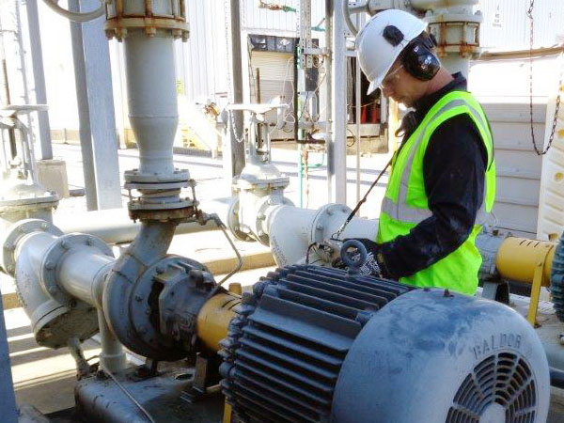

Job steps
Break job down into 4-5 basic steps*:
Preparation
Mobilisation
Work Activity
Demobilisation
Notes:
*Tasks should remain high level (5 in number) unless the controlled/residual risk is in the red-zones (at this point the authorising authority should want a refined breakdown of tasks.
An example of a basic task breakdown should include:
1. Preparation - Visit site and inspect equipment.
2. Mobilise to work-front (e.g. moving of equipment/mobile plant to workfront).
3. Remove equipment (e.g. Pulling out a pump motor)
4. Reinstate new equipment (e.g. Installation of replacement pump motor).
5. Demobilise from workfront (transfer of removed pump to workshop for overhaul).
Traps: Getting too detailed in the breakdown of tasks.

Slide 15
Raw risk
Is the risk associated with undertaking your work activities without any controls in place.
Consequences v’s Likelihood.
Notes:
Consequence = The reasonable outcome(s) should a hazard eventuate.
Likelihood = The likelihood of the event occurring and resulting in the identified consequence.
Traps: Choosing the highest consequence but selecting the likelihood for a lesser outcome (e.g. Selecting a consequence of death and then selecting a likelihood more suitable for bruising)

Slide 16
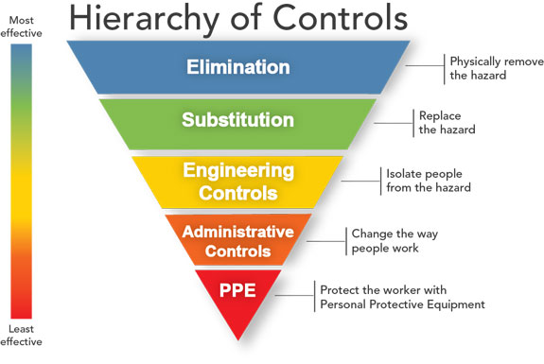
Controls
The mechanisms put in place to reasonably ensure the health & safety of workers from hazardous risks.
Notes:
We must show that the hierarchy of controls has been applied and that the selected hazardous risk control is as high up the hierarchy of controls as is reasonably possible.
It is a good idea to record on your JSEA the justifications for not selecting a control(s) that would sit higher up the hierarchy of controls.
Traps: A common trap is to over estimate the effectiveness of administrative/PPE controls when establishing risk.
As a general guide the reduction of risk scores should be calculated at:
a. Elimination risk score is reduced by 100% as the risk no longer exists.
b. Substitution – the risk reduction depends on the risk associated with the substitute materials.
c. Engineering control risk scores can be reduced by between 50% to 80% depending on its effectiveness
(considerations include the ability for people to work-around/over-ride safety features/etc.)
d. Administrative controls & PPE – the risk reduction should not exceed 25 points per admin & PPE control.
(e.g. 2 x admin controls equals a drop from a risk score of 100 to 50)

Slide 17
Controlled risk
Is the risk associated with undertaking your work activities with your selected controls in place.
Consequences v’s Likelihood.

Slide 18

Risk Acceptance
Acceptance Authority:
A manager (or their designated Authority) who is representing Ballance as an officer regarding the undertaking of work where controlled hazardous risks remain significant.
Notes:
Acceptance Authority:
A manager (or their designated Authority) who is representing Ballance as an officer regarding the undertaking of work where controlled hazardous risks remain significant.
The Acceptance authority is accepting that the risk cannot be lowered any further and is authorising the work to go ahead.

Slide 19

Recovery Actions
Stressful situations
=
Plan for them
Notes:
In an emergency situation it is stressful and it can be difficult to remember what needs to be done to prevent the outcomes getting worse.
This section the JSEA is to clearly identify and encourage discussion about worker recovery/response actions & responsibilities prior to undertaking work.

Slide 20

Legal
Notes:
Signing of the document is recording that you are aware of the risks, the controls & the required actions.
If it is ever relied on as evidence in court, you cannot say that you were not aware of the controls or required actions and as such may be held accountable for your actions.

Slide 21
Practical
Divide into teams of 2 and complete a risk assess a common work activity that you and your teams undertake.
Complete the digital risk register & return to your facilitator for review prior to the 1st November 2019.

Slide 22
JSEA Training
Thank you

