Slide 1
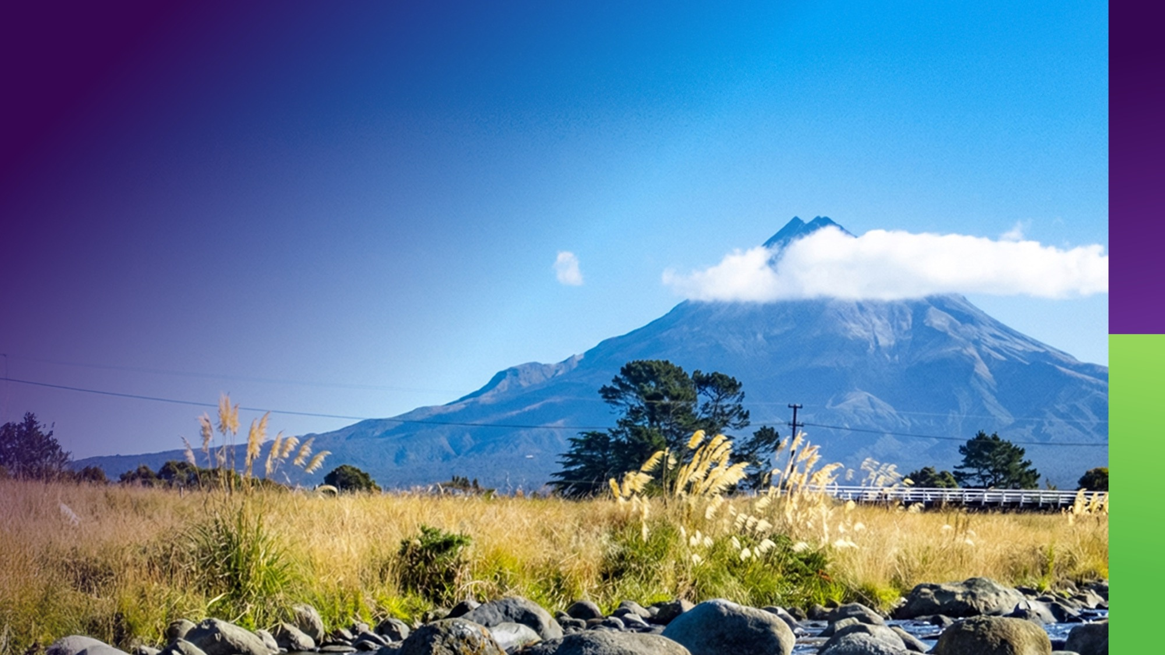


Working safely around Electrical Infrastructure
Safety by Design. Human Factors.
Shared Responsibility

Slide 2
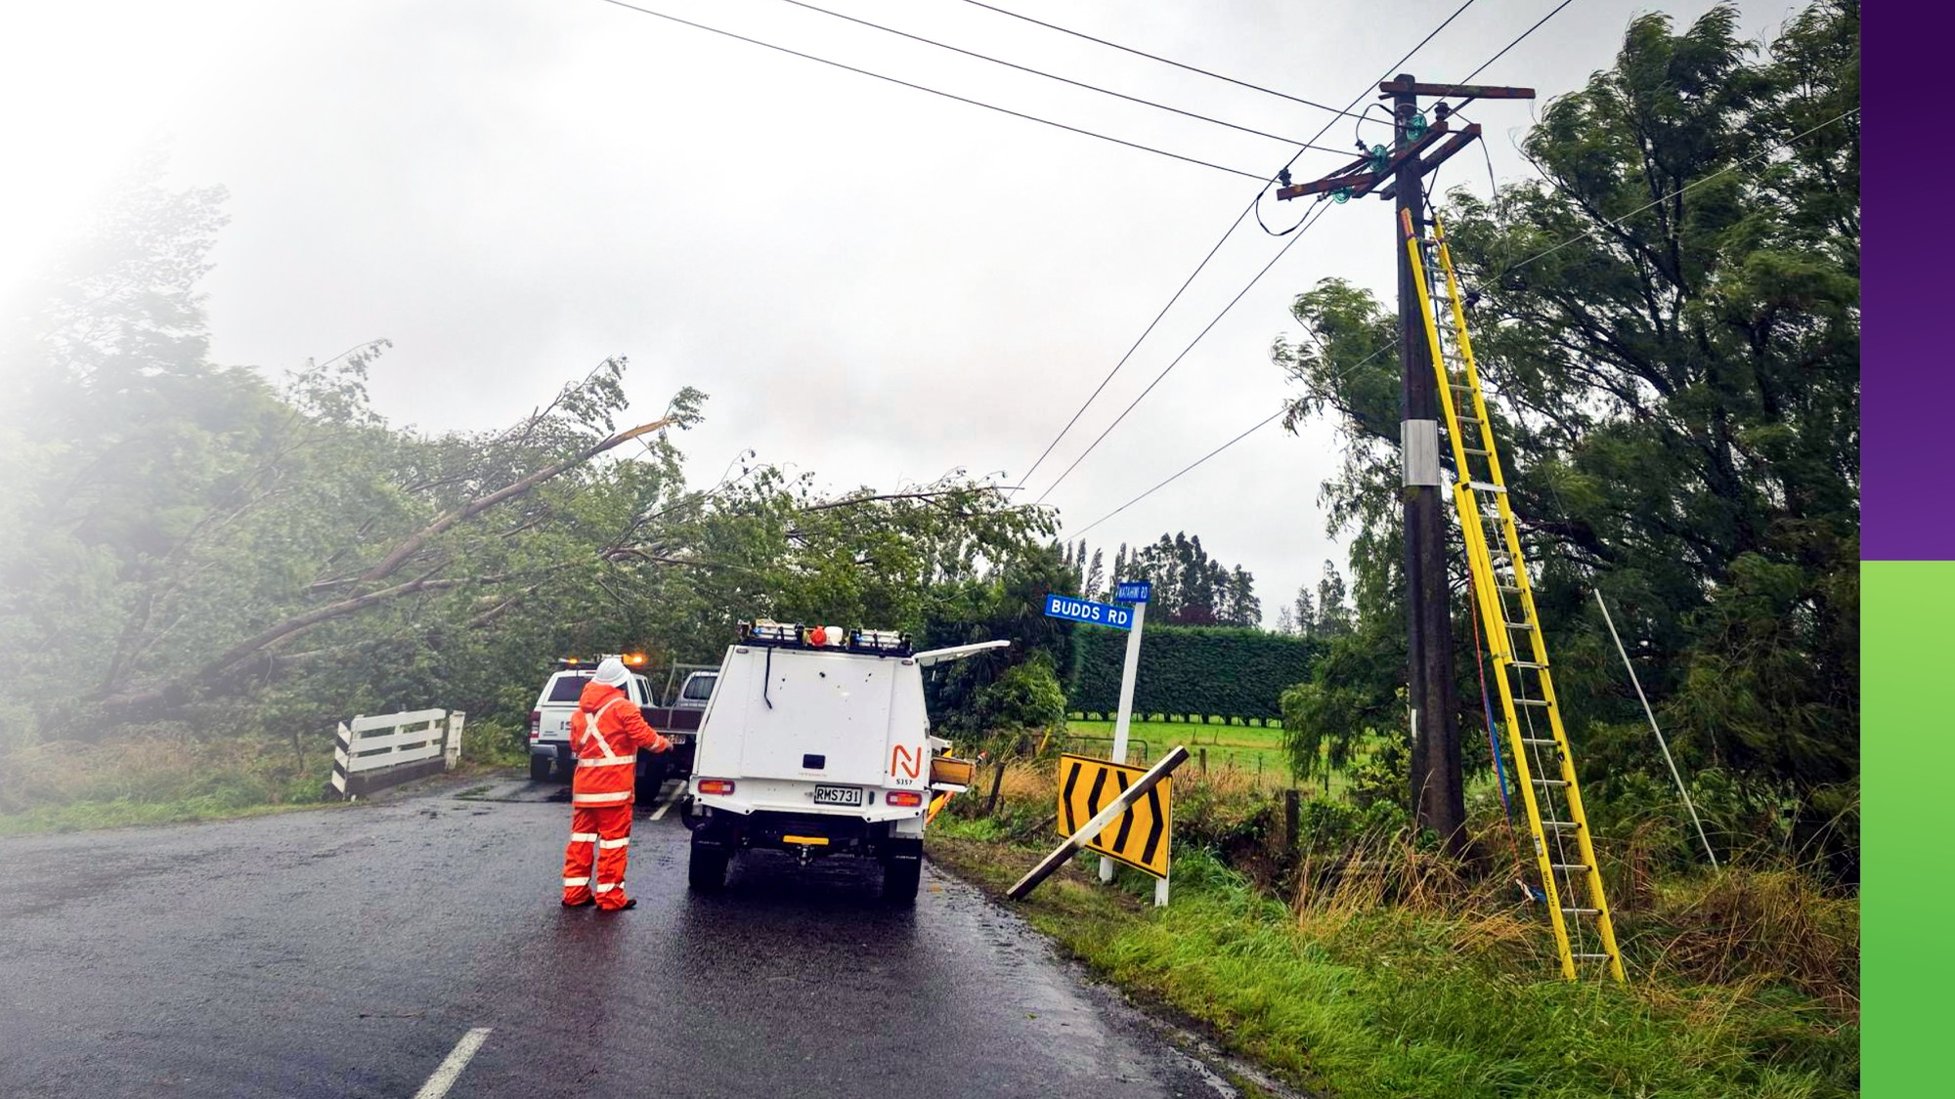
Why this matters
Notes:
Electricity is unforgiving
Small errors → catastrophic outcomes
Shared responsibility across Taranaki industry
Design + Planning + Behaviour = Safety
Speaker Notes:
Electricity does not give second chances. In our network, the difference between a normal day and a fatal event can be millimetres — or seconds.”
I want to position today as a regional partnership conversation — it's not about Powerco policing wider industry.
We all operate in the same environment — be that civil contractors, traffic management teams, designers, architects, builders, engineers. The risk sits in the spaces between our organisations.”

Slide 3
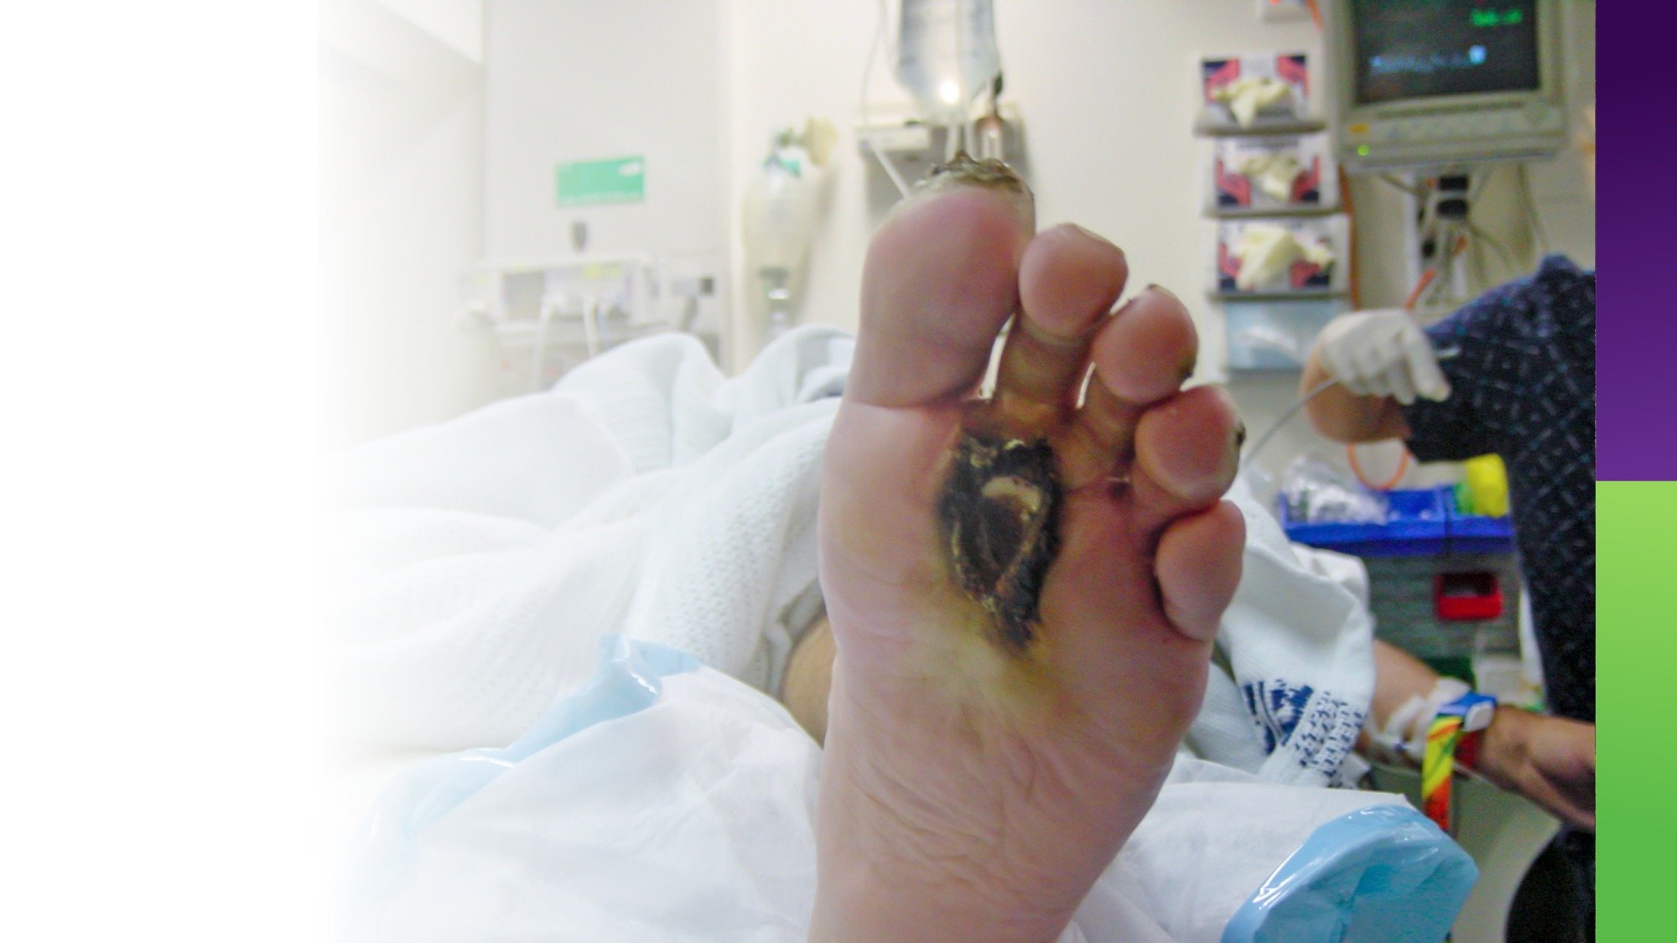
The reality of electrical risk
Notes:
Overhead lines
Underground cables
Poles & supporting structures
Mobile plant & height work interactions
Explain that electrical risk is often indirect exposure:
A tip truck tray
A crane boom
Scaffolding
A concrete pump
Traffic detours shifting lanes closer to poles
MADS reduced during construction – as recent as last week
Most serious incidents involve:
Assumptions about distance
“We’ve done this before” – Human conditioning, pushed by need to get work done all whilst site conditions are changing constantly.

Slide 4
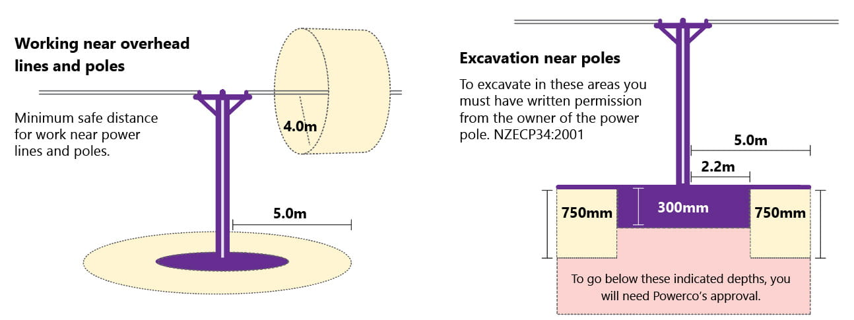
What is NZECP 34?
Notes:
Sets minimum electrical safe distances
Applies to buildings, structures & activities near lines
Recognised under Electricity (Safety) Regulations
Mandatory minimum standards
Explain clearly:
“NZECP 34 sets the minimum safe distances from live electrical conductors.”
Emphasise:
This is not guidance — it is enforceable.
Distances vary by voltage.
Applies to permanent AND temporary works.
Then make your key expansion point:
“This isn’t just about new buildings. It applies to minor works, scaffolding, fencing, signage, traffic diversions, lifting operations — anything that changes the proximity to live lines.”

Slide 5
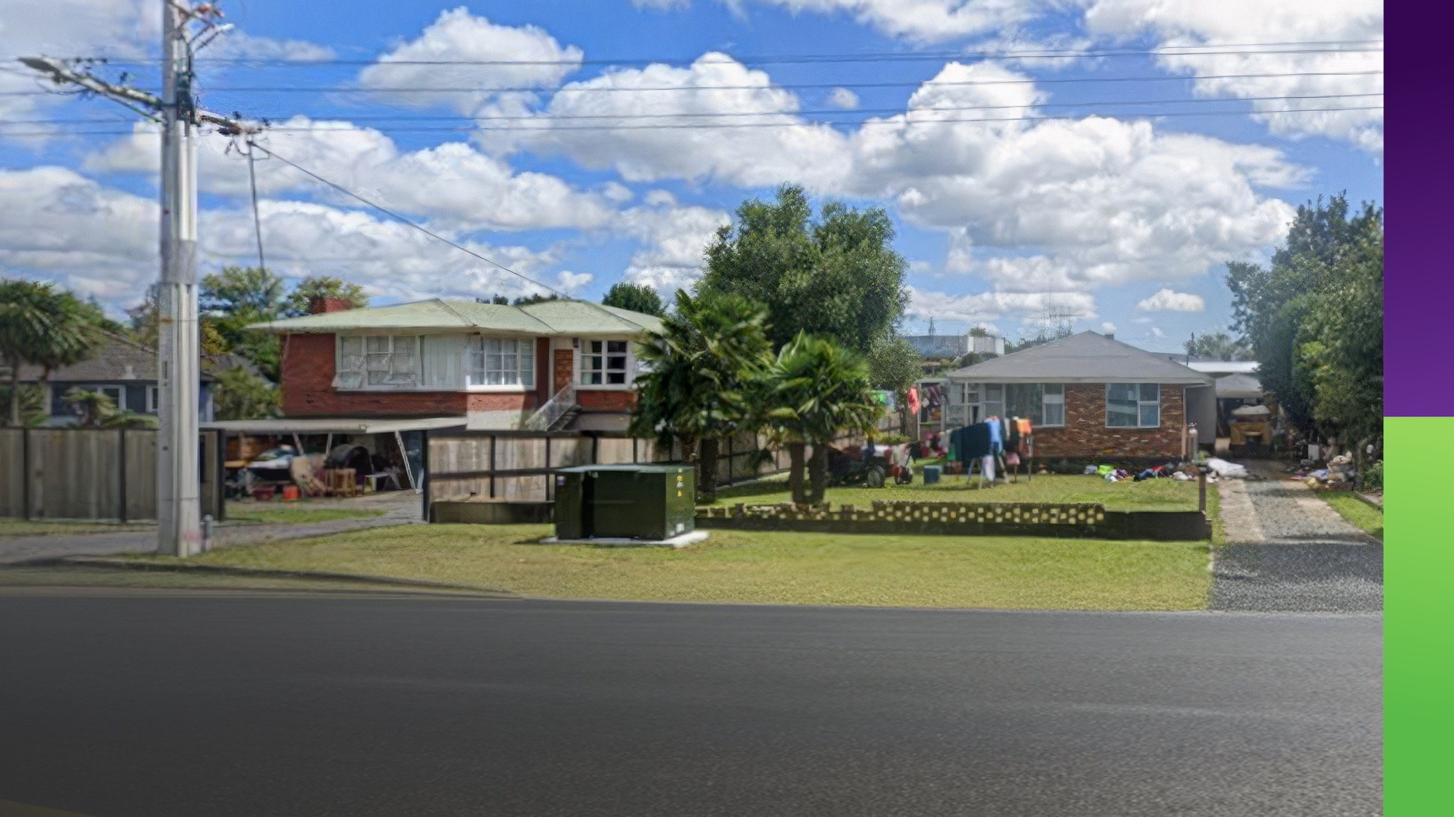
Safety by Design.
Broader than you think
Notes:
Safety by Design includes:
Civil works
Temporary traffic management
Minor construction
Signage & street furniture
Excavation
Event infrastructure
“Safety by design is often misunderstood as architectural design. In reality, it’s about eliminating or reducing risk at the planning stage — before boots hit the ground.”
Examples:
Moving a laydown yard 2 metres further from a pole
Rerouting traffic to avoid plant operating under lines
Selecting smaller plant
Scheduling isolations
Design is about shaping the system so humans don’t have to rely on perfect behaviour.

Slide 6


Human Factors. Why incidents really happen
Basketball Awareness Test
Notes:
Speaker Notes:
Introduce the video as a human factors lens.
People operate under pressure
Assumptions fill gaps
Normalisation of deviation
System conditions drive behaviour
After the video:
“Most electrical incidents are not caused by people trying to do the wrong thing. They’re caused by normal people operating in systems that don’t fully account for human limits.”
Talk about:
Time pressure
Competing priorities
Unclear drawings
Changing site conditions
Overconfidence from experience
Poor design/HAZOP studies

Slide 7
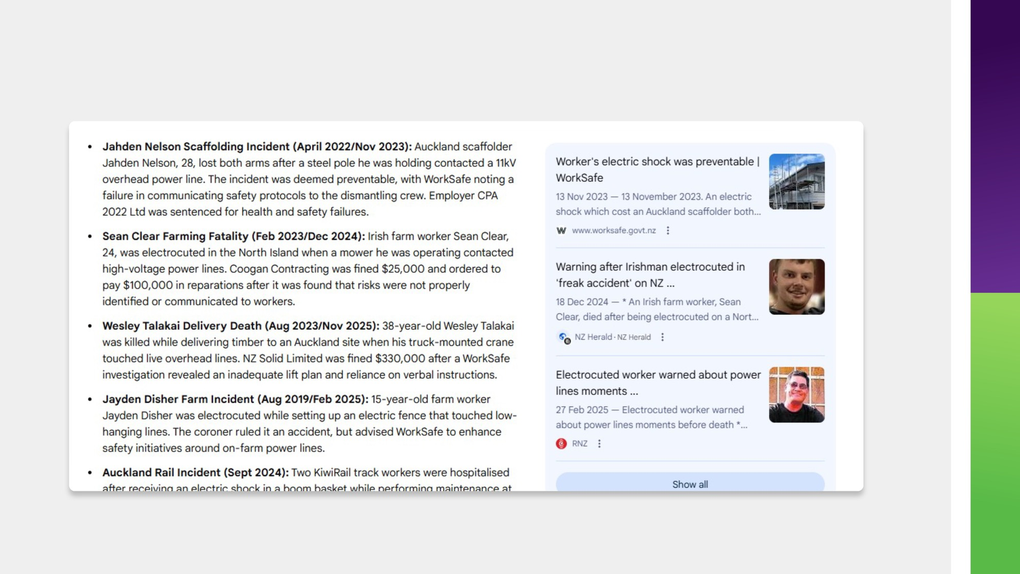
Human Factors in Electrical Work
Notes:
Common Contributors:
Misjudged distance
Poor visibility
Inadequate supervision
Ambiguous site controls
Assumed isolation status
“How many of us have thought ‘that looks far enough away’?”
Highlight:
Depth perception is unreliable
Voltage is invisible
Weather affects sag and swing
Fatigue changes judgment- not just hours worked but task fatigue
Design must compensate for this.

Slide 8
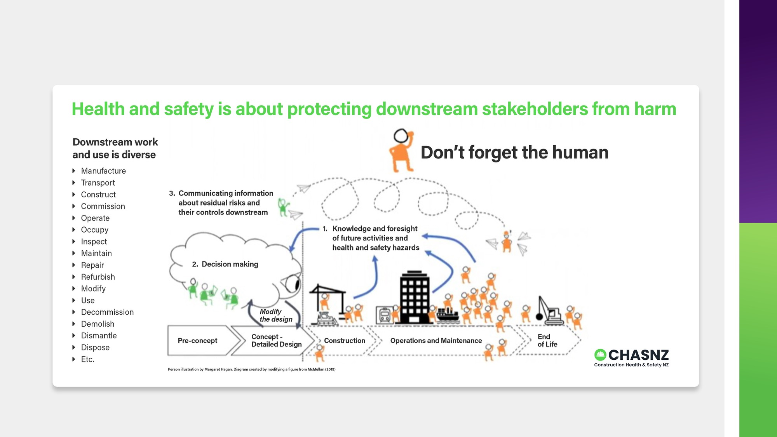
Designing for Human Reliability
Notes:
Good Safety Design:
Clear exclusion zones
Physical barriers
Visual markers
Engineering controls
Early engagement with asset owners
Simple permit systems
“We don’t design safety for perfect humans. We design for normal humans.”
Examples:
Goal posts for plant
Height restrictors
Spotters with clear authority
Isolation confirmation processes
Tie this back to NZECP 34 minimum distances.
Minimum distances are the baseline — good design often exceeds them.

Slide 9
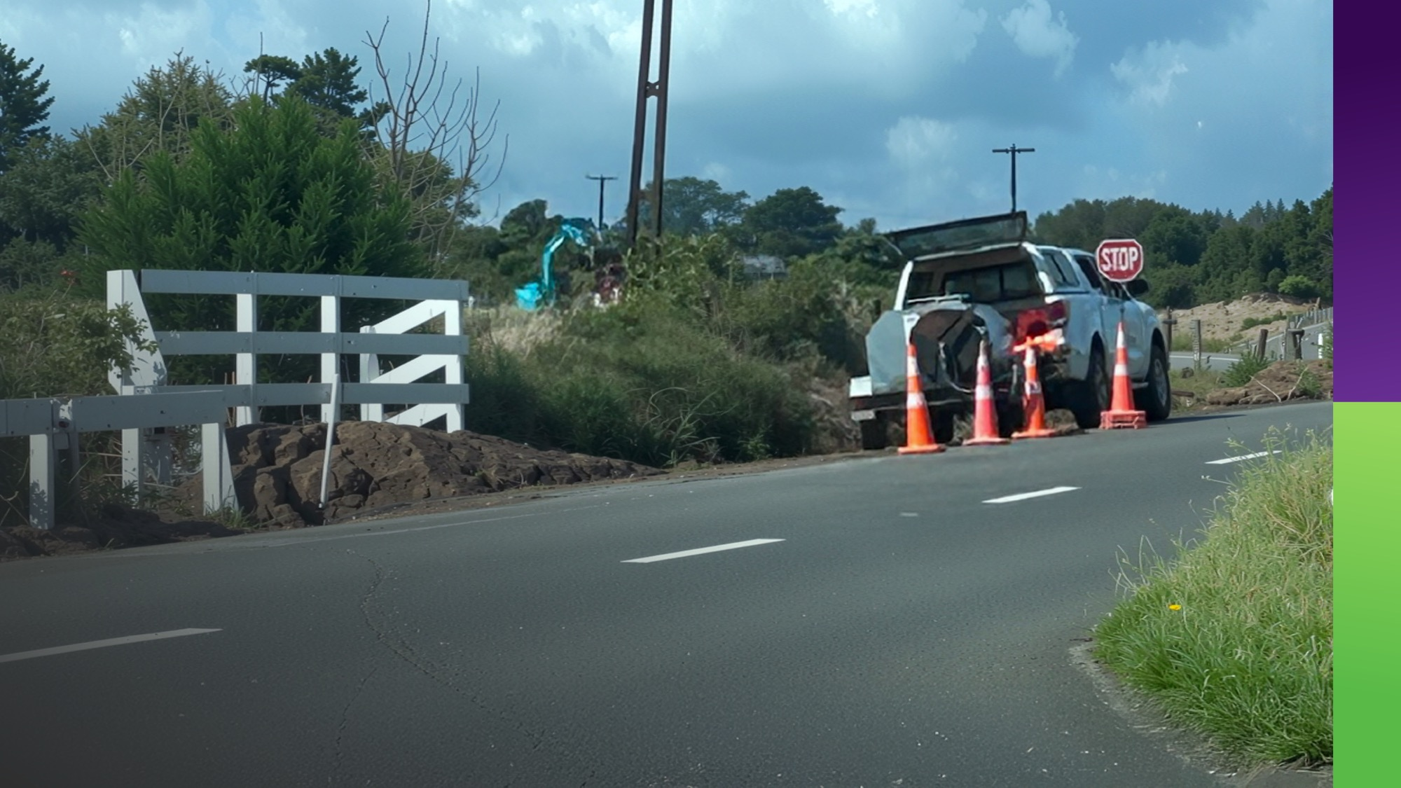
Minor Works & Traffic Works
Notes:
High-Risk Scenarios:
Traffic light installations
Temporary signage
Road resealing
Vegetation trimming
Crane lifts
Event set-up
Emphasise:
“Some of the highest exposure we see is not major construction — it’s routine minor works.”
Traffic diversions can:
Shift lanes closer to poles
Change plant approach angles
Reduce visibility
Minor works must still comply with NZECP 34.

Slide 10
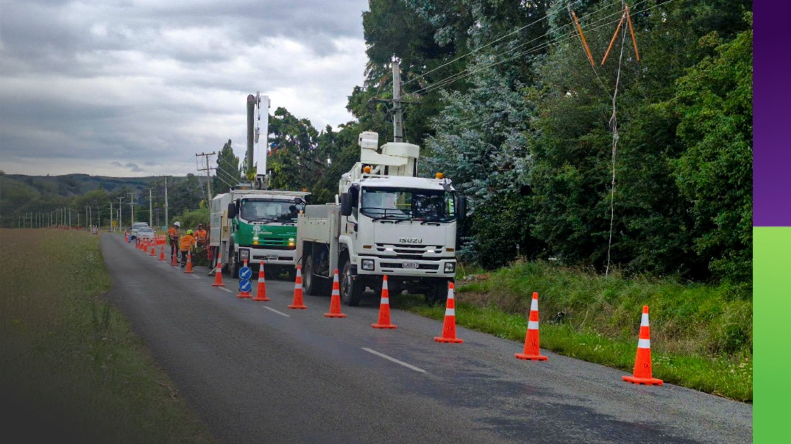
What we expect across
Taranaki industry
Notes:
Before Work Starts:
Identify proximity to electrical assets
Check NZECP 34 distances
Engage early with us
Build controls into planning
Account for human factors
“We don’t expect perfection. We expect early engagement, thoughtful planning, and systems that don’t rely on luck.”

Slide 11

Safety is Designed.
Safety is Shared.
Safety is Deliberate.
Notes:
Design work so that when humans are humans – the outcome is still safe

Slide 12
