Slide 1
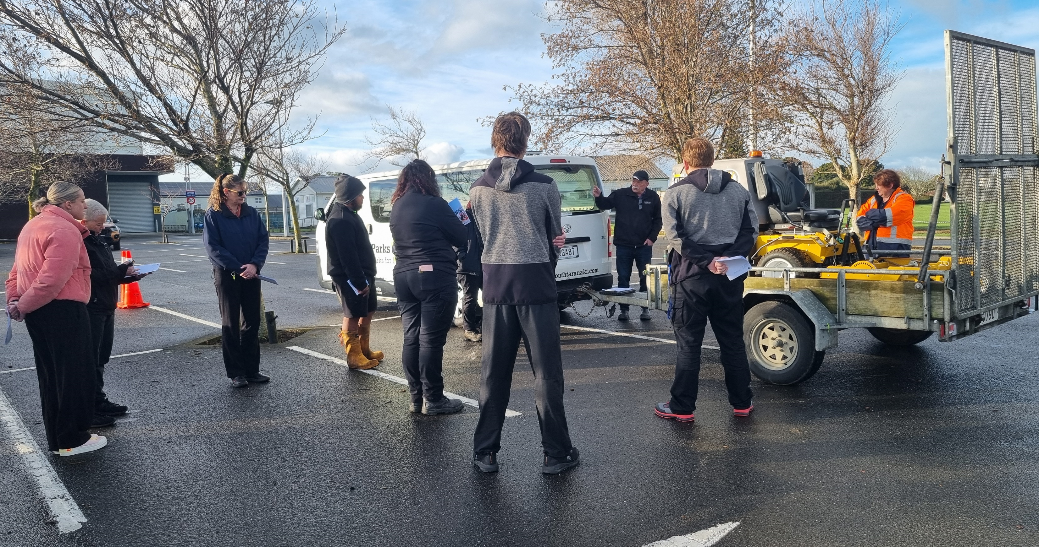
Trailer Safety Workshops
Notes:
Trailer Safety: A Critical Yet Often Overlooked Workplace Issue
At many workplaces, the safe use of trailers can go unnoticed, despite the risks involved. To address this, together with John Stewart from Mobilize Care Training we have been visiting worksites and conducting workshops that focus on the fundamentals of trailer safety.
These sessions typically last between one to one and a half hours, depending on the group and their specific circumstances. We aim to keep the group sizes small to ensure active engagement and participation from everyone.
This is one of the few services RoadSafe Taranaki charge for, but we keep costs between $100 and $150 per workshop, depending on the duration. Travel fees are only applied if the worksite is outside the New Plymouth area.

Slide 2
Why Now?
Regulatory Requirements
WorkSafe NZ emphasises that businesses must eliminate or minimize risks to health and safety when using trailers. This can be achieved through proper maintenance, training, and risk management strategies
Importance of Documentation: Keeping training records, inspection logs, and ensuring staff certifications are up to date.
Notes:
There is the obvious - In the event of an accident WorkSafe will want to look over staff training records, service /maintenance records, employment records, purchase agreements, safe systems of working, Standard Operating Procedures, purchase or lease agreements
It's common for the least experienced team members to be assigned the task of loading trailers, and, often, different individuals handle hitching, loading, and driving, resulting in a lack of accountability and awareness regarding load security.
We are emphasizing the need for the driver to personally inspect the load and perform a thorough double-check, as they are ultimately responsible if something goes wrong.

Slide 3
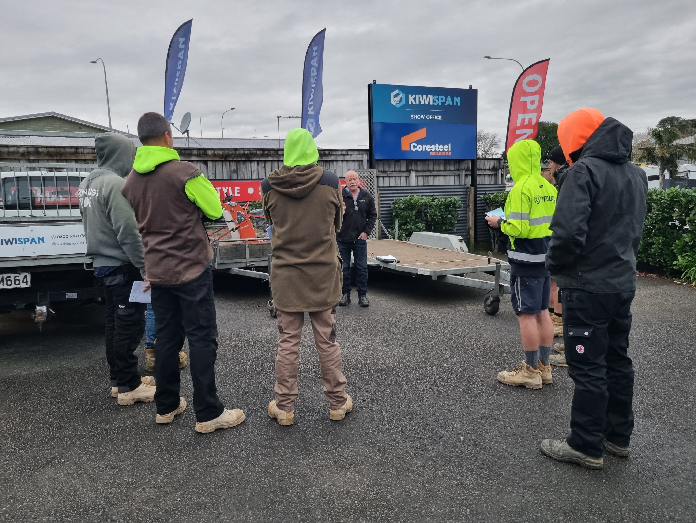
Why Trailer Safety Training is Crucial
Injury Prevention
Avoid Property Damage
Compliance with Regulations
Efficiency and Productivity
Notes:
: Protect employees from accidents and injuries caused by improper trailer use.
: Prevent costly damage to trailers, vehicles, and other equipment.
: Stay compliant with industry standards and legal requirements.
: Well-trained employees work faster and with fewer mistakes, increasing overall efficiency
These workshops are conducted in a relaxed, hands-on environment. Participants practice hitching trailers, discuss weight distribution, and perform walk-around safety checks on the trailers.

Slide 4
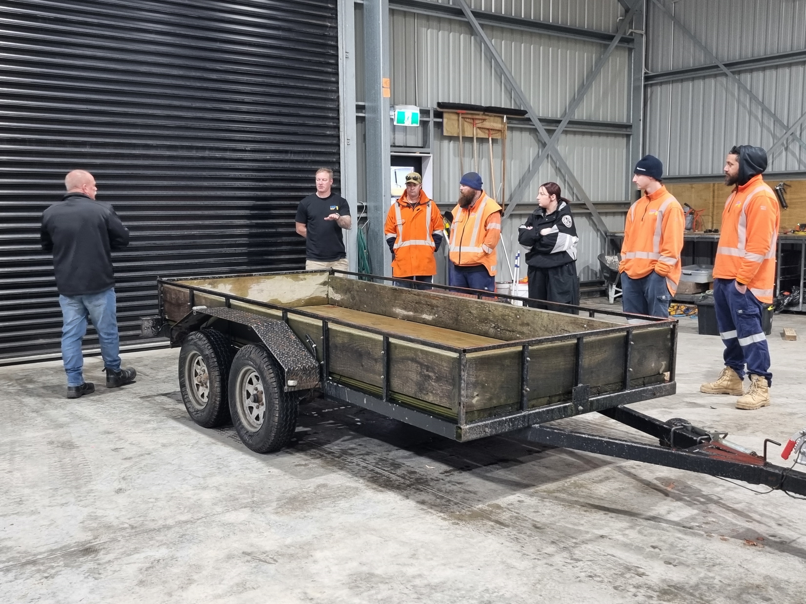
Key Components of Trailer Safety Training
Loading and Weight Distribution
Hitching and Coupling
Trailer Inspection
Emergency Procedures
Notes:
Proper weight distribution to avoid tipping and ensure safe travel.
Different use of tie-downs and securing the load.
Step-by-step guide on securely connecting trailers to vehicles.
Regular inspection procedures to identify potential issues early.
How to handle trailer-related emergencies.

Slide 5
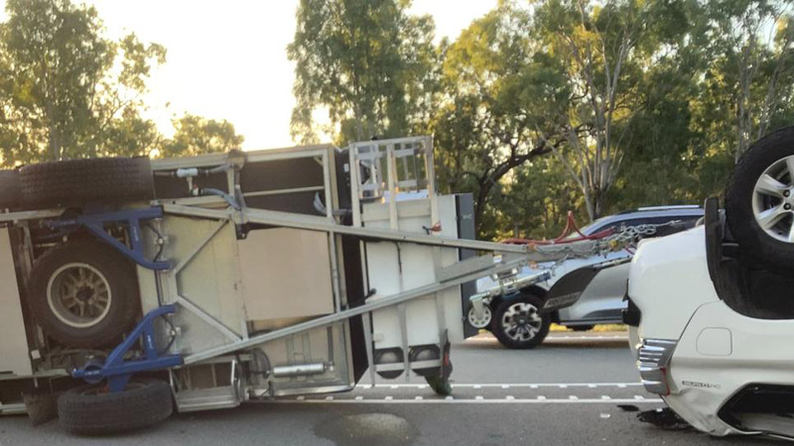

Slide 6
Risks & Statistics
Trailer sway
Contributing factors –
Overloading
Incorrect tyre pressures
Incorrect torque on the wheel nuts
Incorrect load distribution on the trailer
Speed
Lack of training
Notes:
Trailer sway is our leading cause of fatality in NZ when it comes to trailer safety and most people do not know how best to handle this situation.

Slide 7
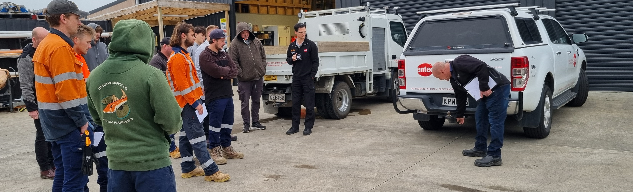
Benefits
Improved Safety Awareness: Employees become conscious of the risks and procedures that mitigate accidents.
Reduced Downtime: Fewer accidents and incidents mean less equipment downtime.
Cost Savings: Prevent injuries, property damage, and insurance claims through better safety.
Boosted Morale: A safety-first environment creates trust, boosting staff morale and retention.
Notes:
Brian Ropitini friend that had a fatality at their worksite with a container door swinging in the wind…

Slide 8
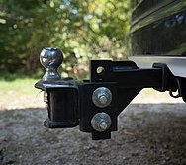

Reap the Benefits
Safety training is an essential investment in the well-being of your employees and the long-term success of your business.
Notes:
We don’t claim to be the ultimate authority on trailer safety training, but at a minimal cost, we aim to raise safety awareness, particularly among the often young individuals working with trailers.
While employers invest significant time in ensuring their teams are well-trained for their roles, once staff are on the road, there’s only so much control they can have. Focusing on safety when towing trailers is one of these key areas.
This aligns with our Business Workplace Charter, where we are promoting more safety awareness with all drivers, be they in company vehicles or their own private cars.

Slide 9
People deserve to be well trained and looked after, your business won’t run without them

